Slide 1
Sustainability: at the heart of our business and as a driver of your investments
Julia Dreblow Founder SRI Services & Fund EcoMarket
3 October 2023
Session time: 15:40-16:10 (30 minutes – 15 + 15)

Slide 2
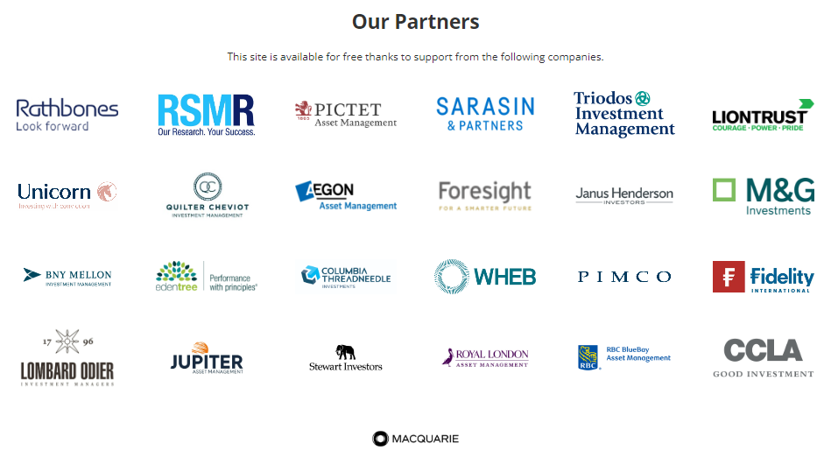
Introduction to SRI Services
Who?
Retail Sustainable and Responsible Investment specialist
Promoting sustainability for 30+ years
What?
Fund EcoMarket ESG / SRI database (‘open source’) - 2011
Fund EcoMarket >46,000 unique users over last 3 years
Sustainability fund info & classifications only
SRI Services - Consultancy / support /data
Parmenion, ii, RSMR, Fidelity, PIMFA ESG Academy
Where else?
FCA DLAG / BSI PAS 7342
UKSIF board 2002-09 & 2019 -21
Friends Provident 1996-08, NPI 1989-94
Why?
Because it matters where we invest
Because client opinions matter
Because it makes sound financial sense
This presentation is for use by UK financial services professionals only. Its content is for information only and is not to be viewed as advice, recommendation or endorsement of any kind. SRI services is not regulated or authorised to offer advice. Information correct at time of publication. Registered company: SRI Consultants Ltd, 03904843

Slide 3
The investment landscape is changing

Slide 4
Our lifestyles are warming the planet, destroying habitats and ruining lives
Pakistan – August 2022

Slide 5
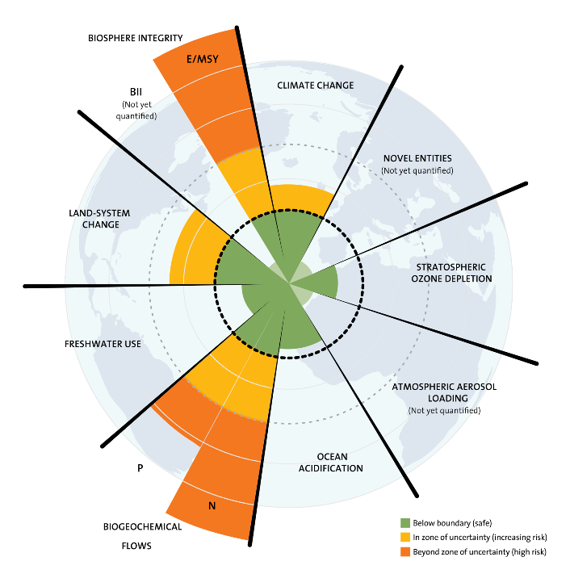
And, as expected, it is getting worse: Recent headlines…
International average temperatures were 1.47C degrees above preindustrial averages in June 2023 (Berkely Earth)
21/9/23 FT:
‘World has experienced its hottest June – August season’
‘Humanity has opened the gates to hell’ … ‘currently heading towards +2.8C’..., … ‘foot dragging’ and ‘naked greed of entrenched interests raking in billions from fossil fuels’ . UN Secretary General Guterres

Slide 6
Too big to ignore
Analysing ESG risk is increasingly BAU
… But very different from ‘focusing on sustainability issues and outcomes’
SDR seeks to differentiate…, aid understanding & address greenwash

Slide 7
How relevant is all this?

Slide 8
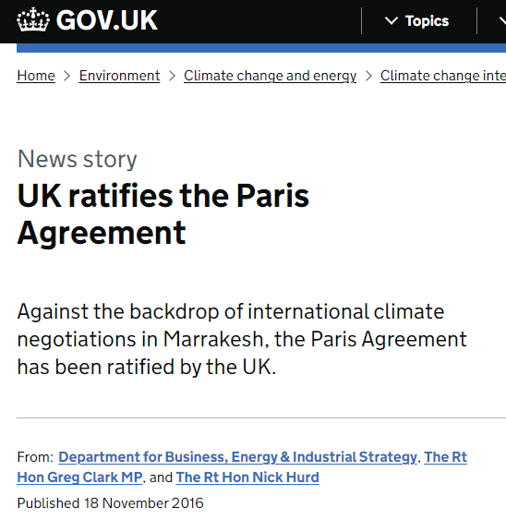
The UK is signed up to ‘net zero’ in 2016

Slide 9
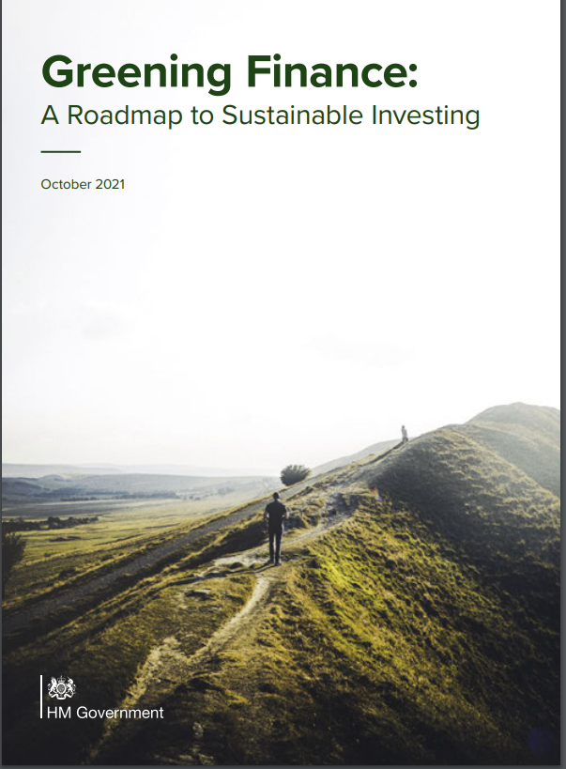
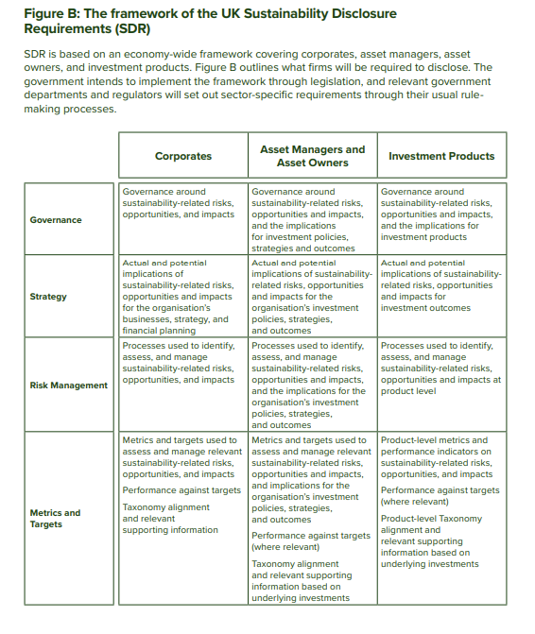
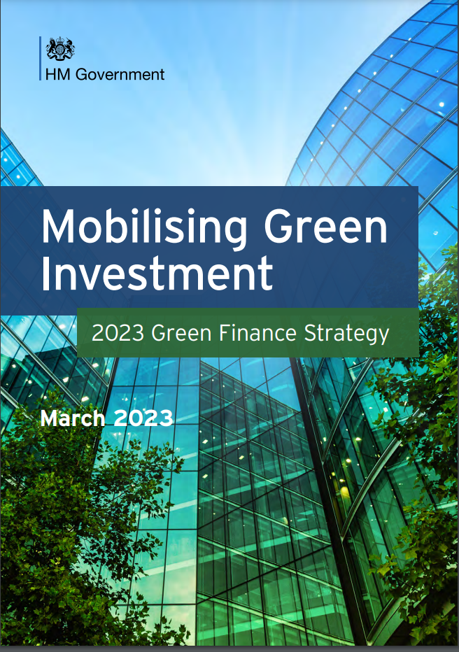
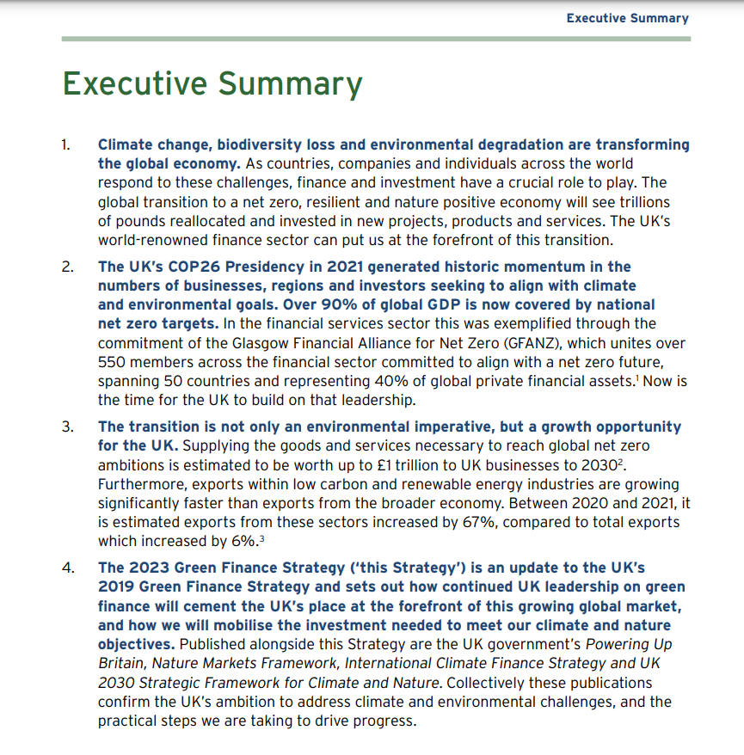
Government policy (Oct 21) > regulation

Slide 10
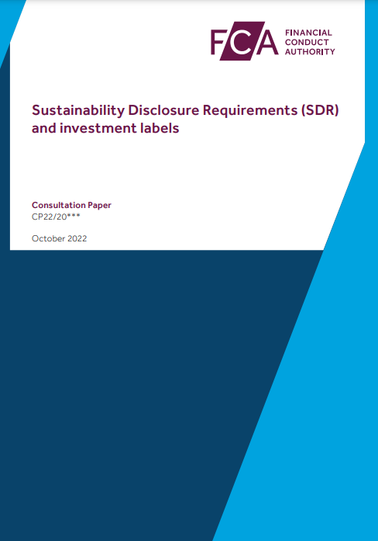
‘Sustainability Disclosure Requirements & investment labels’ consultation What the FCA ‘wants’ to change: (p5)
Sustainable investment labels (for consumers)
Consumer facing disclosures
Detailed disclosures
(pre-contractual, ongoing fund sustainability perf info, sustainability ‘entity’ report)
Naming and marketing rules
Requirements for distributors
General ‘anti-greenwash’ rule
Reporting Q4 2023
DP22/20 Oct 2022

Slide 11
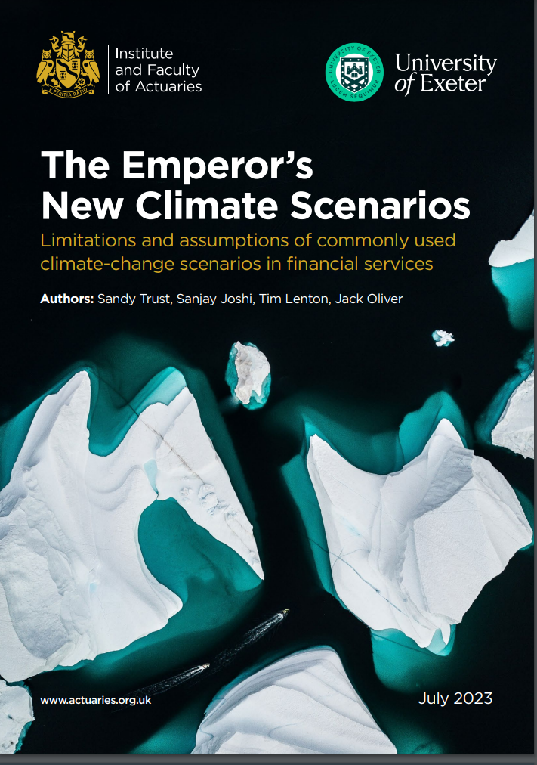
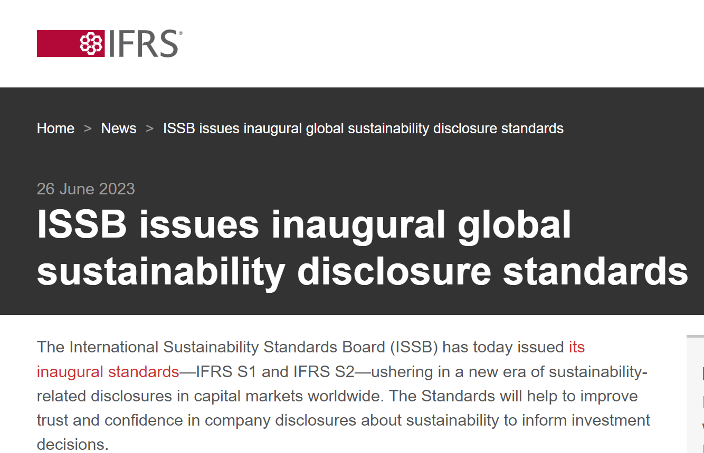
Impacting all sectors:
IFoA :
“there is a possibility that the remaining carbon budget for limiting warming to +1.5C is already zero”
“Time is too short to wait for models that are perfect”
“history is replete with incidents in which we have placed too much faith in models”.
FS community encouraged to contemplate “a ruin scenario of 100% GDP loss”
Need to avoid … ‘herd mentality’.

Slide 12
Clients & your business

Slide 13
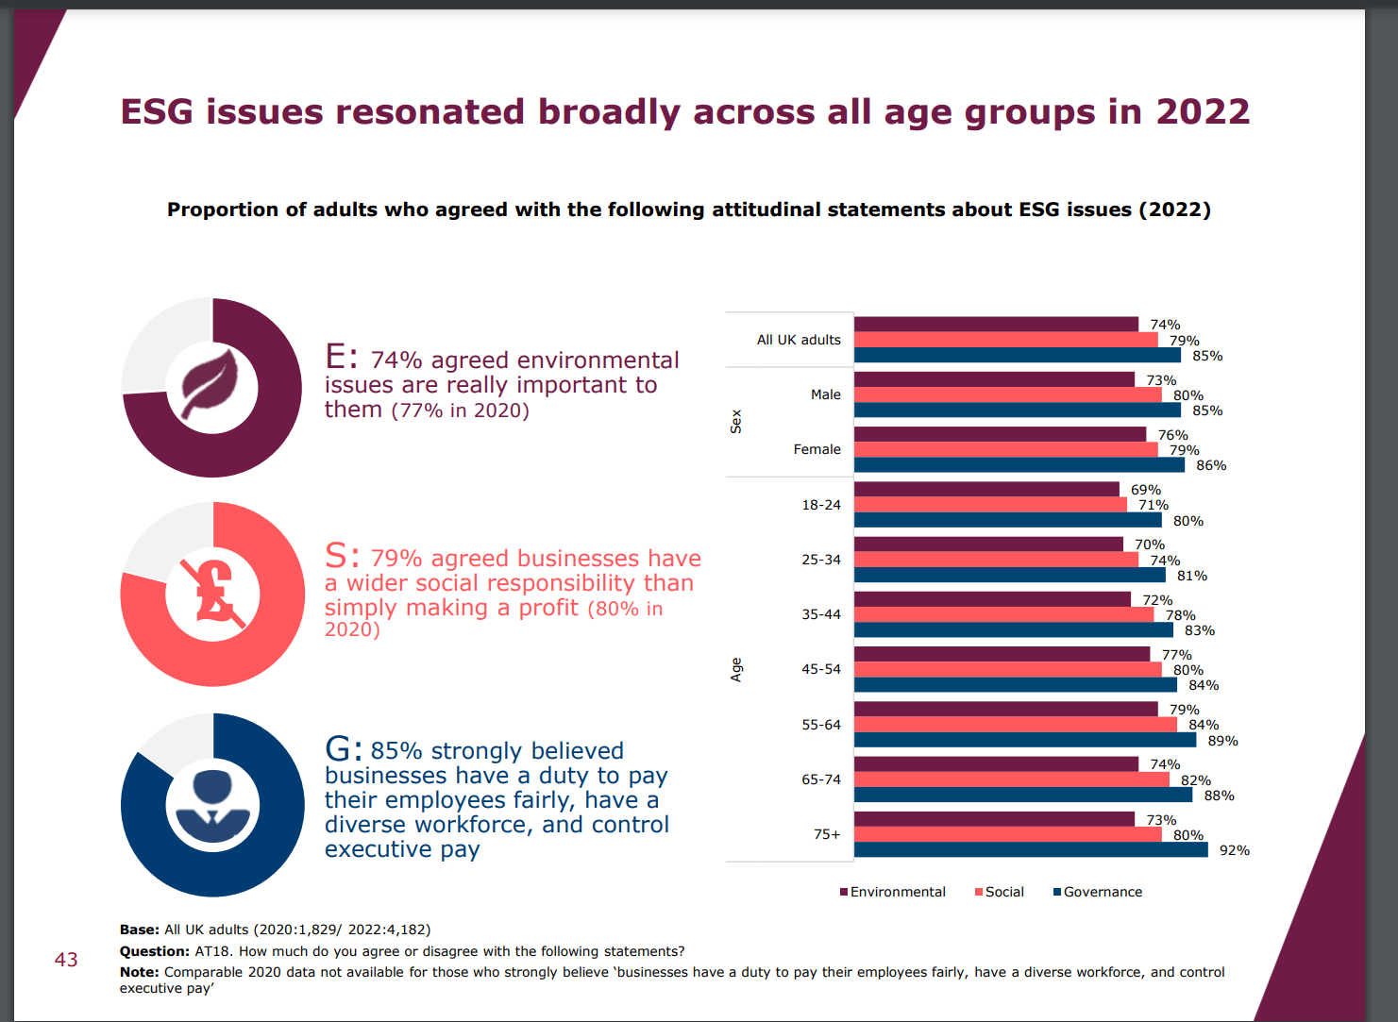
FCA Financial Lives Survey 2022
‘at May 2022 79% of consumers think businesses have a wider social responsibility than simply to make a profit’.
https://www.fca.org.uk/publication/financial-lives/fls-2022-consumer-investments-financial-advice.pdf slides42

Slide 14
ONS research Q4 2022
Around three in four adults (74%) reported feeling (very or somewhat) worried about climate change; the latest estimate is similar compared with the percentage who said they felt worried (75%) around a year ago.
Around 1 in 10 people (9%) felt unworried (somewhat unworried or not at all worried) about climate change, higher than a year ago when it was 6%, and around one in five (17%) said they were neither worried nor unworried.
When asked about a range of issues, climate change was the second biggest concern facing adults in Great Britain (74%), with the rising cost of living being the main concern (79%).
https://www.ons.gov.uk/peoplepopulationandcommunity/wellbeing/articles/worriesaboutclimatechangegreatbritain/septembertooctober2022
It is time to change the advice narrative

Slide 15
Getting practical… Talking sustainable investments with clients

Slide 16
Language matters: & evolves
Sustainability / sustainable (can go on & on)
ESG / ESG focus (risk focus)
Impact (real world outcomes)
Stewardship (responsible ownership)
Ethical (personal values)
Screen (favour or avoid named areas)
Tilt (overweight / underweight)
Integrated (also consider…)
Aligned (matching eg Paris, - 7% eCO2 pa)

Slide 17
Sustainable fund ‘mix & match’
1. Performance
These are investments…
2. Real world ‘intended’ outcomes
Invest to grow ‘solutions’
Encourage existing companies to transition
3. Approaches
Avoid
Support
Engage (stewardship)
4. Issues
Environmental
Social
Governance
Ethical
1
2
3
4
Components vary eg by:
Fund / Fund company
Stock selection / engagement
Labelled funds = E&S focus

Slide 18
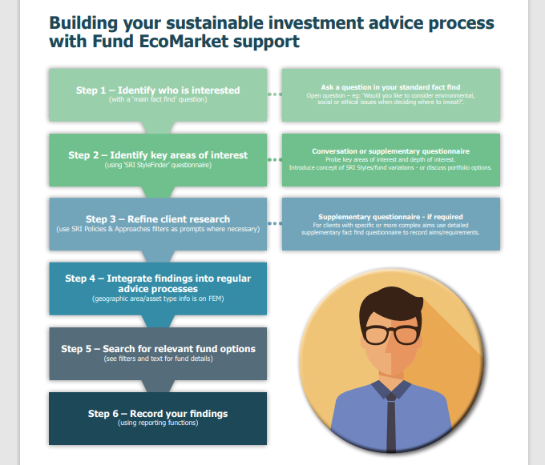
Advisers are part of ‘the sustainability chain’
Need to understand relevance, range of options and client aims – but you do not need to be clones!

Slide 19
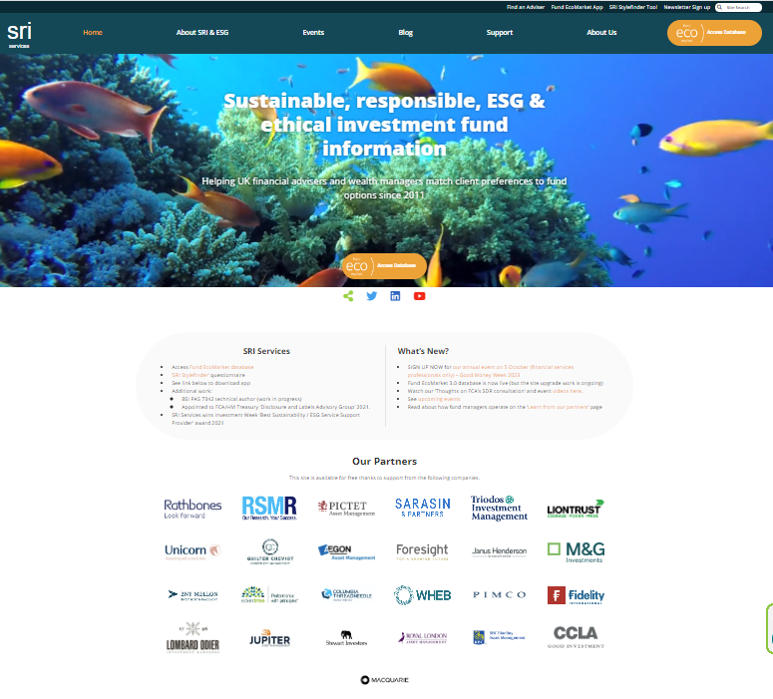

Slide 20
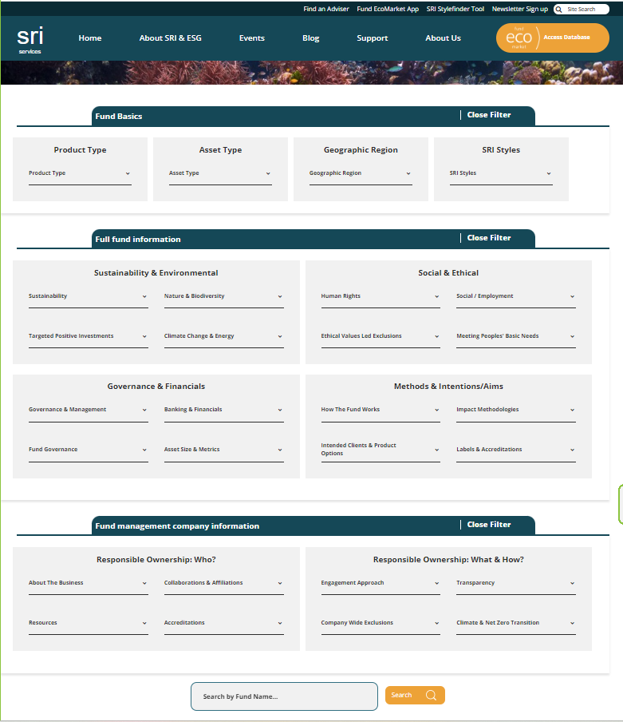
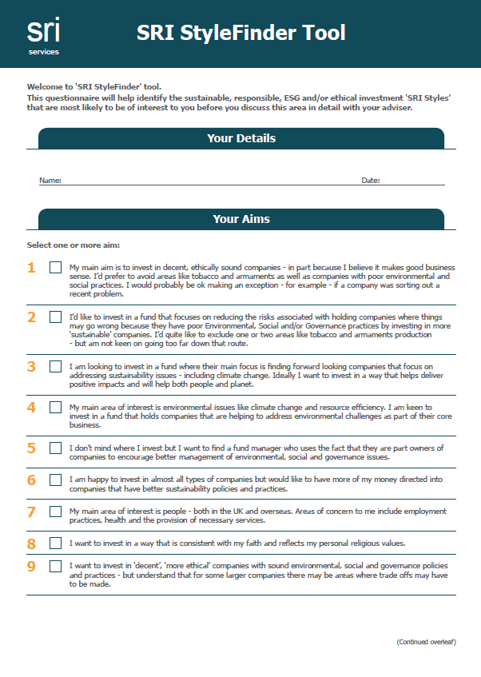
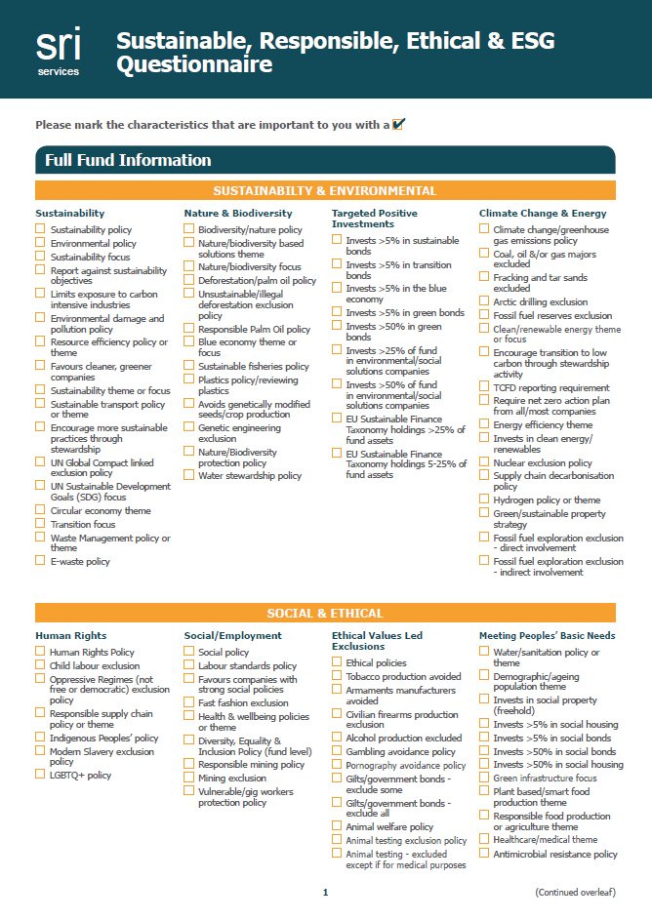
Introducing the new:
www.sriServices.co.uk

Slide 21
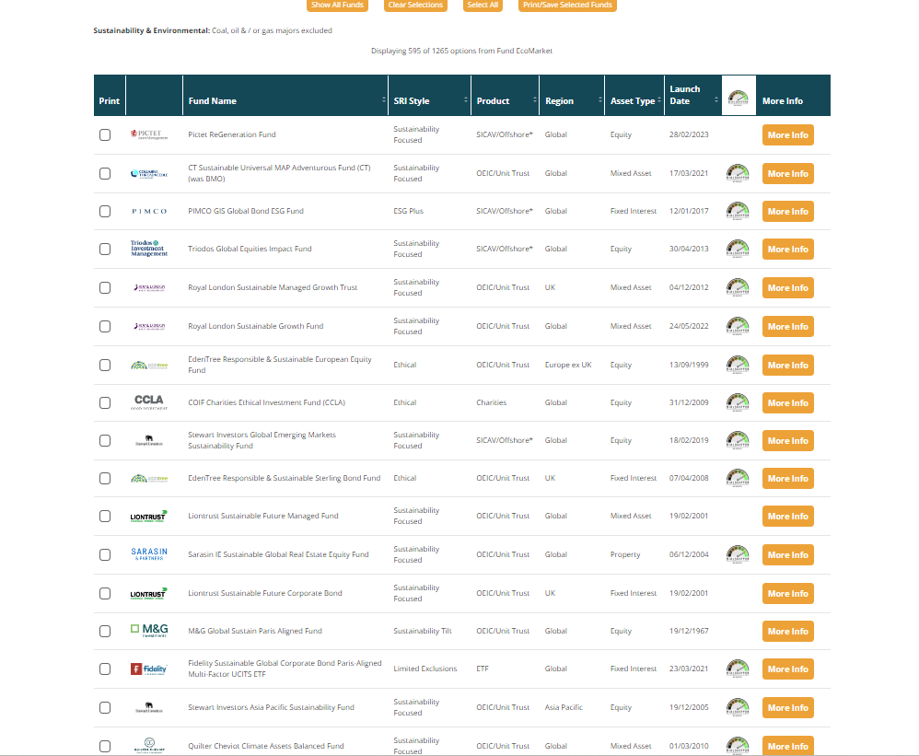

Slide 22
Key messages:
Understanding why this is relevant
Things are changing - this creates risks & opportunities
Companies (assets) are complex & dynamic – none are perfect, change is constant
Data is improving but imperfect … expect grey areas
Strategy variations are valuable - not a problem ‘per se’ / clients views vary.
But oversimplification is not (= greenwash risk)
Investors hold the key to solving problems
Understanding how this will impact your business
SDR will focus on ‘sustainable funds’ – ie those eligible to carry labels, but this is relevant to all
Other options remain relevant for many eg ESG/ responsible and ethical funds
Regulatory implications of ‘majority concerned..’
Further regulatory developments include ratings, culture etc
Dovetails with eg Consumer Duty

Slide 23
®

Slide 24
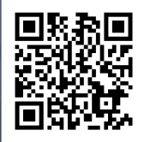
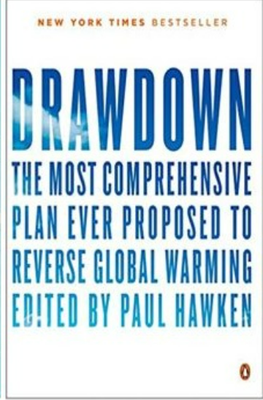
Thank you for listening Let’s talk!
Julia Dreblow www.sriServices.co.uk
For information only. This represents our current thoughts, which evolve over time. We are not regulated or authorised to offer advice.
Please read the consultation paper and contact the FCA with any questions.

