Slide 1




























SRI Services & Partners Annual
Good Money Week Event
The Sustainable Investment event for financial advisers, planners and wealth managers
Event partners:
Keynotes:
Part of:
Organising partner:
CPD accreditation:

Slide 2
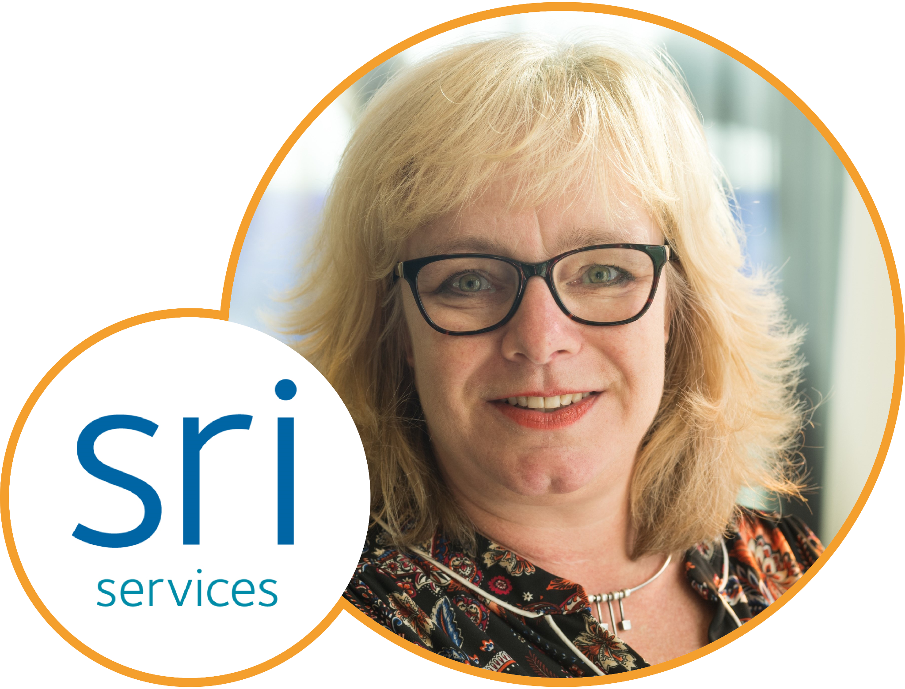
Welcome Address
Julia Dreblow
Founding Director, SRI Services

Slide 3

10.00 – 10.10: Welcome
Thank you for coming!
Why do we do this?
Logistics
  Wifi, facilities, what’s where?
  Please ask questions – and use the red cards!
  Food & drinks
  Feedback forms
  CPD
  Agenda

Slide 4
Morning Agenda
10.00 – 10:10: | Welcome
10.10 – 10.30: | UKSIF CEO James Alexander
10.30 – 10.45: | Fund EcoMarket update
10.45 – 11.15: | MORNING KEYNOTE – Sara Woodroffe, FCA Manager, ESG Policy and Advisory
11.15 – 11.25: | Discuss FCA developments
11.25 – 11.45: | Coffee break
11.50 – 12.30: | Fund Manager Panel 1 – Investment selection, divestment and engagement are our dial shifting tools, but which should we use, when and why?
12.30 – 13.10: | Fund Manager Panel 2 – Measuring and managing ESG risks. What are the biggest risks we face and how helpful are ratings and data services?
13.10 – 14.15: | Lunch break – (Including 13.35 - 14.05: ‘Almost open mic’)

Slide 5
Afternoon Agenda
14.15 – 14.25: | Welcome back
14.25 – 15.05: | Fund Manager Panel 3 – Shifting the circular economy dial – what are the challenges and opportunities?
15.05 -15.45: | Fund Manager Panel 4 – If sustainable funds are to help deliver the positive impacts and outcomes many clients desire, asset selection is crucial.
15.45- 16.05: | Coffee break
16.05 – 16.35: | AFTERNOON KEYNOTE – Joanne Etherton, Head of Purposeful Markets at ClientEarth
16.35 – 17.00: | Fund Manager’s share their stories Panel 5
17.00 – 17.15: | Expert presentation – Mike Clark, Ario Advisory – An actuary’s view of Climate Risk
17.15 – 17.30: | ‘Next Steps’ and close (Julia)
17.30 – 20.30: | Drinks reception and canapes

Slide 6
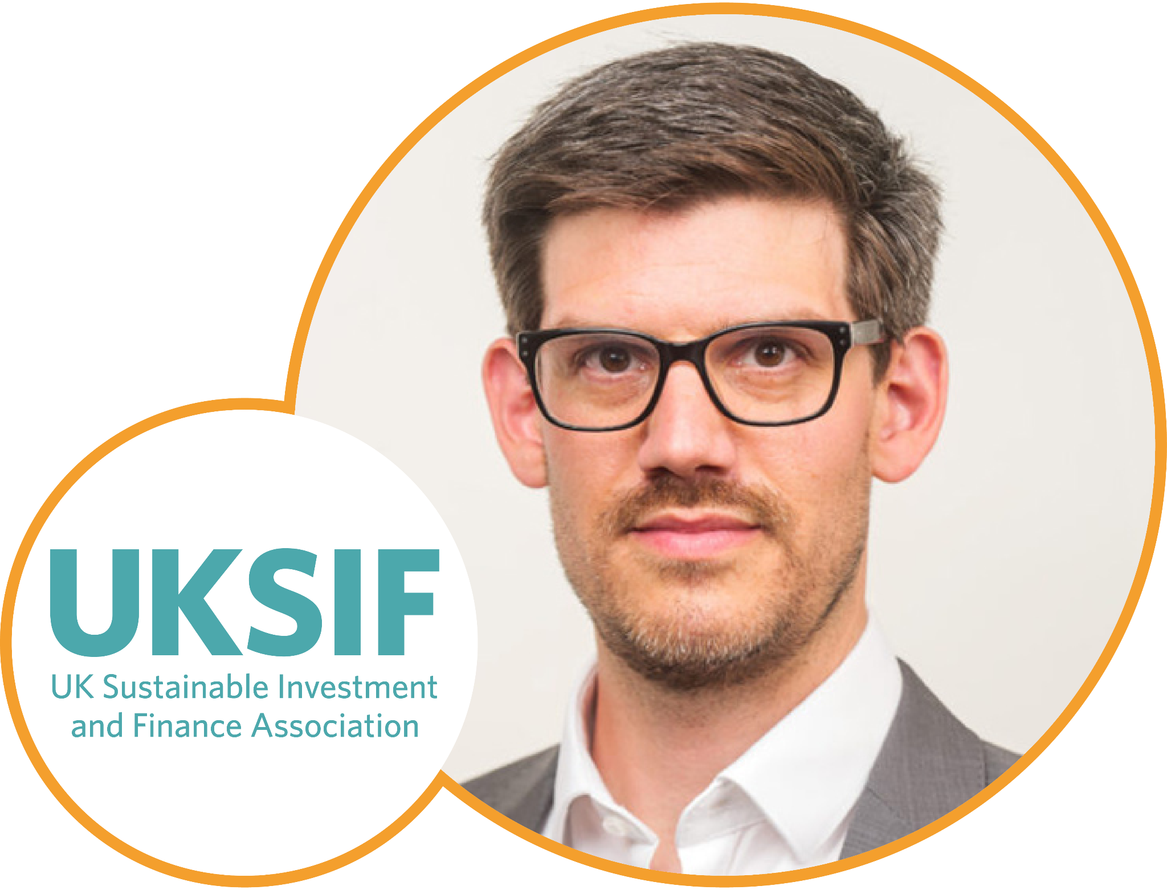
Good Money Week
Update
James Alexander
CEO, UKSIF

Slide 7
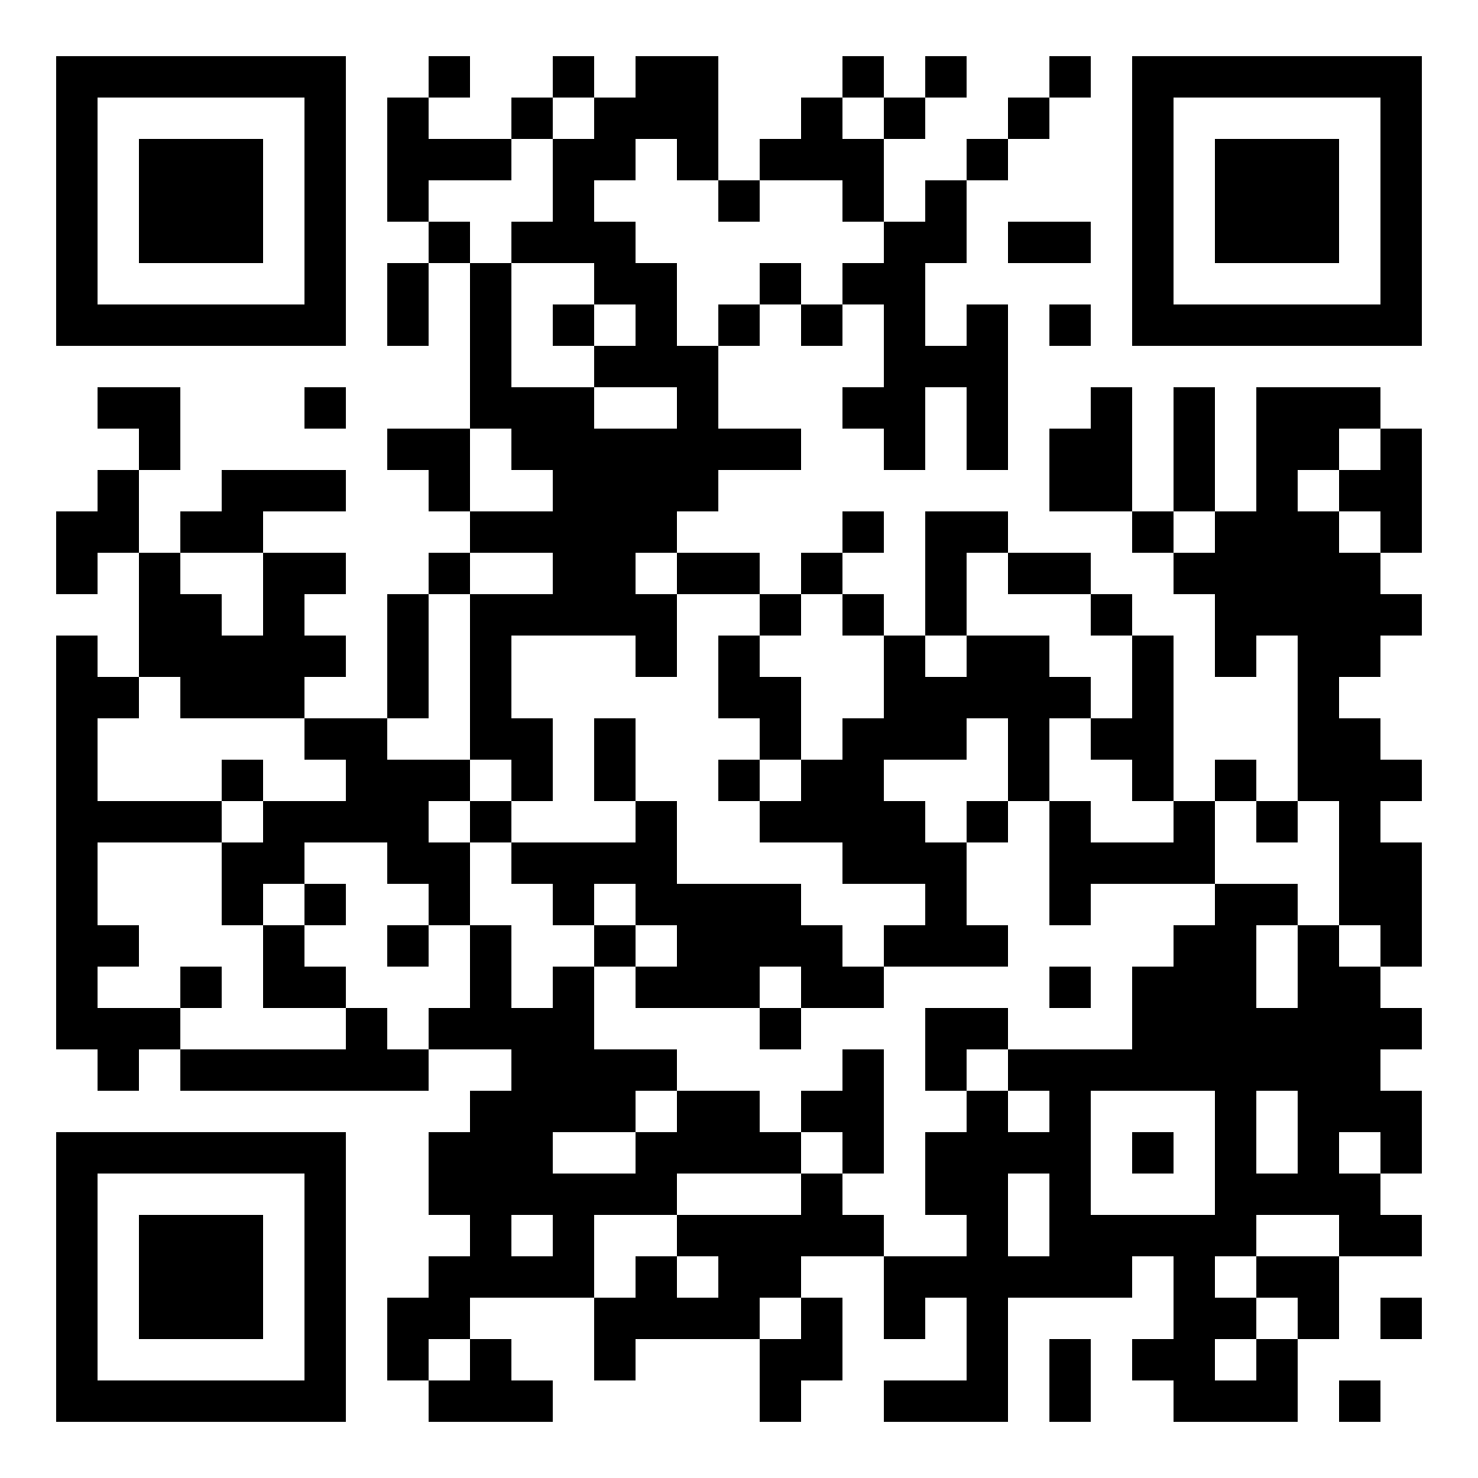
Fund EcoMarket
Improvements
and beyond
Julia Dreblow
Founding Director,
SRI Services

Slide 8

Too big to ignore
Analysing ESG risk is increasingly BAU
  … But very different from ‘focusing on sustainability issues and outcomes’
SDR seeks to differentiate…, aid understanding & address greenwash

Slide 9
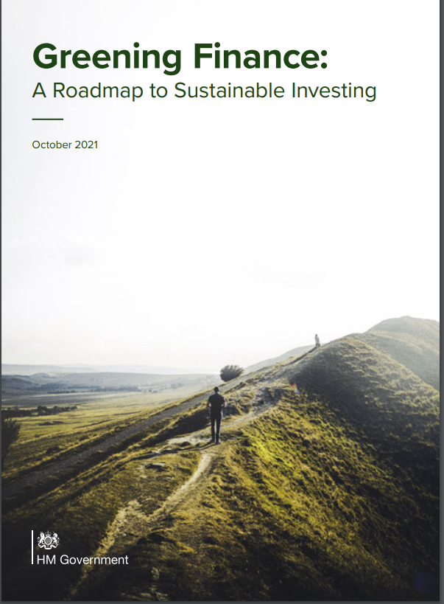
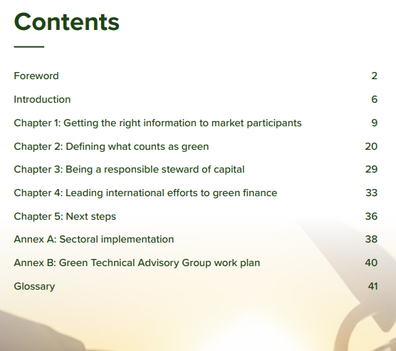
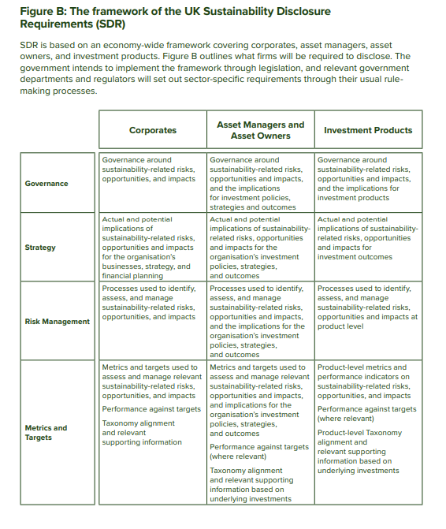

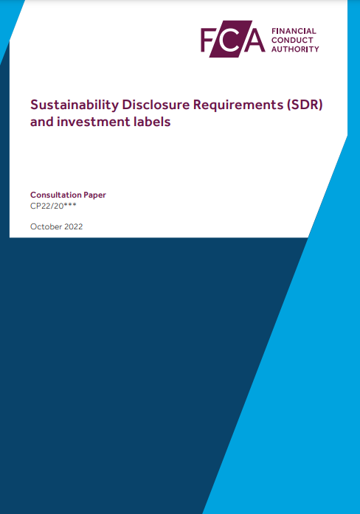
Government policy (Oct 21) > regulation

Slide 10
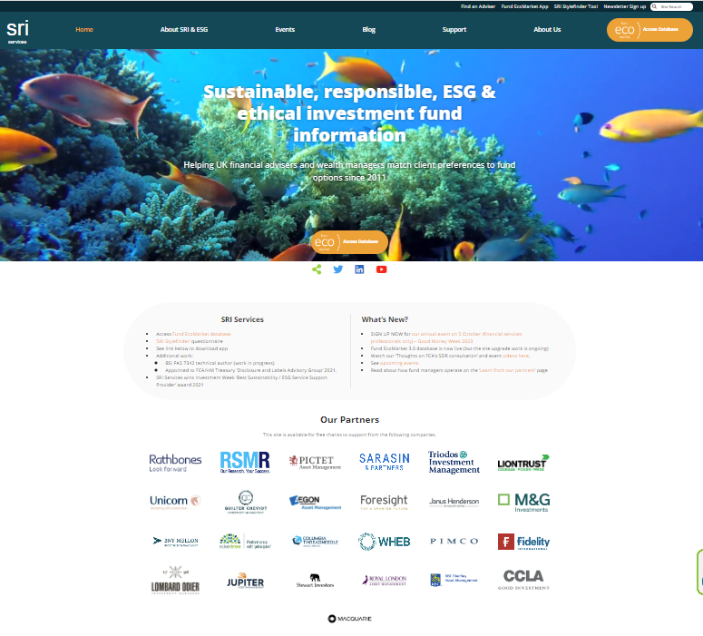

Slide 11
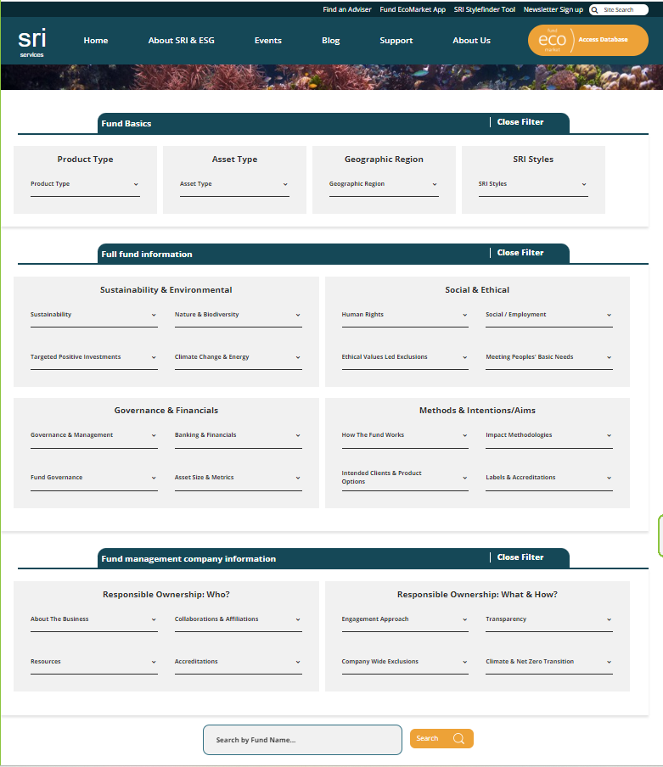
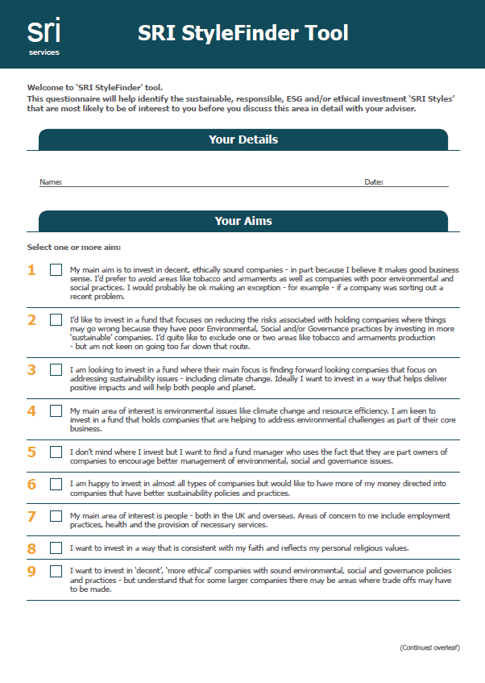

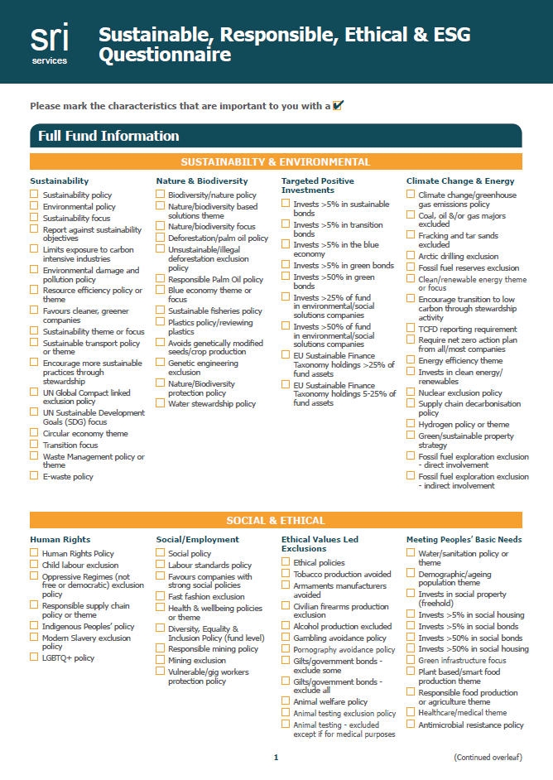
Introducing the new:
www.sriServices.co.uk

Slide 12
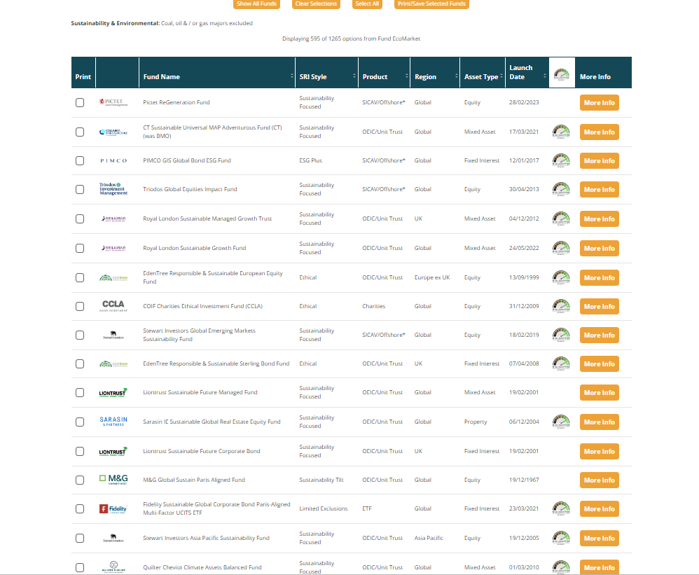

Slide 13


®

Slide 14
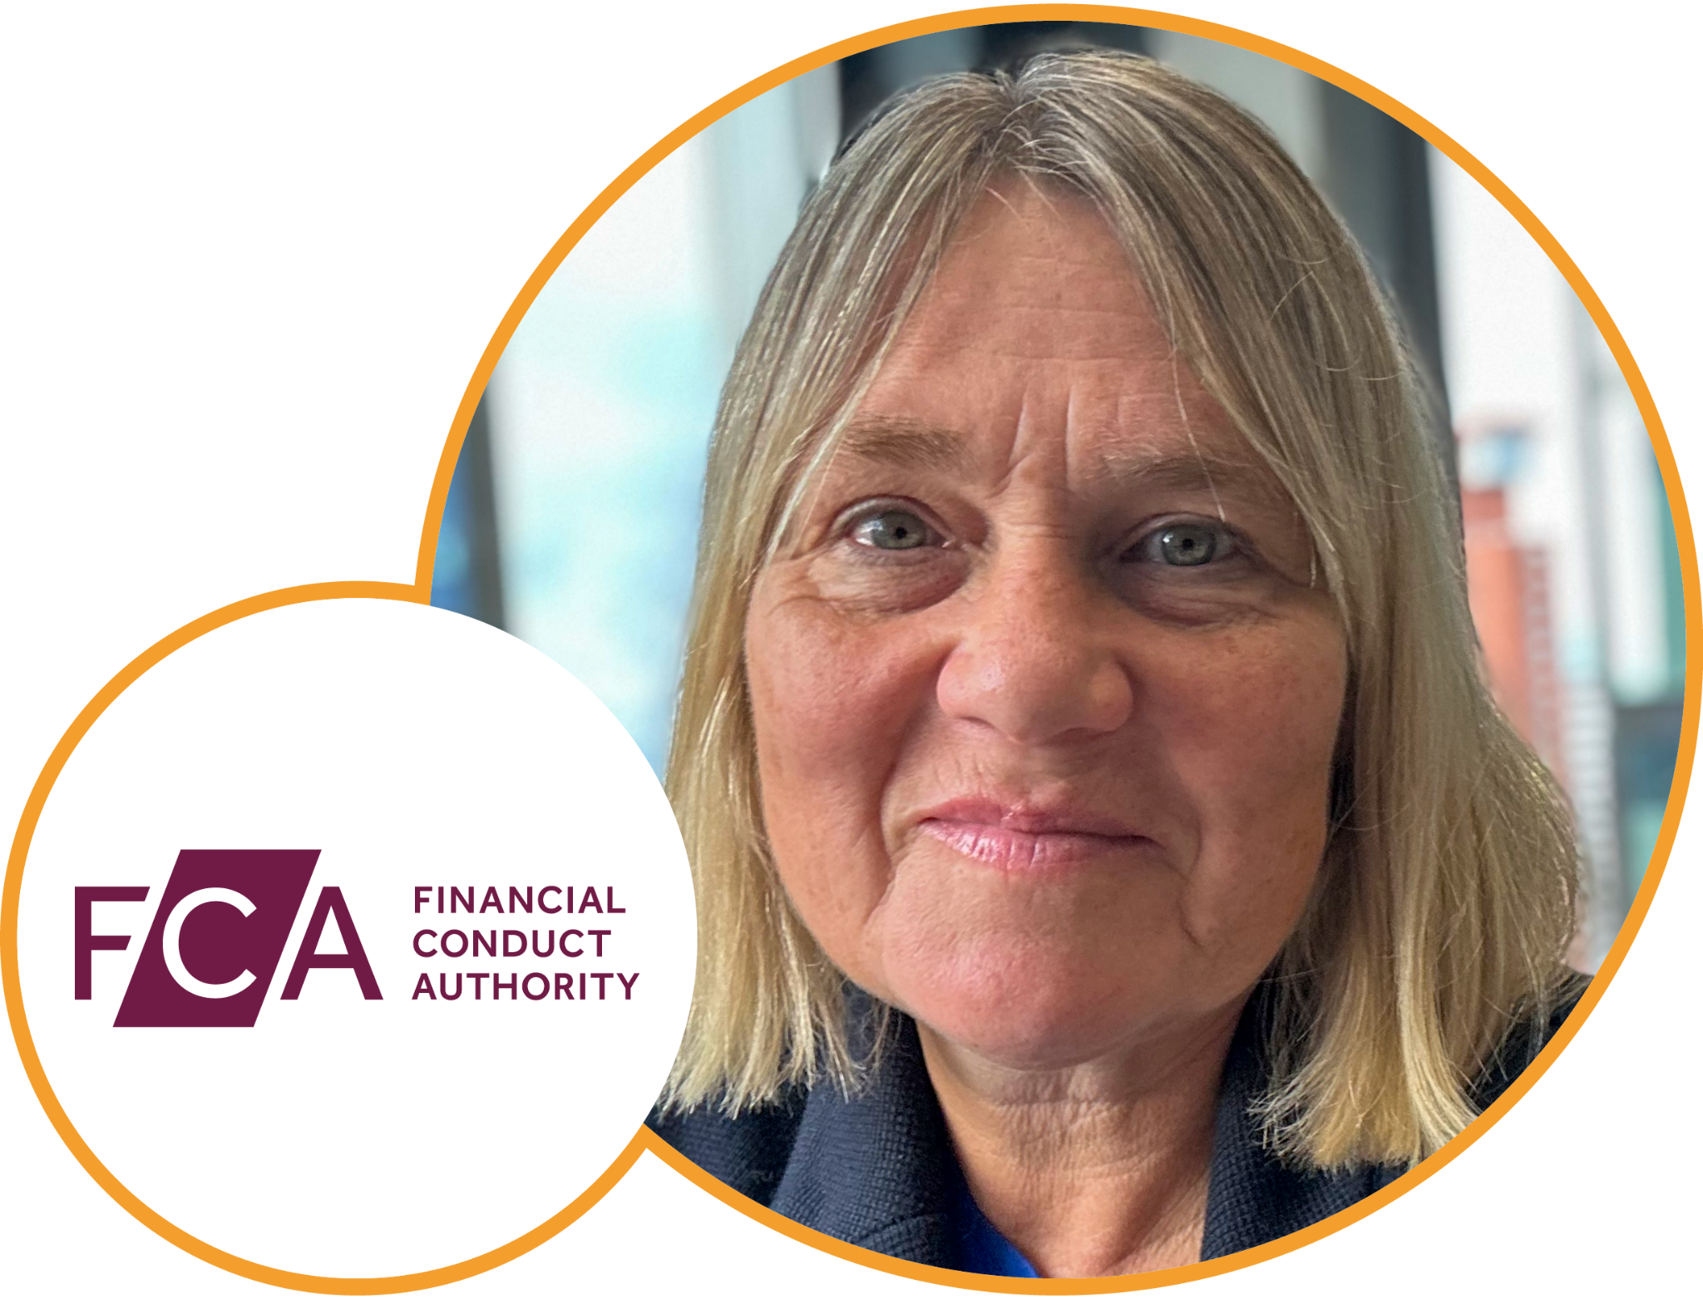
Keynote Address
Sara Woodroffe
Manager ESG Policy & Advisory,
Financial Conduct Authority

Slide 15
Agenda
11.25 – 11.45: | Coffee break
11.50 – 12.30: | Fund Manager Panel 1 – Investment selection, divestment and engagement are our dial shifting tools, but which should we use, when and why?
12.30 – 13.10: | Fund Manager Panel 2 – Measuring and managing ESG risks. What are the biggest risks we face and how helpful are ratings and data services?

Slide 16
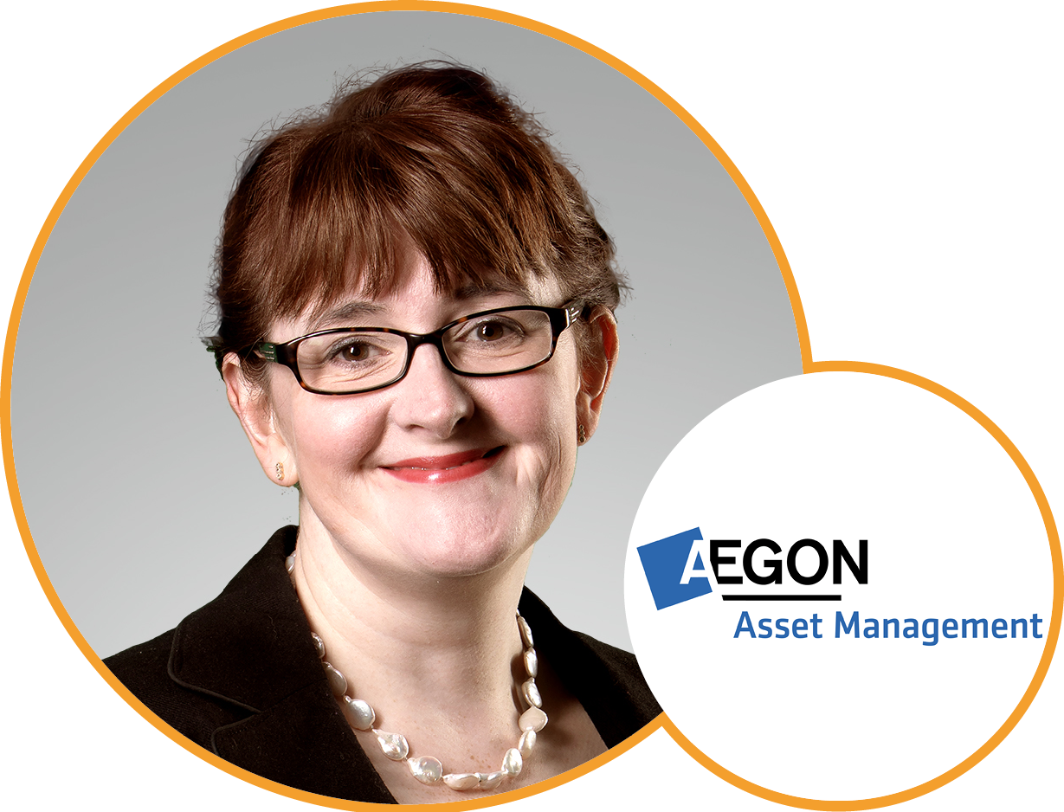
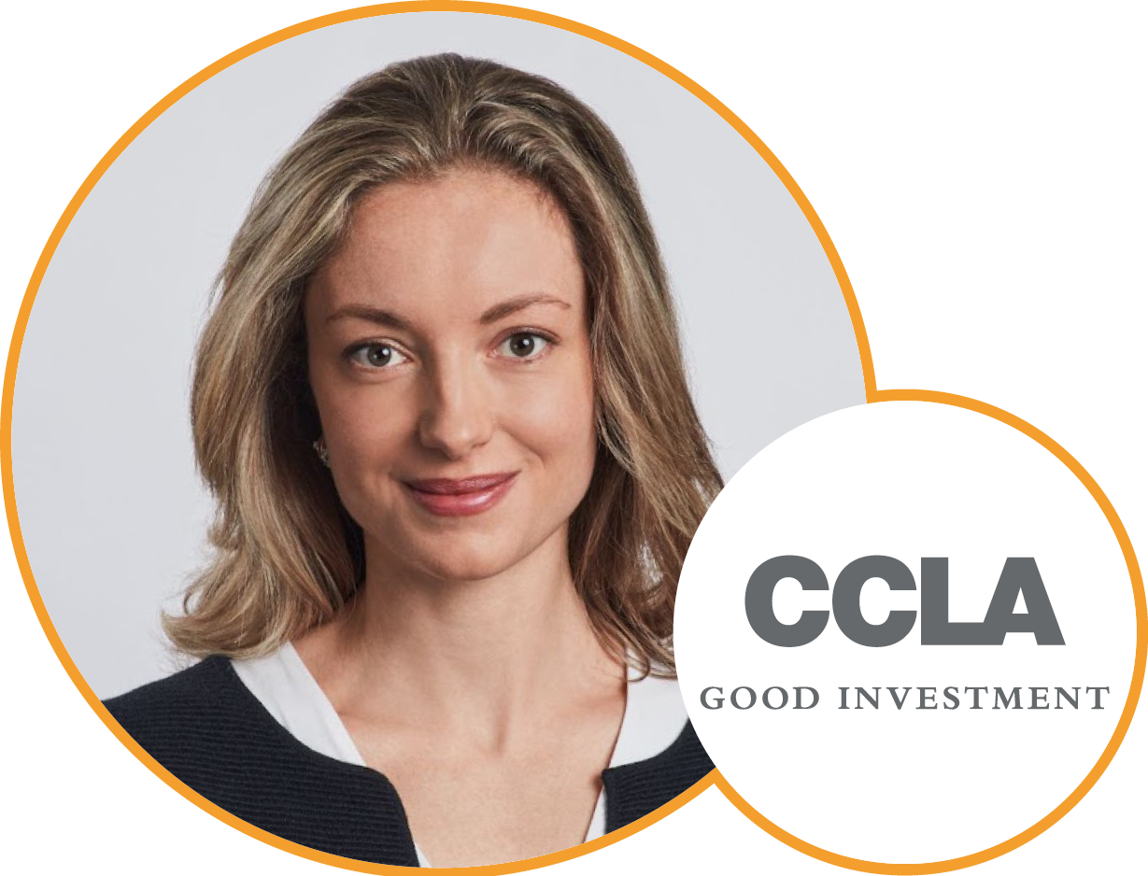
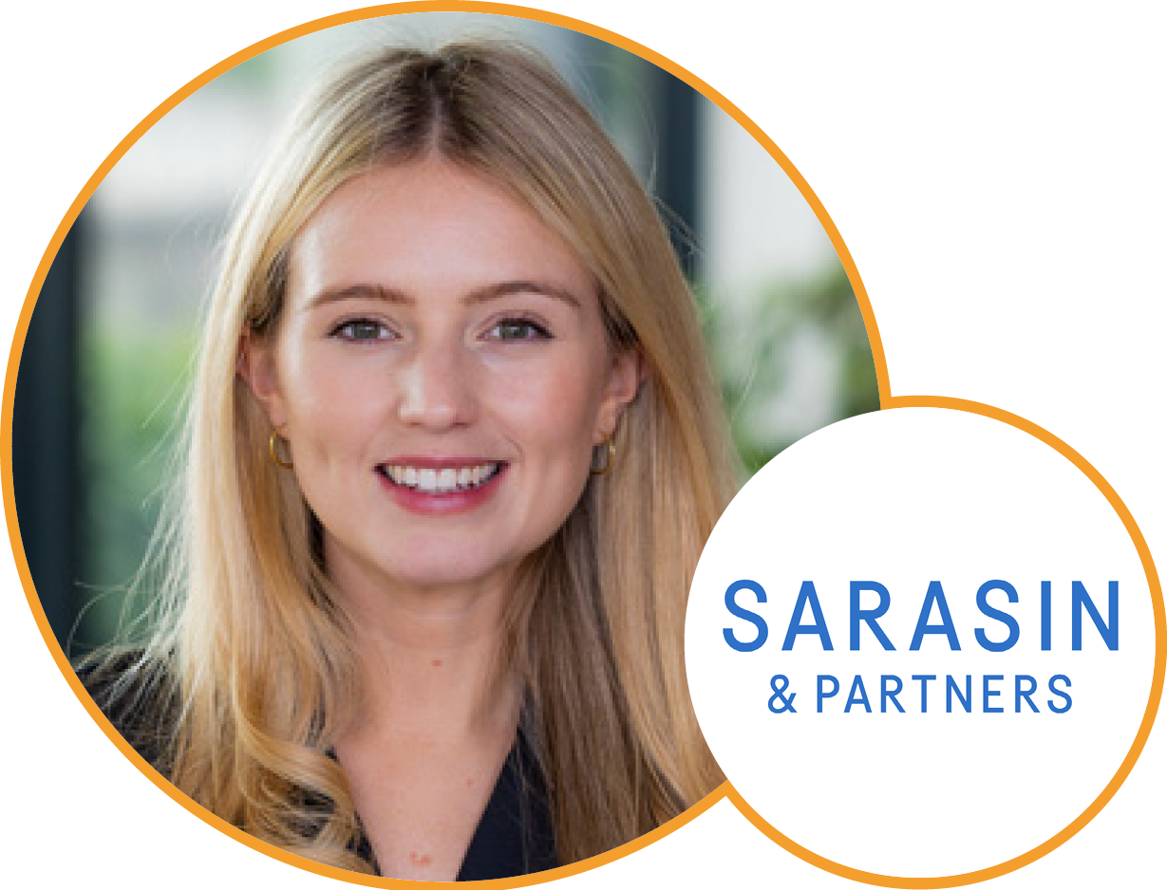
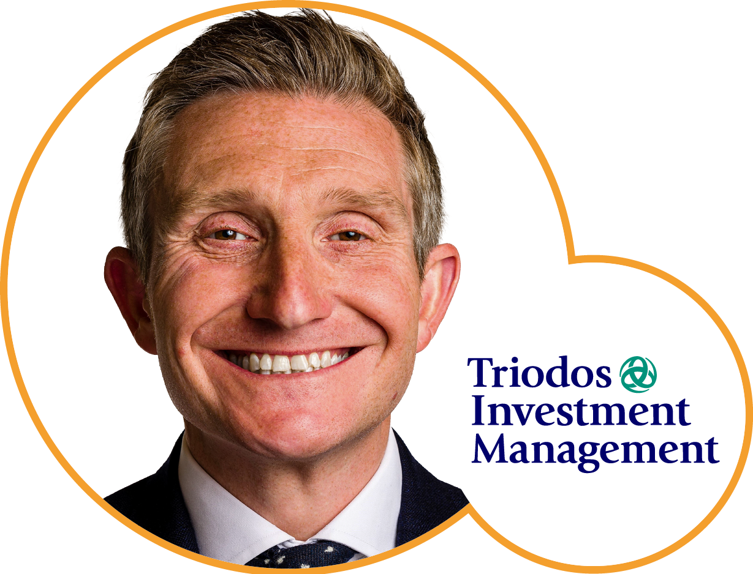
Panel 1: Investment selection, divestment
and engagement are our dial shifting tools, but which should we use, when and why?
Miranda Beacham
Aegon
Asset Management
Amy Browne
CCLA
Investment Management
Megan Brennan
Sarasin & Partners
Adam Robbins
Triodos
Investment Management

Slide 17
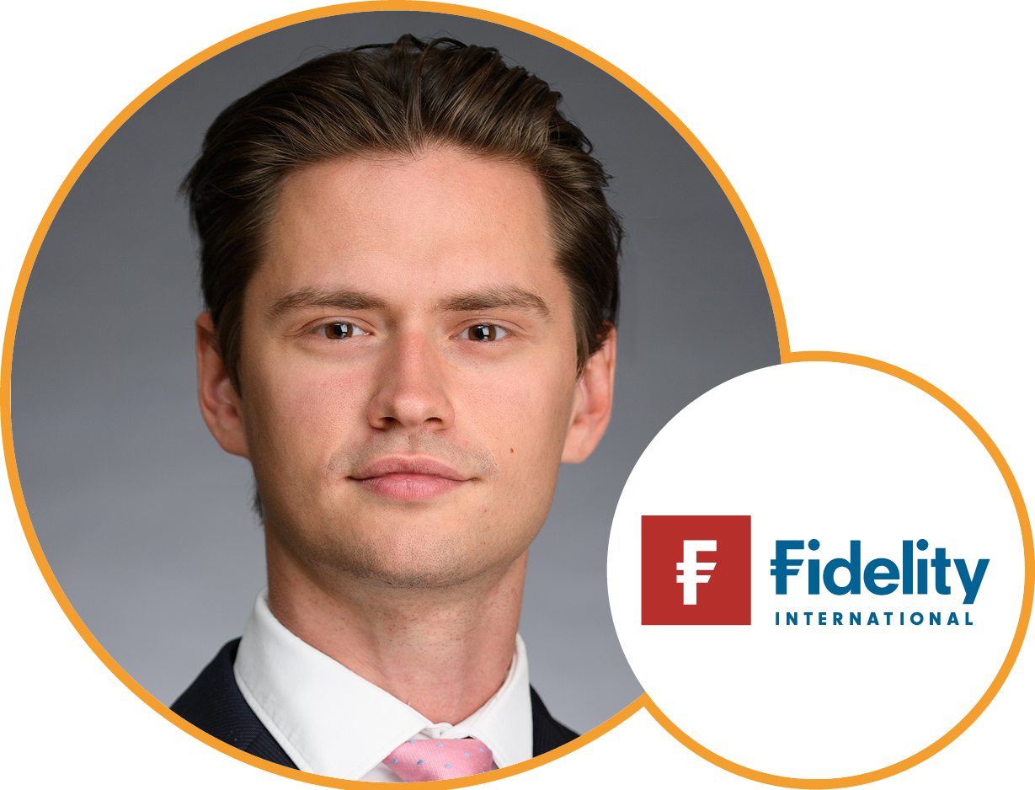
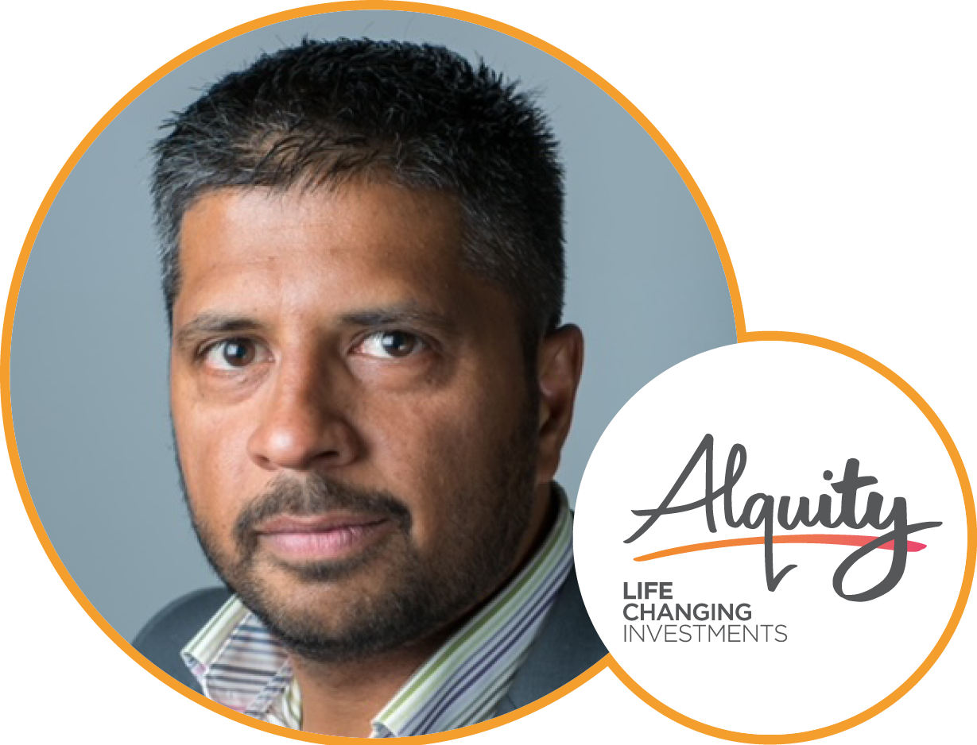
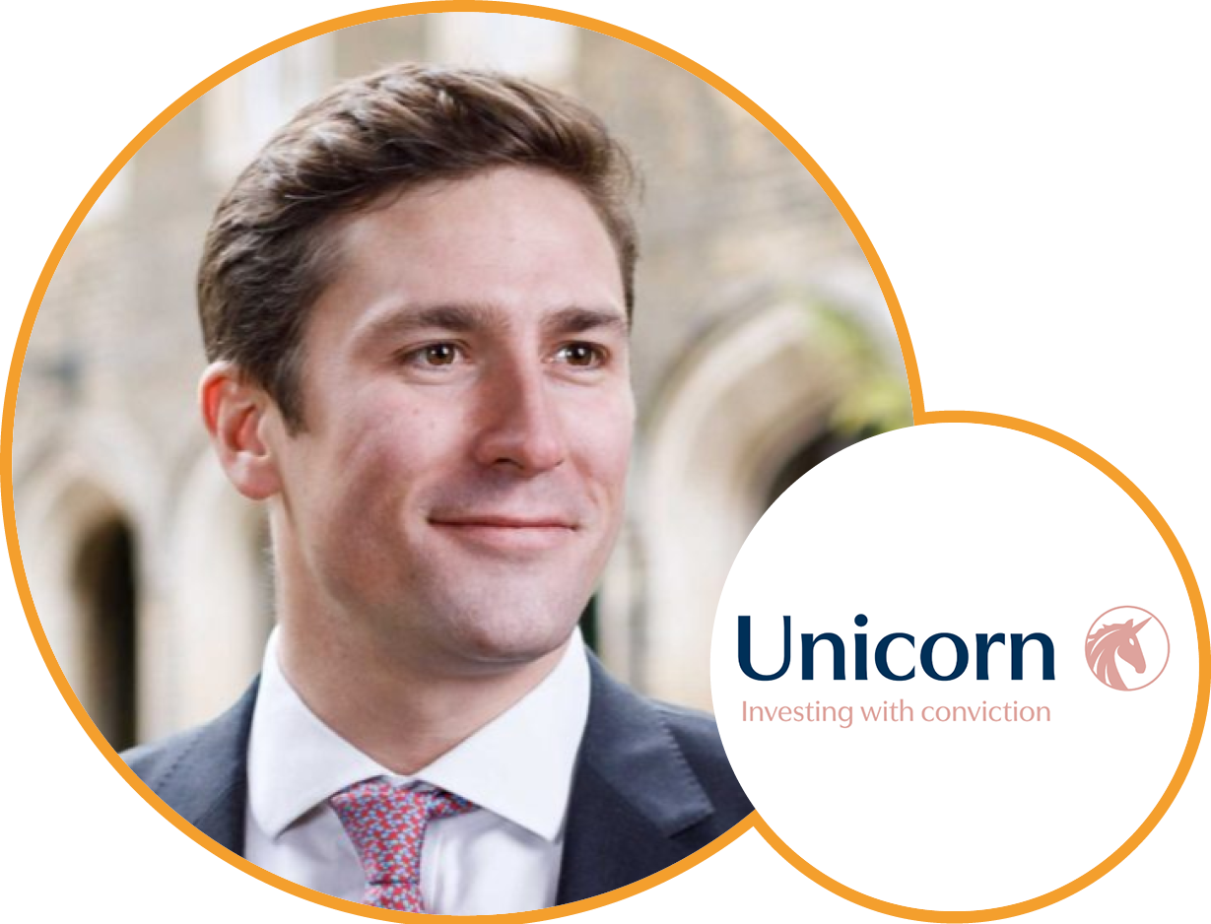
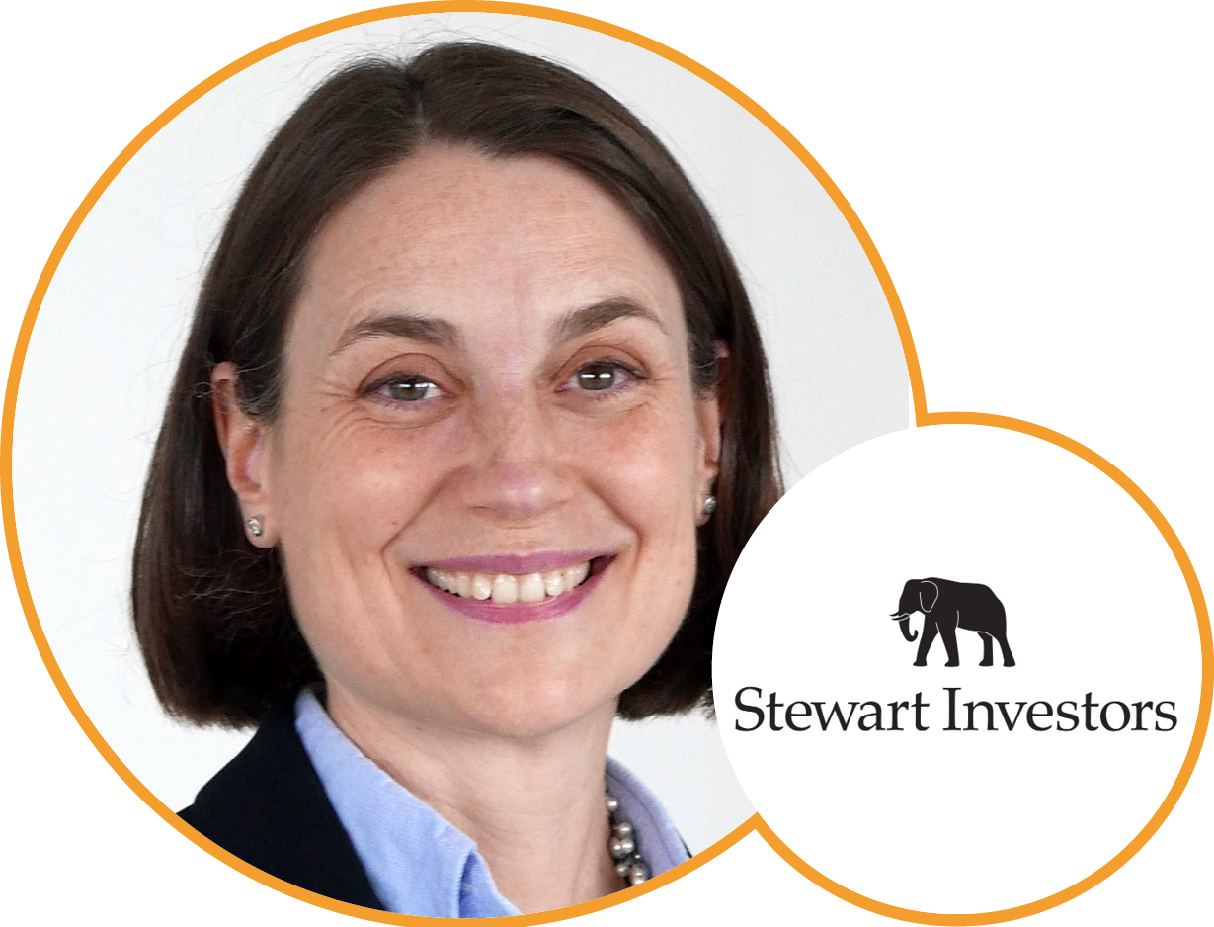
Panel 2: Measuring and managing ESG risks.
What are the biggest risks we face and
how helpful are ratings and data services?
Glenn Anderson
Fidelity International
Suresh Mistry
Alquity
Investment Management
Alex Game
Unicorn
Asset Management
Clare Wood
Stewart Investors

Slide 18
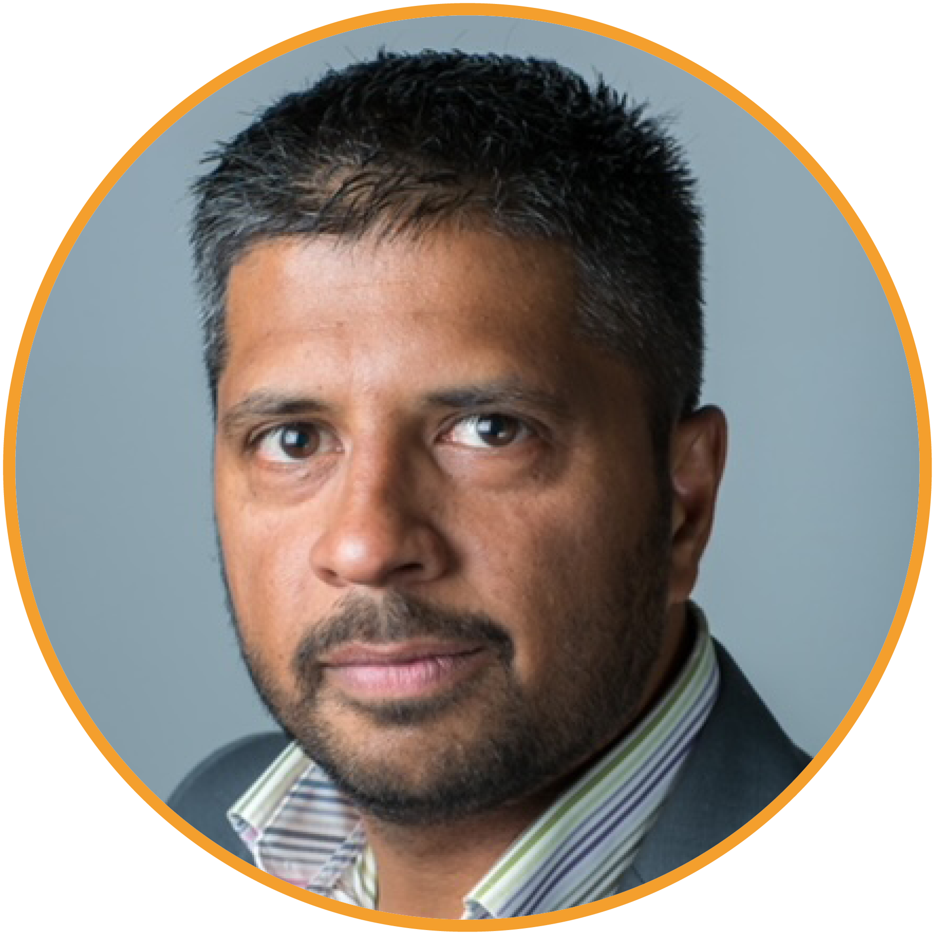
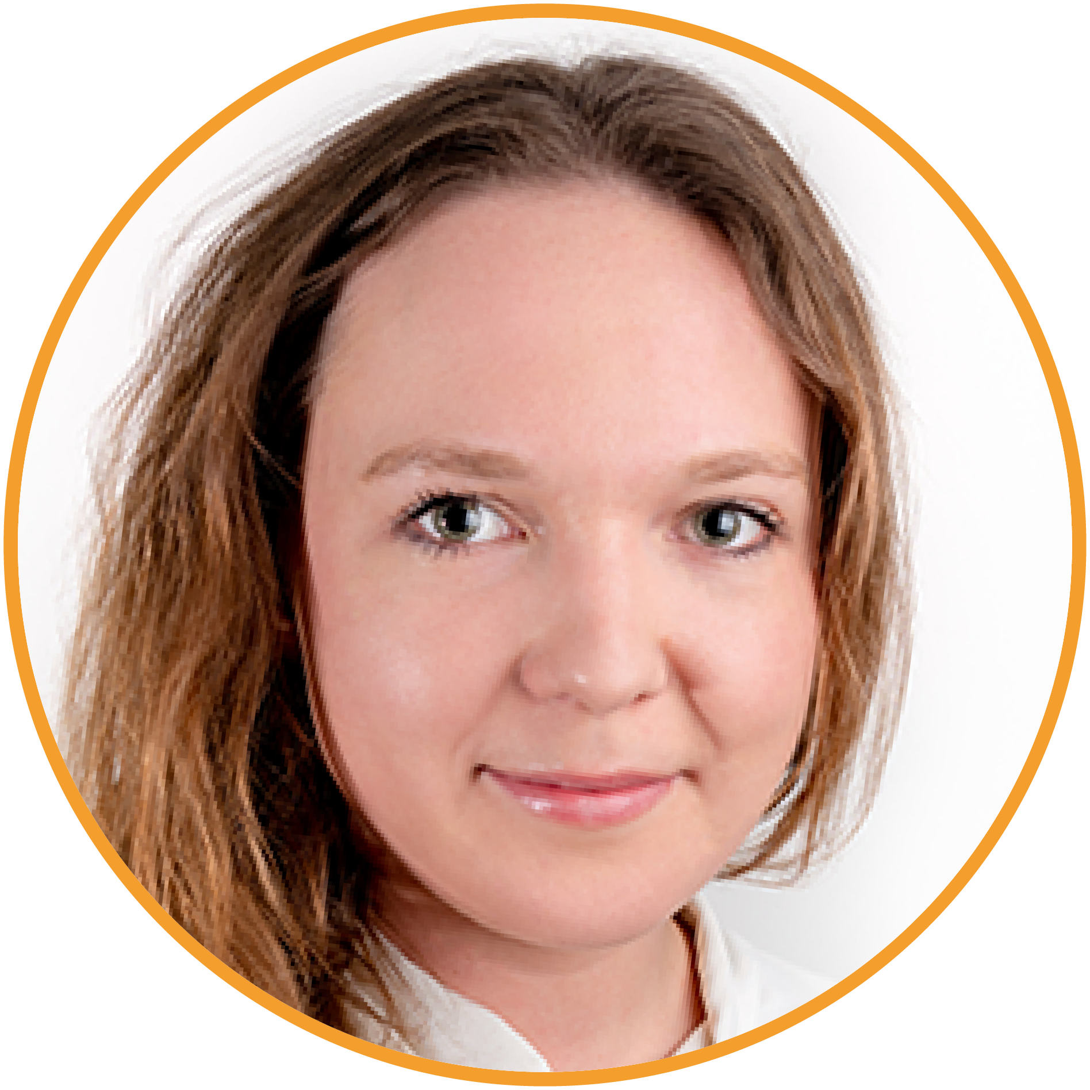
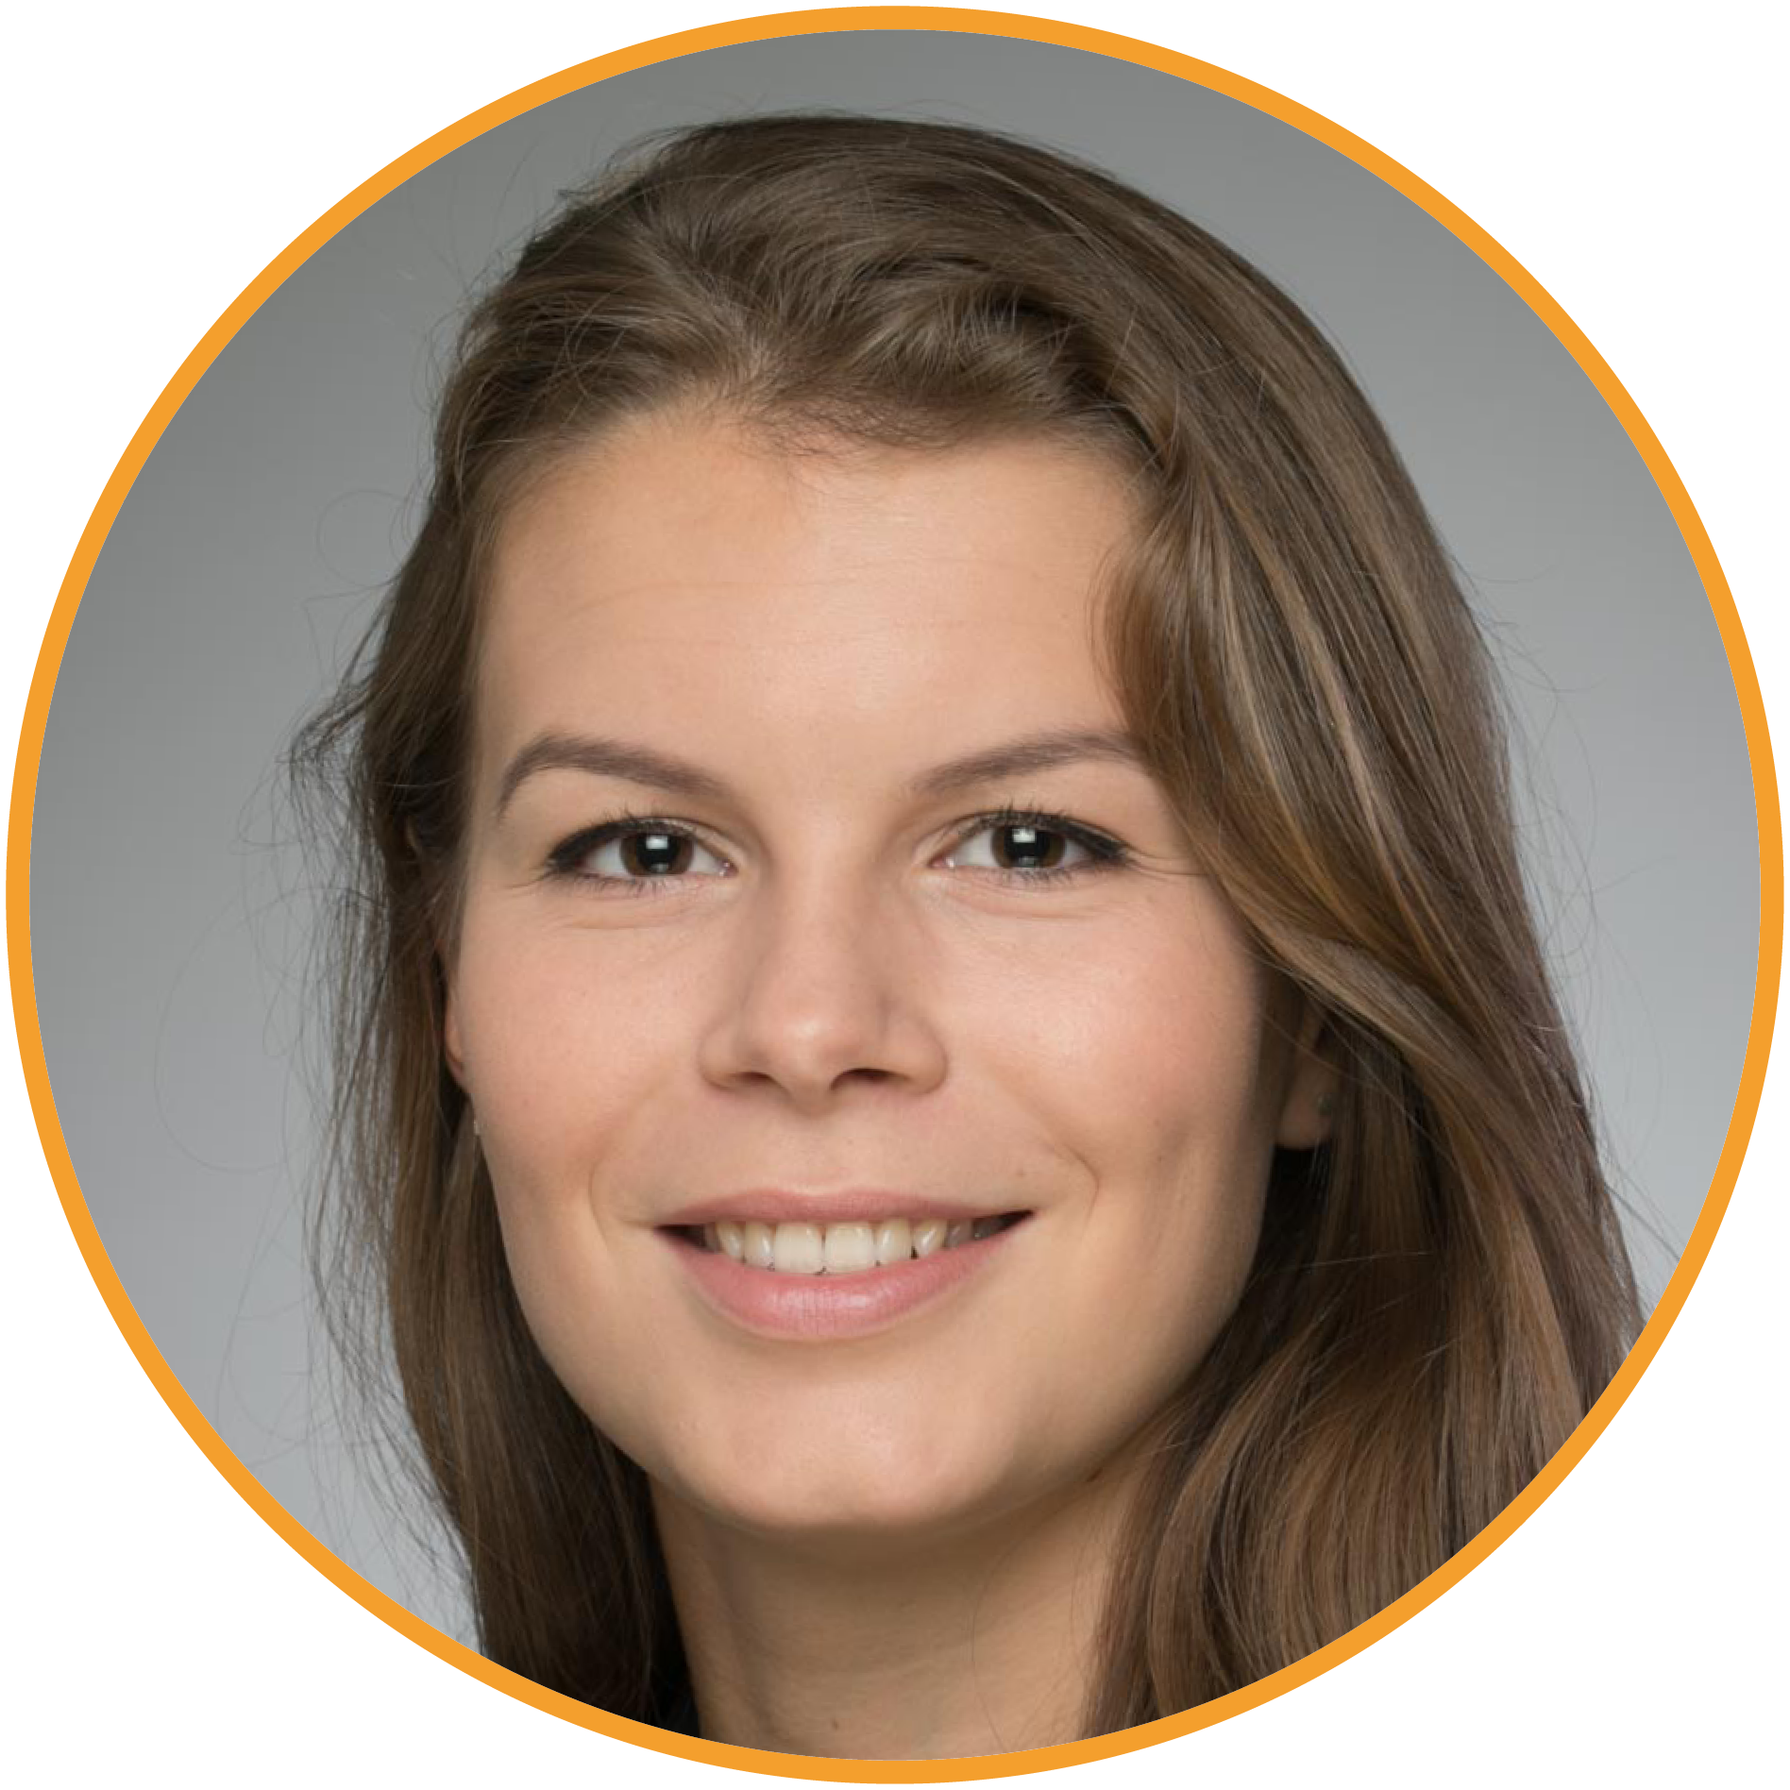
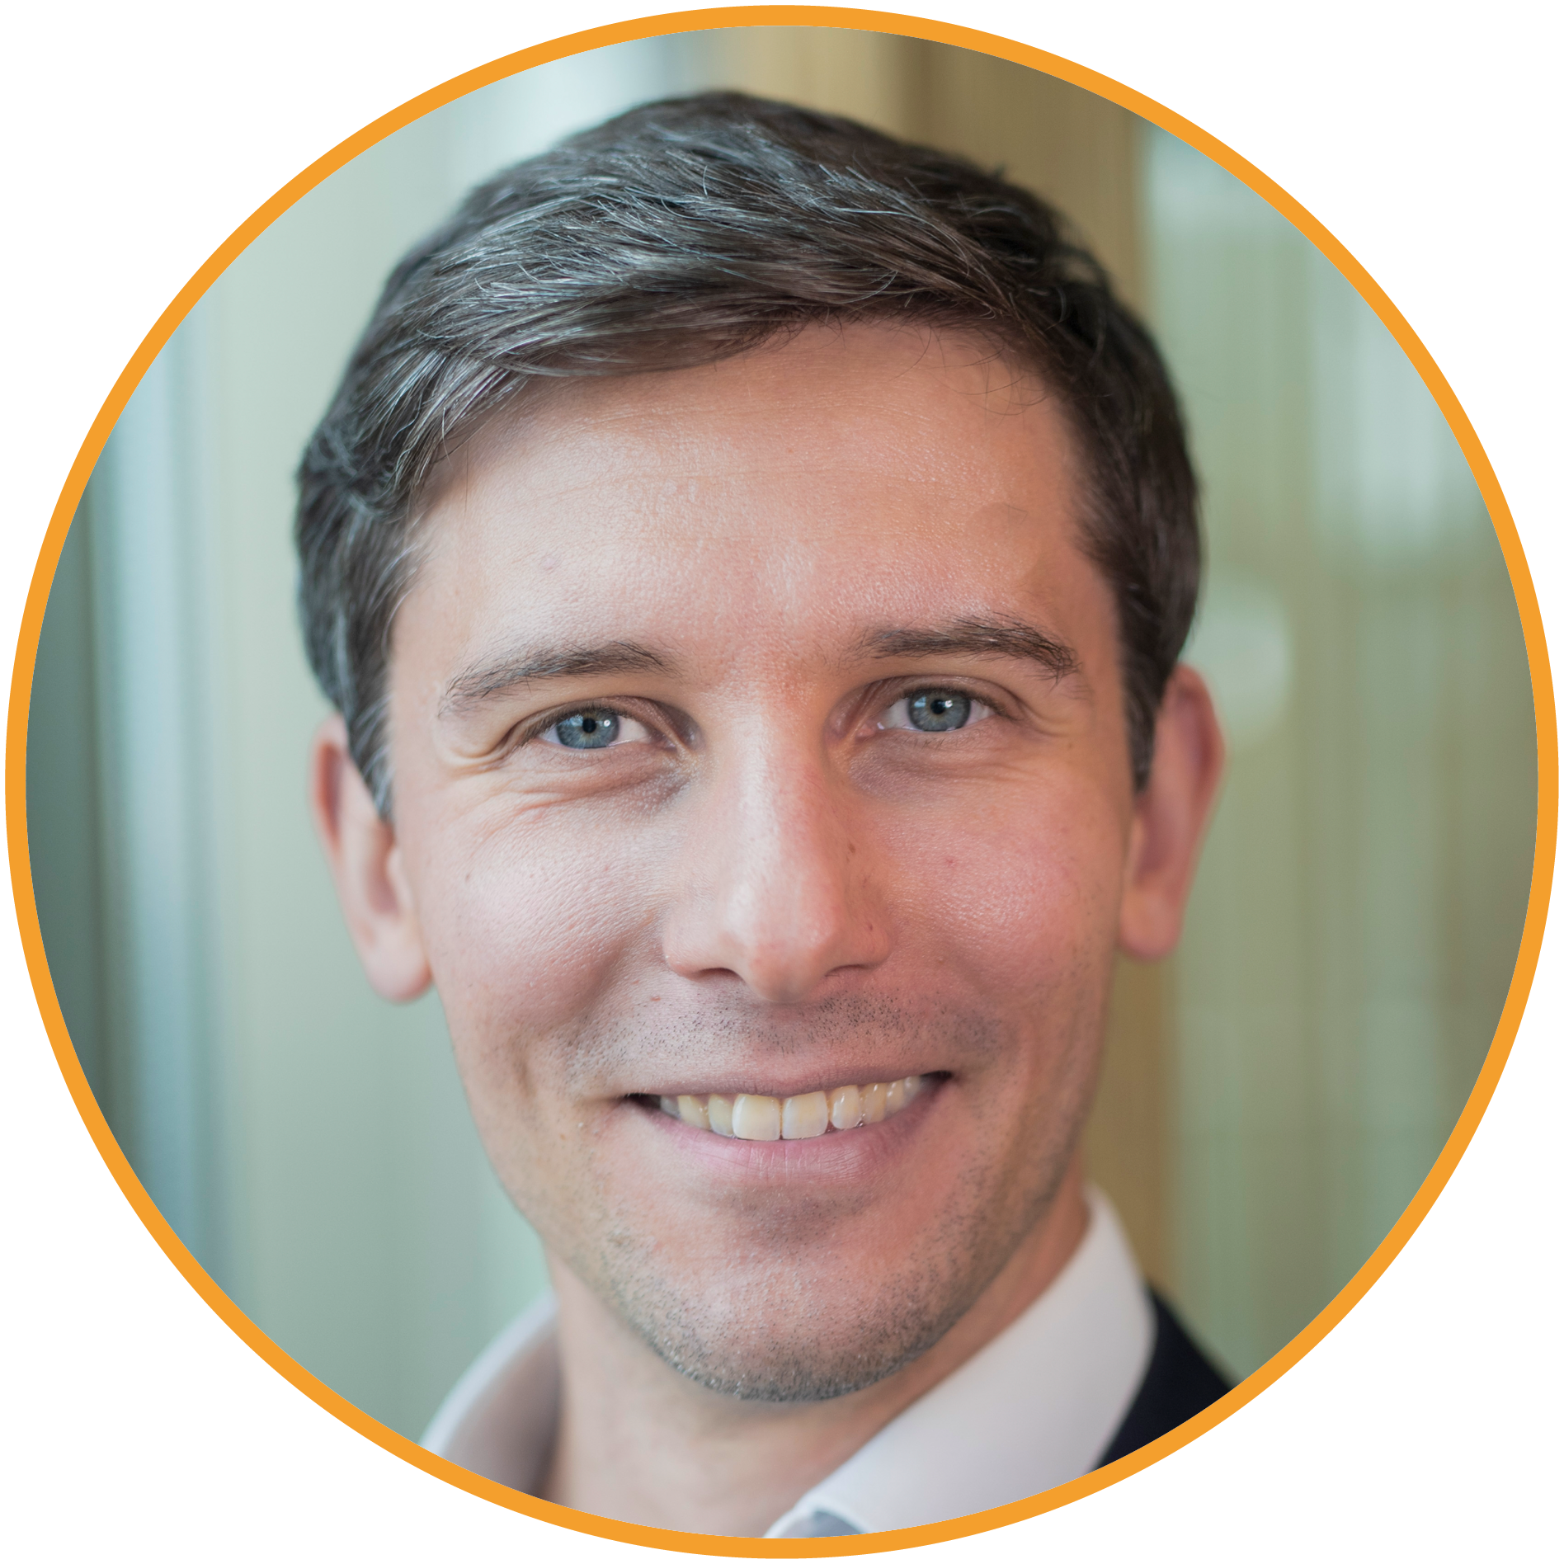
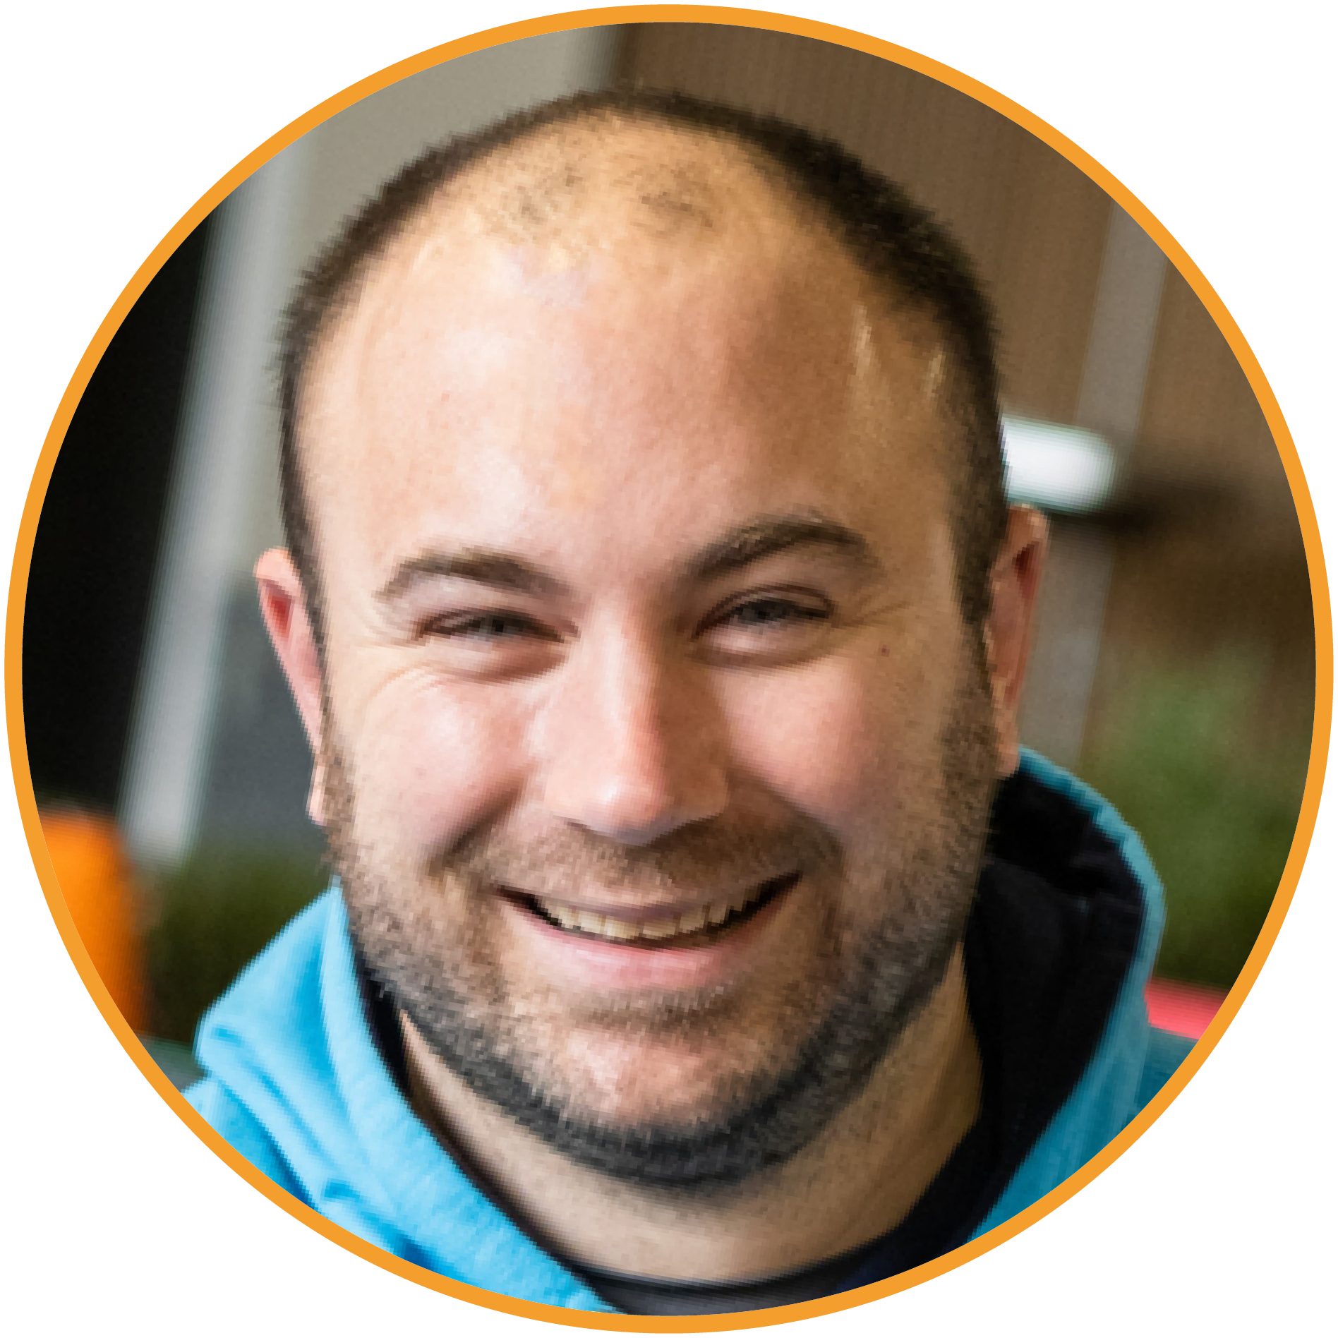
13.10: Lunch starts
13.35 - 14.05: ‘Almost open mic’
14.15: Afternoon session begins
Chair:
Suresh Mistry
Alquity
Investment
Management
Louisiana Salge
EQ Investors
Rowan Stone
Virtuvest
Tom Buffham
Brewin Dolphin
Seb Elwell
Switchfoot
Wealth IFA

Slide 19
Agenda
14.15 – 14.25: | Welcome back
14.25 – 15.05: | Fund Manager Panel 3 – Shifting the circular economy dial – what are the challenges and opportunities?
15.05 -15.45: | Fund Manager Panel 4 – If sustainable funds are to help deliver the positive impacts and outcomes many clients desire, asset selection is crucial.
15.45- 16.05: | Coffee break

Slide 20
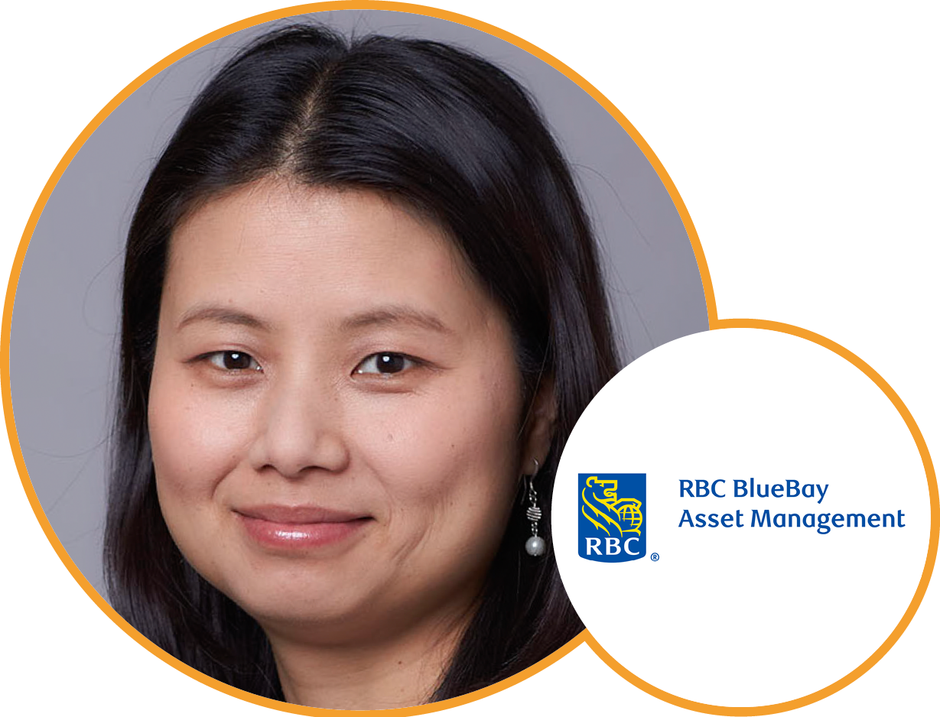
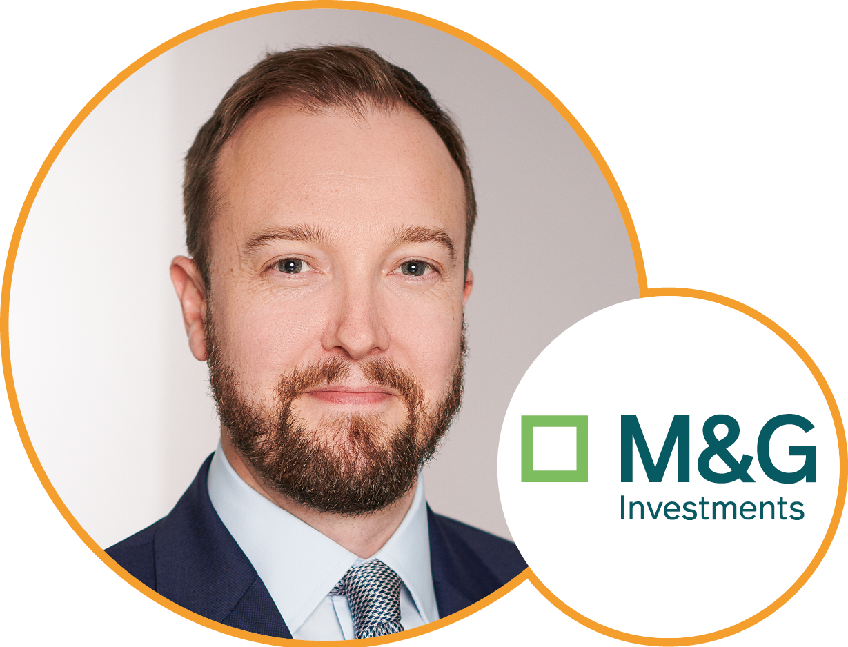
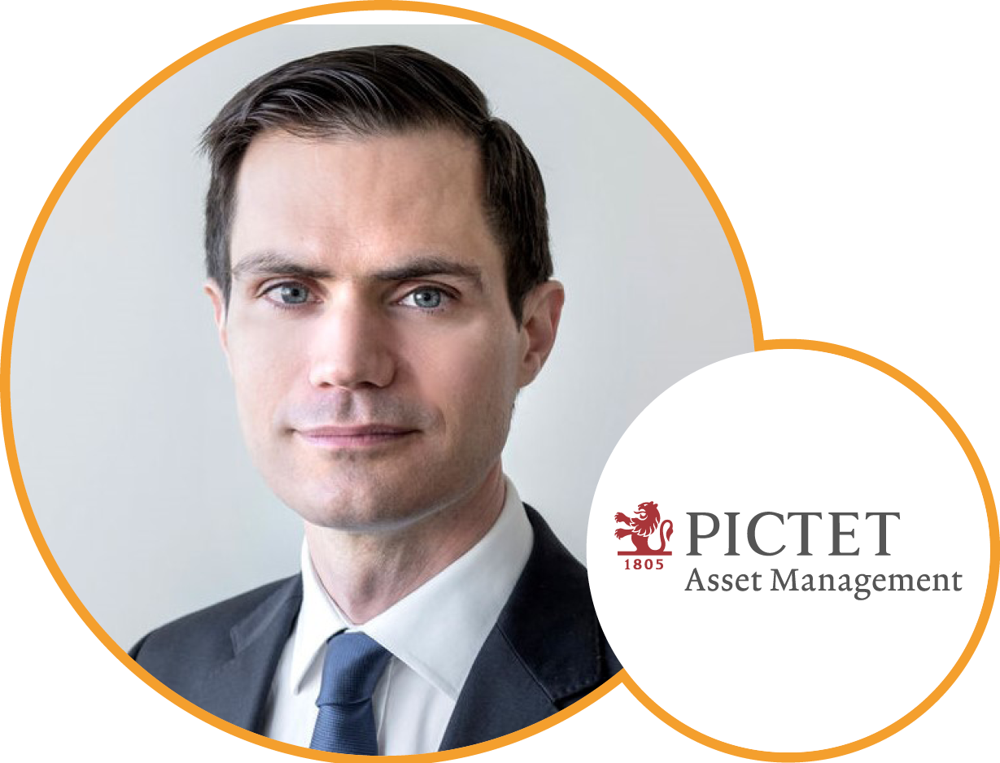
Panel 3: Shifting the circular economy dial – what are the challenges and opportunities?
My-Linh Ngo
BlueBay
Asset Management
Michael Rae
M&G Investments
Gabriel Micheli
Pictet
Asset Management

Slide 21
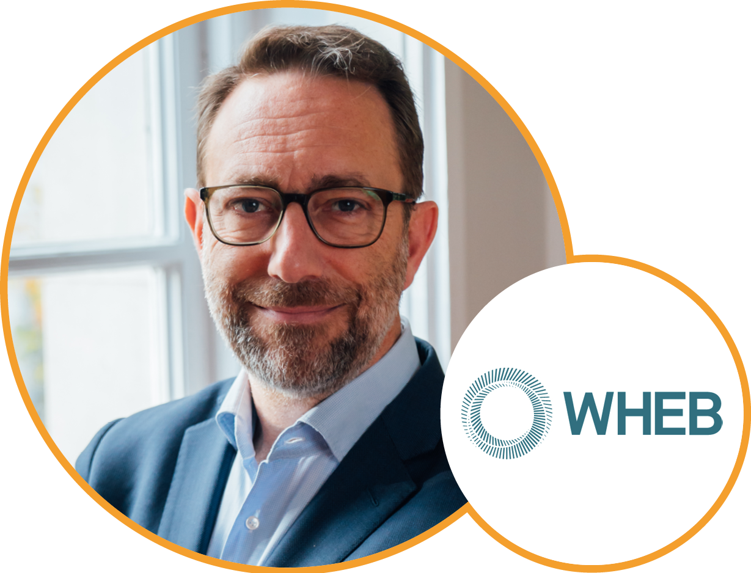
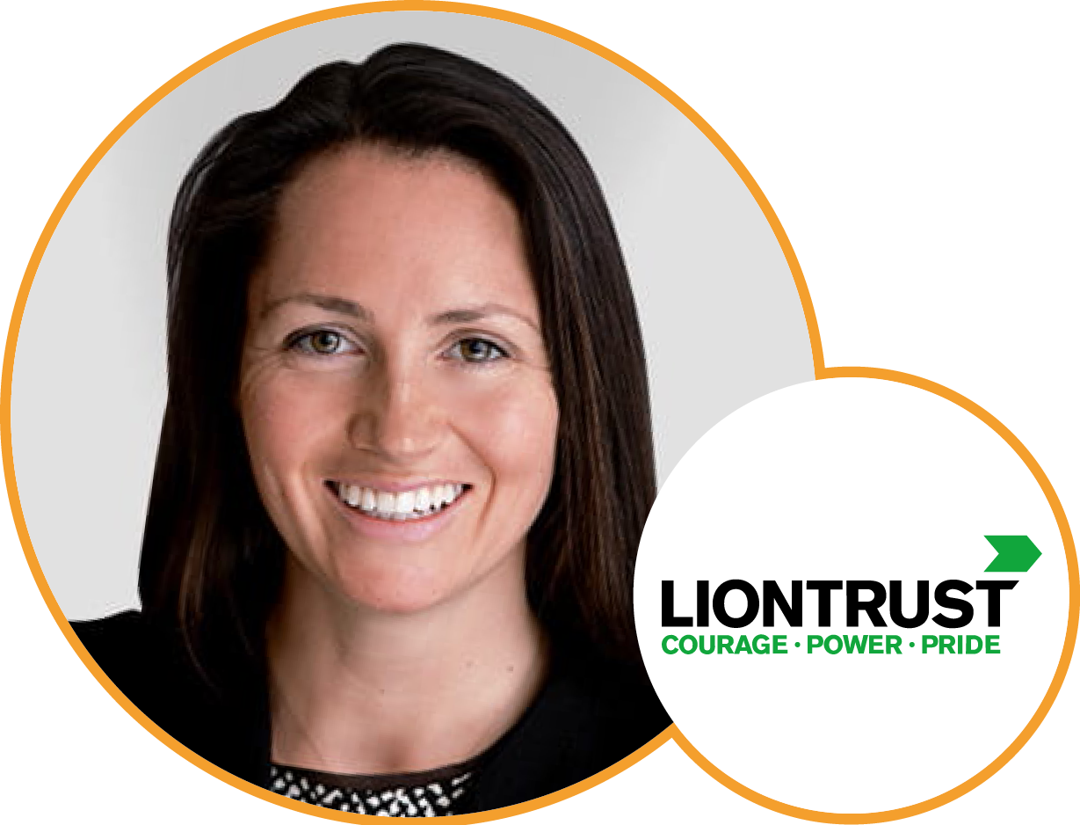
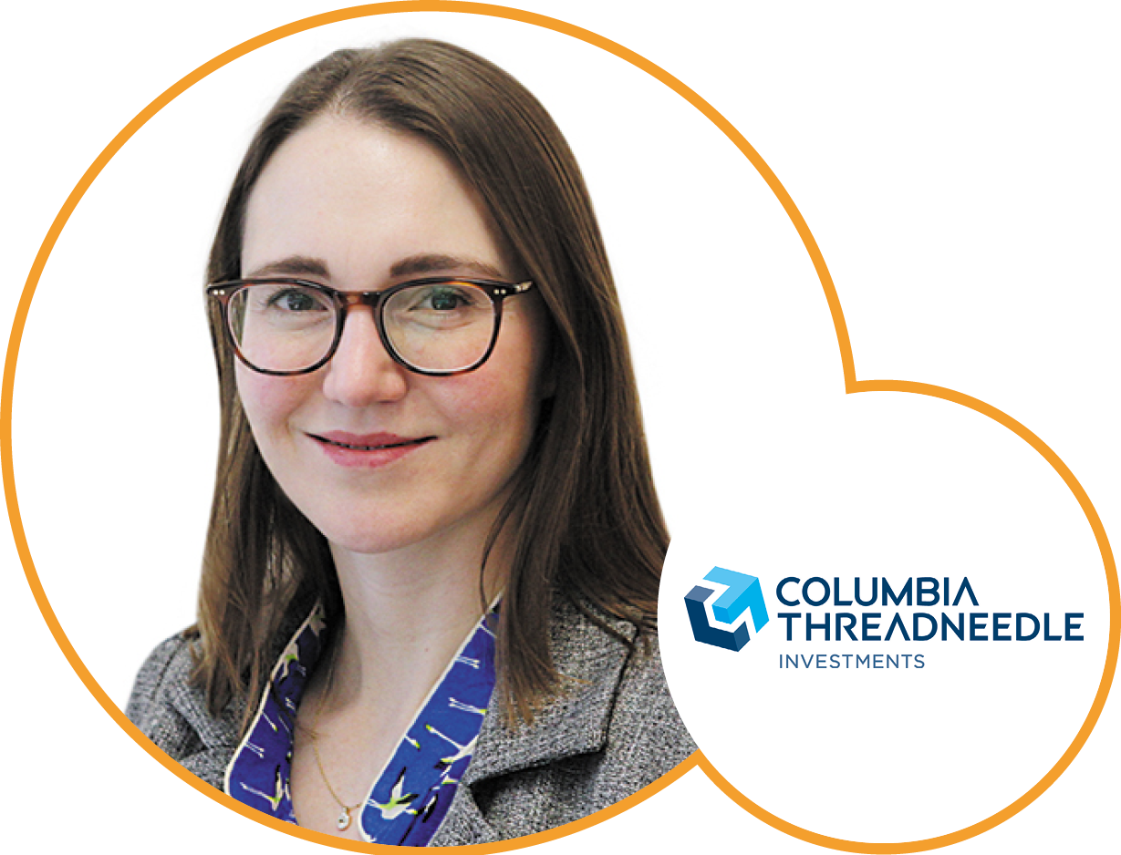
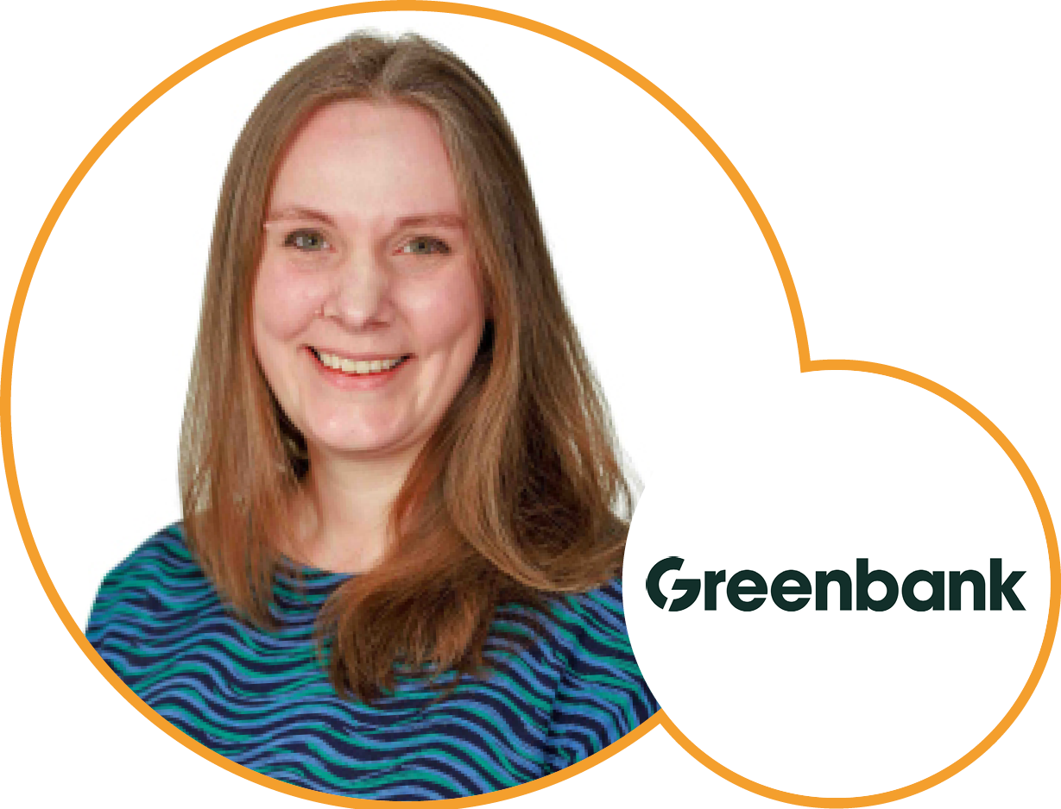
Panel 4: If sustainable funds are to help deliver the positive impacts and outcomes many clients desire, asset selection is crucial.
George Latham
WHEB
Asset Management
Harriet Parker
Liontrust
Asset Management
Alice Evans
Columbia Threadneedle Investments
Kate Elliot
Greenbank

Slide 22
Agenda
15.45- 16.05: | Coffee break
16.05 – 16.35: | AFTERNOON KEYNOTE – Joanne Etherton, Head of Purposeful Markets at ClientEarth
16.35 – 17.00: | Fund Manager’s share their stories Panel 5 – ‘Something I care about, and am working on’
17.00 – 17.15: | Expert presentation – Mike Clark, Ario Advisory – An actuary’s view of Climate Risk
17.15 – 17.30: | ‘Next Steps’ and close
17.30 – 20.30: | Drinks reception and canapes

Slide 23
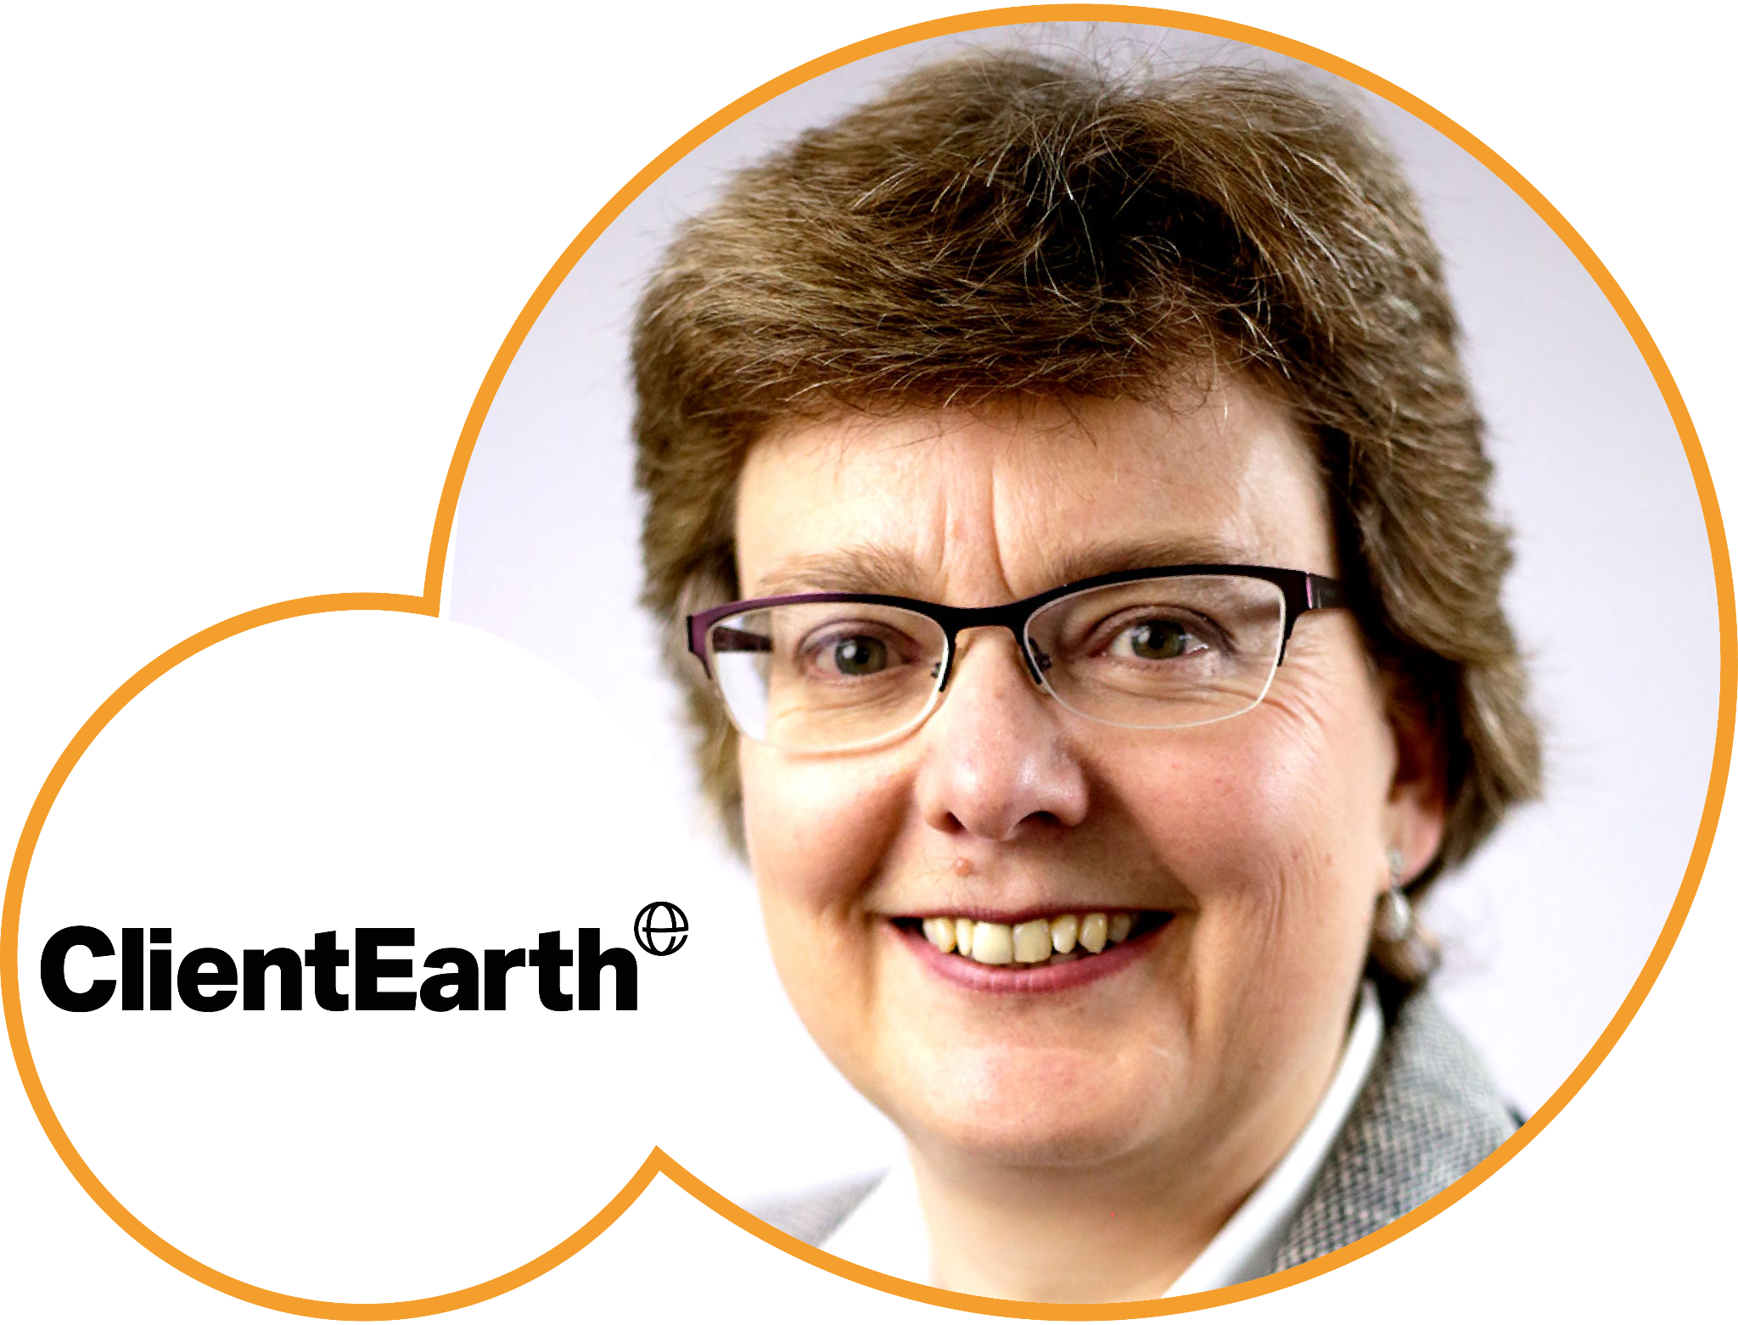
Keynote Address
Joanne Etherton
Head of Purposeful Markets,
ClientEarth

Slide 24
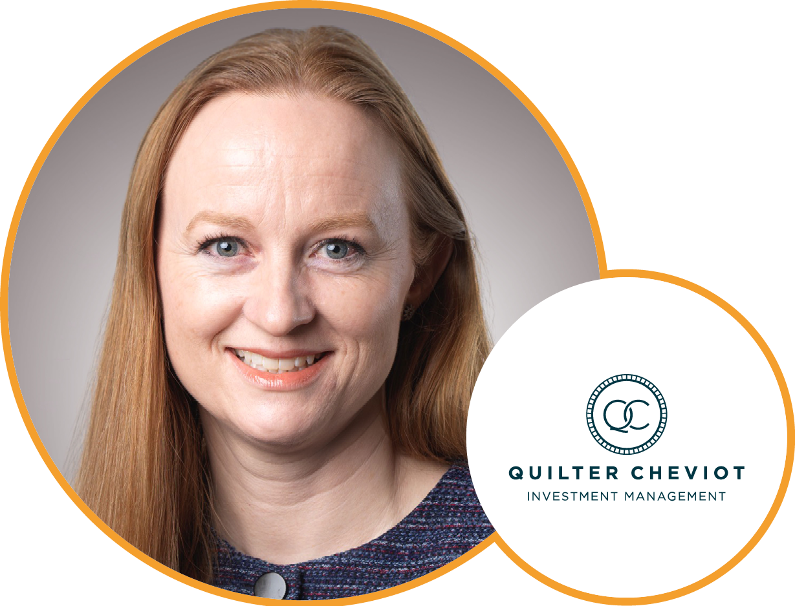
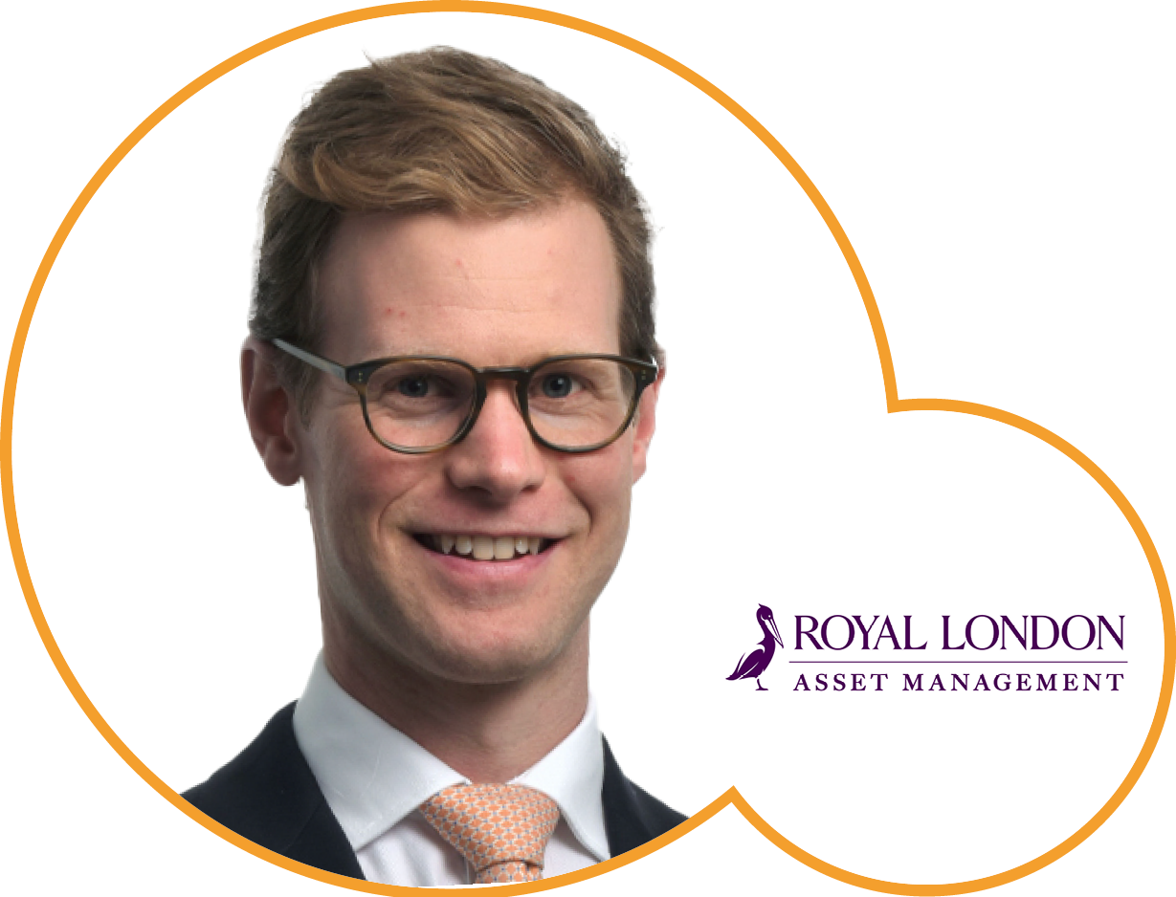
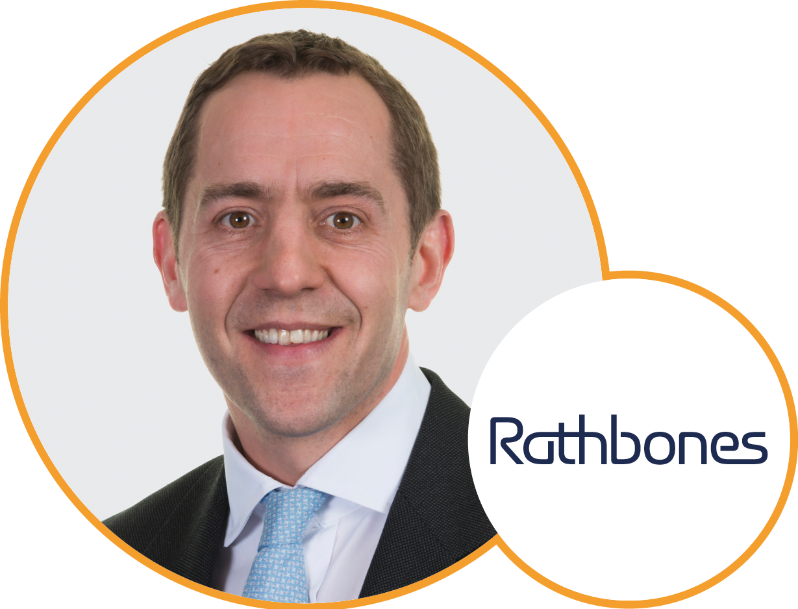
Panel 5: Fund manager stories
‘Something I care about, and am working on’
Caroline Langley
Quilter Cheviot Investment Management
George Crowdy
Royal London
Asset Management
David Harrison
Rathbones Group

Slide 25
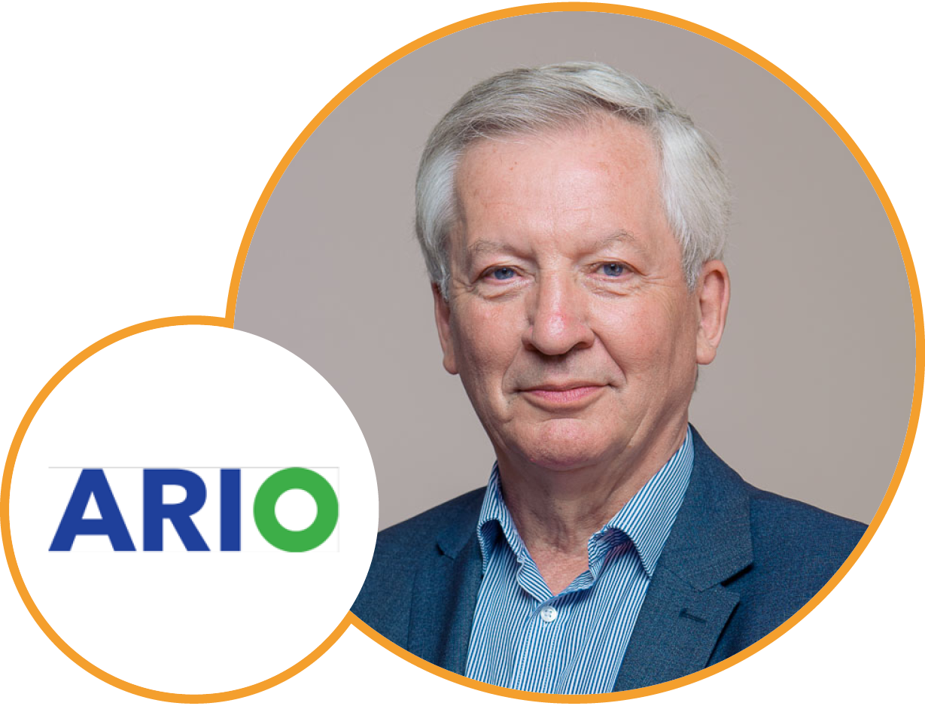
Expert Presentation:
An actuary’s view
of Climate Risk
Mike Clark
Founder Director, Ario Advisory

Slide 26
Next Steps
Julia Dreblow
Founding Director, SRI Services

Slide 27
17.15 – 17.30: ‘Next Steps’
and close
Questions…?
Thank you for attending!
Don’t forget your:
  CPD sign in / out – we need your names!
  Feedback forms
  Dialshifter postcards
Drinks – 17.30 – last orders at 20.30

Slide 28
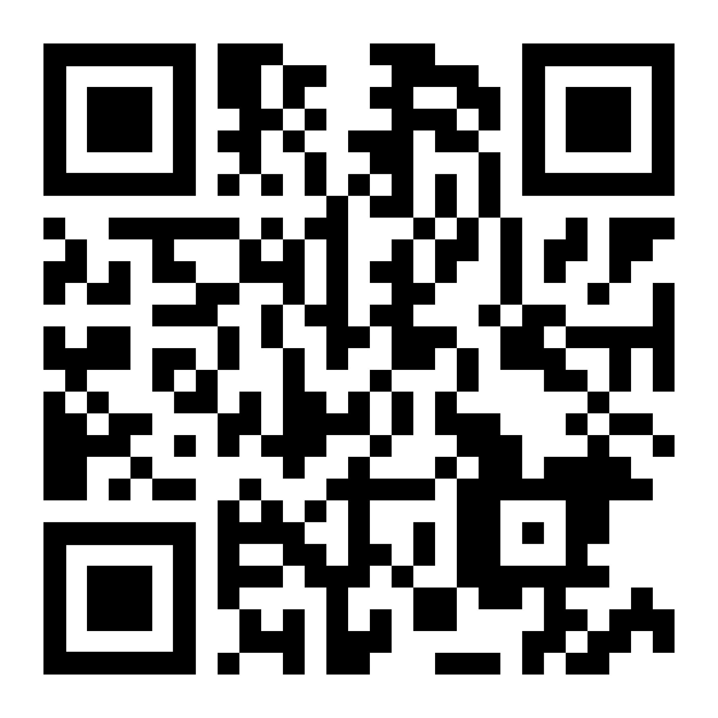
Thank you for joining us
www.sriServices.co.uk
For information only. We are not regulated or authorised to offer advice.
Event partners:
Keynotes:
Part of:
Organising partner:
CPD accreditation:

