Slide 1

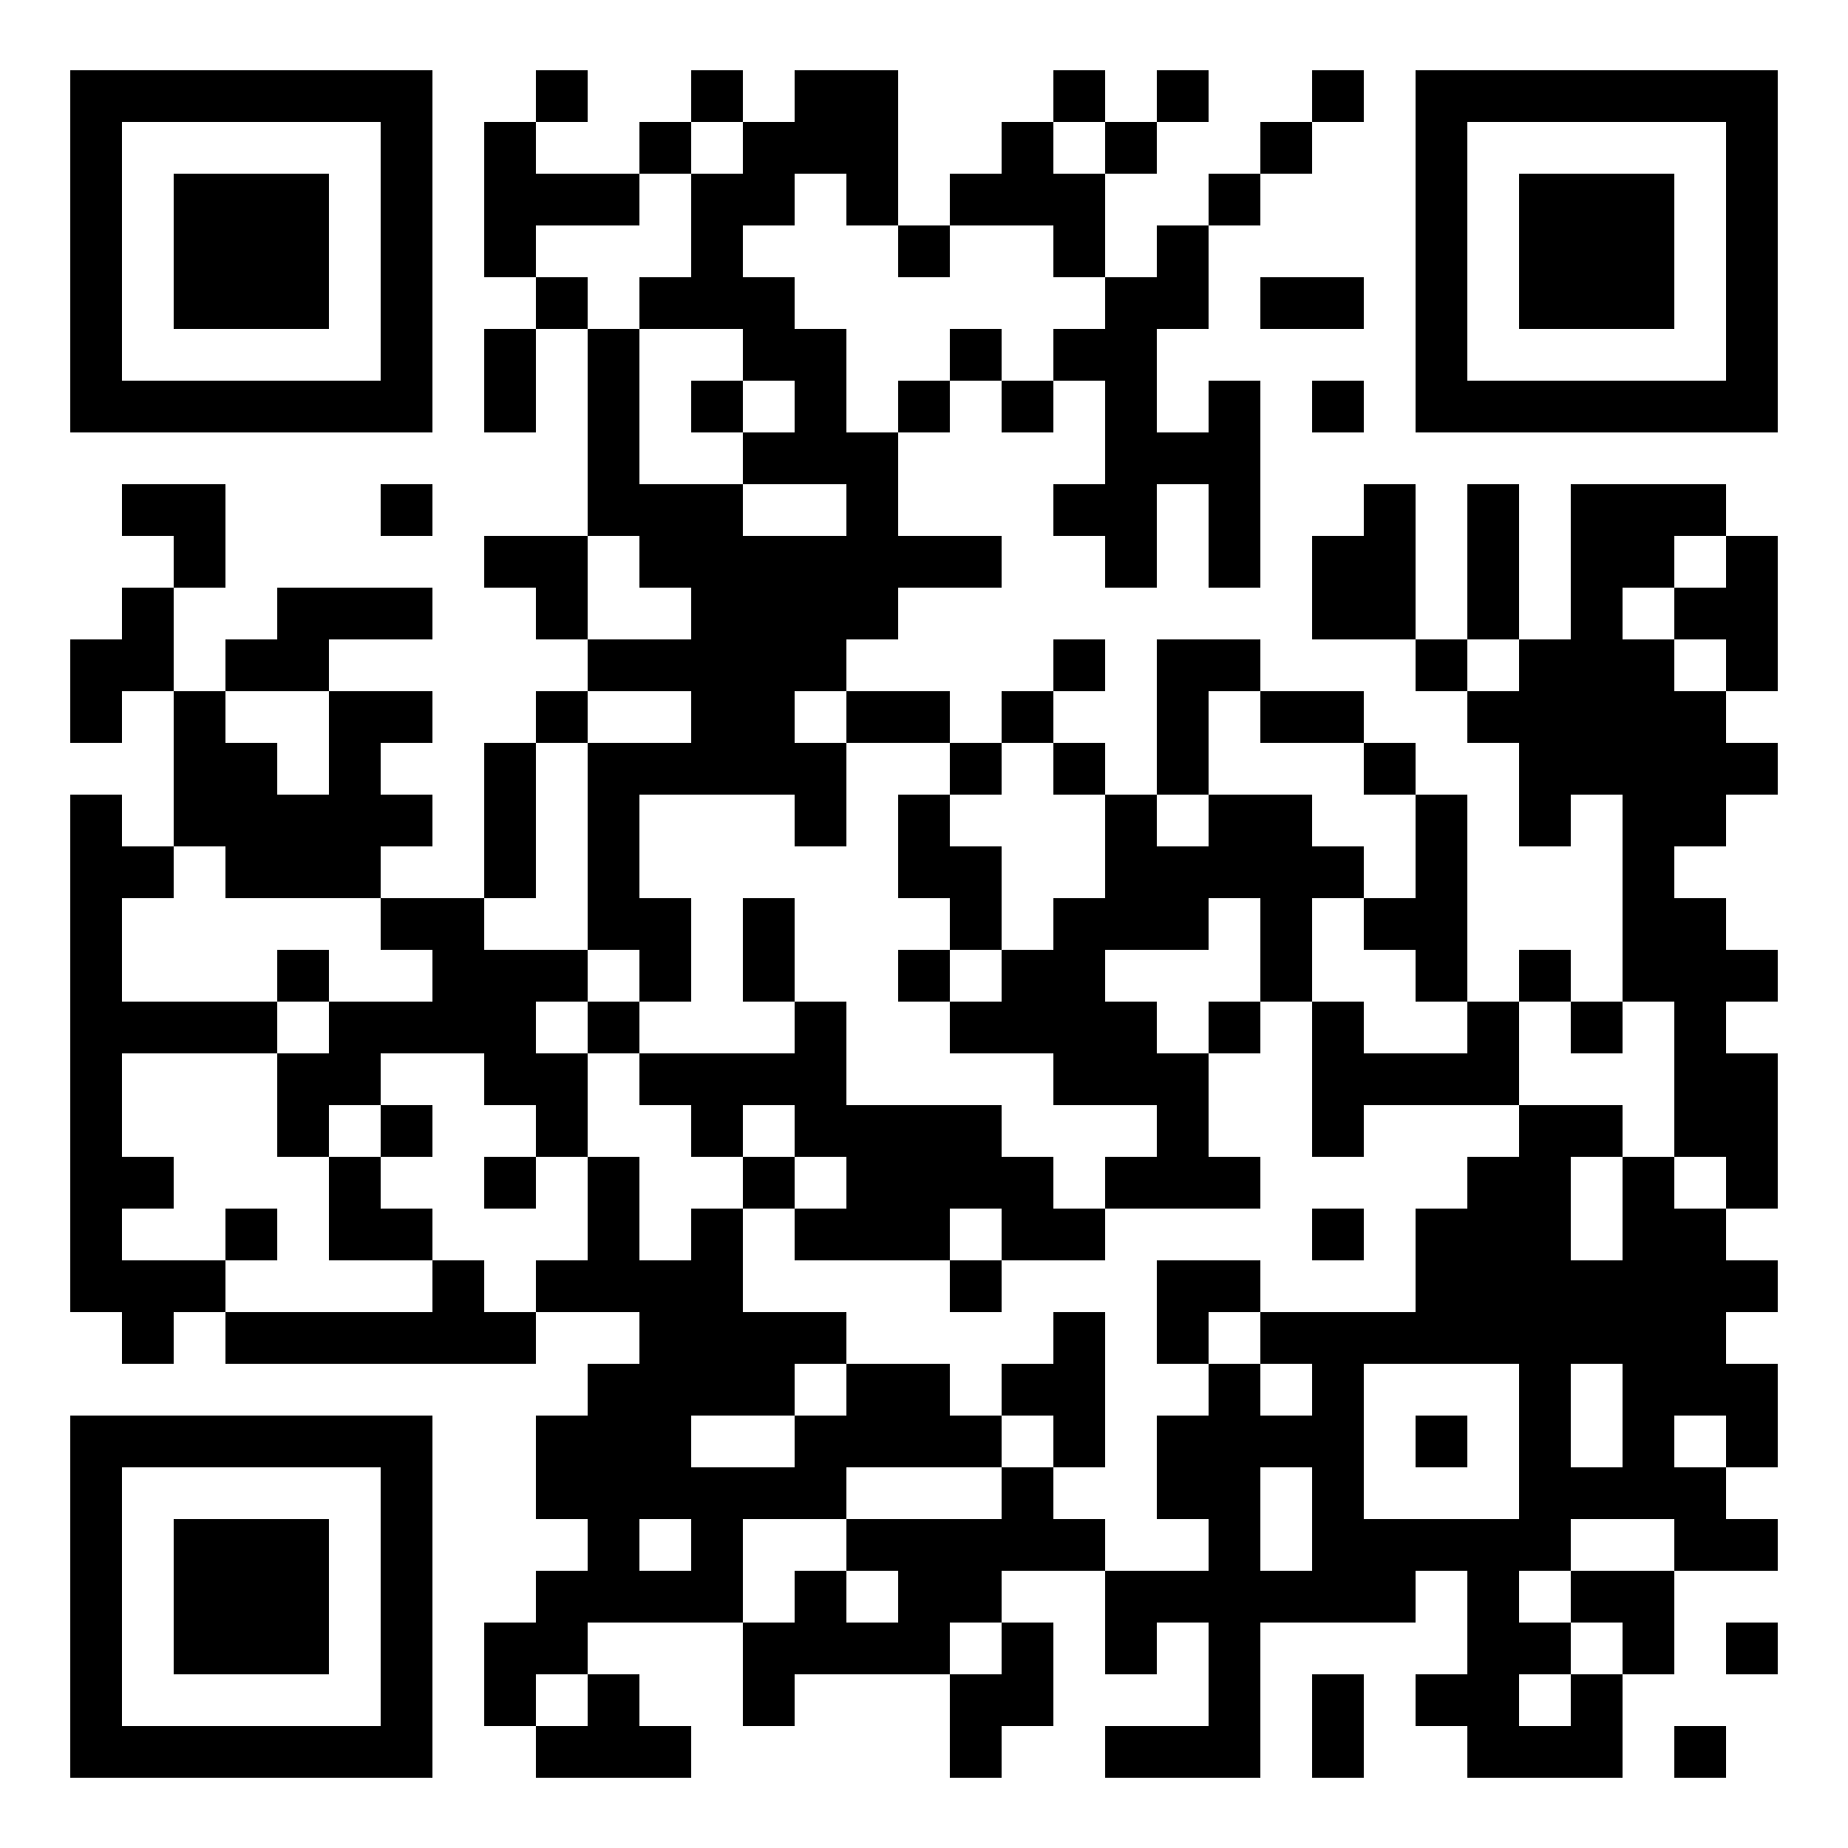
Five things you need to know about sustainable investment & ESG
16 April 2024
PIMFA conference, Stream 2 (12.30 – 1.00)
Julia Dreblow
Founder, SRI Services
www.FundEcoMarket.co.uk
This presentation is for information purposes only.
We are not regulated or authorised to offer advice.

Slide 2
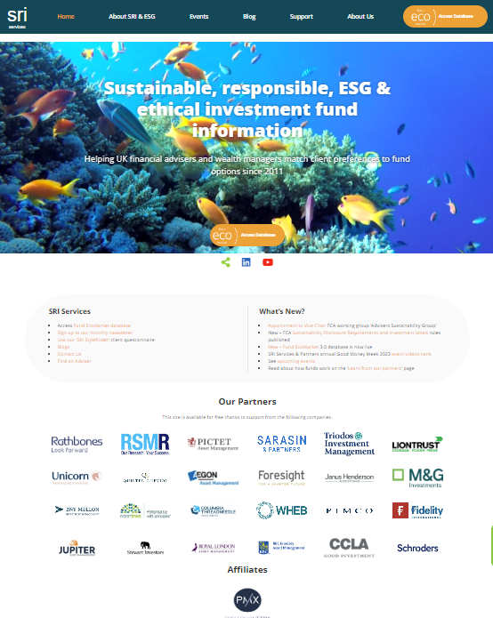
Mini biog
Specialised in ‘SRI’ since 1990’s
Set up own business 2010, launched Fund EcoMarket database 2011 – to help intermediaries
  Share data with Fidelity & ii
  Work with eg Parmenion, PIMFA, RSMR
FCA DLAG member since 2021
Tech author BSI PAS 7342 (fund standard)
Vice chair Adviser Sustainability Group (industry working group set up by FCA Jan 2024)
PIMFA ESG Academy lead
PFS Sustainable Financial Advice panel member
  Previously on not-for-profit UKSIF board (10y total)
  … Former broker consultant, SRI Marketing Manager at Friends Provident (1996-2008)

Slide 3
Five things you need to know about Sustainable investment & ESG
The issues are real, longstanding, and risky
Clients’ views matter
Fund strategies vary
Understanding key concepts
Regulation is changing – and will make your role more important

Slide 4
1
Issues…The issues these funds focus on are real, longstanding and some are systemic risks

Slide 5



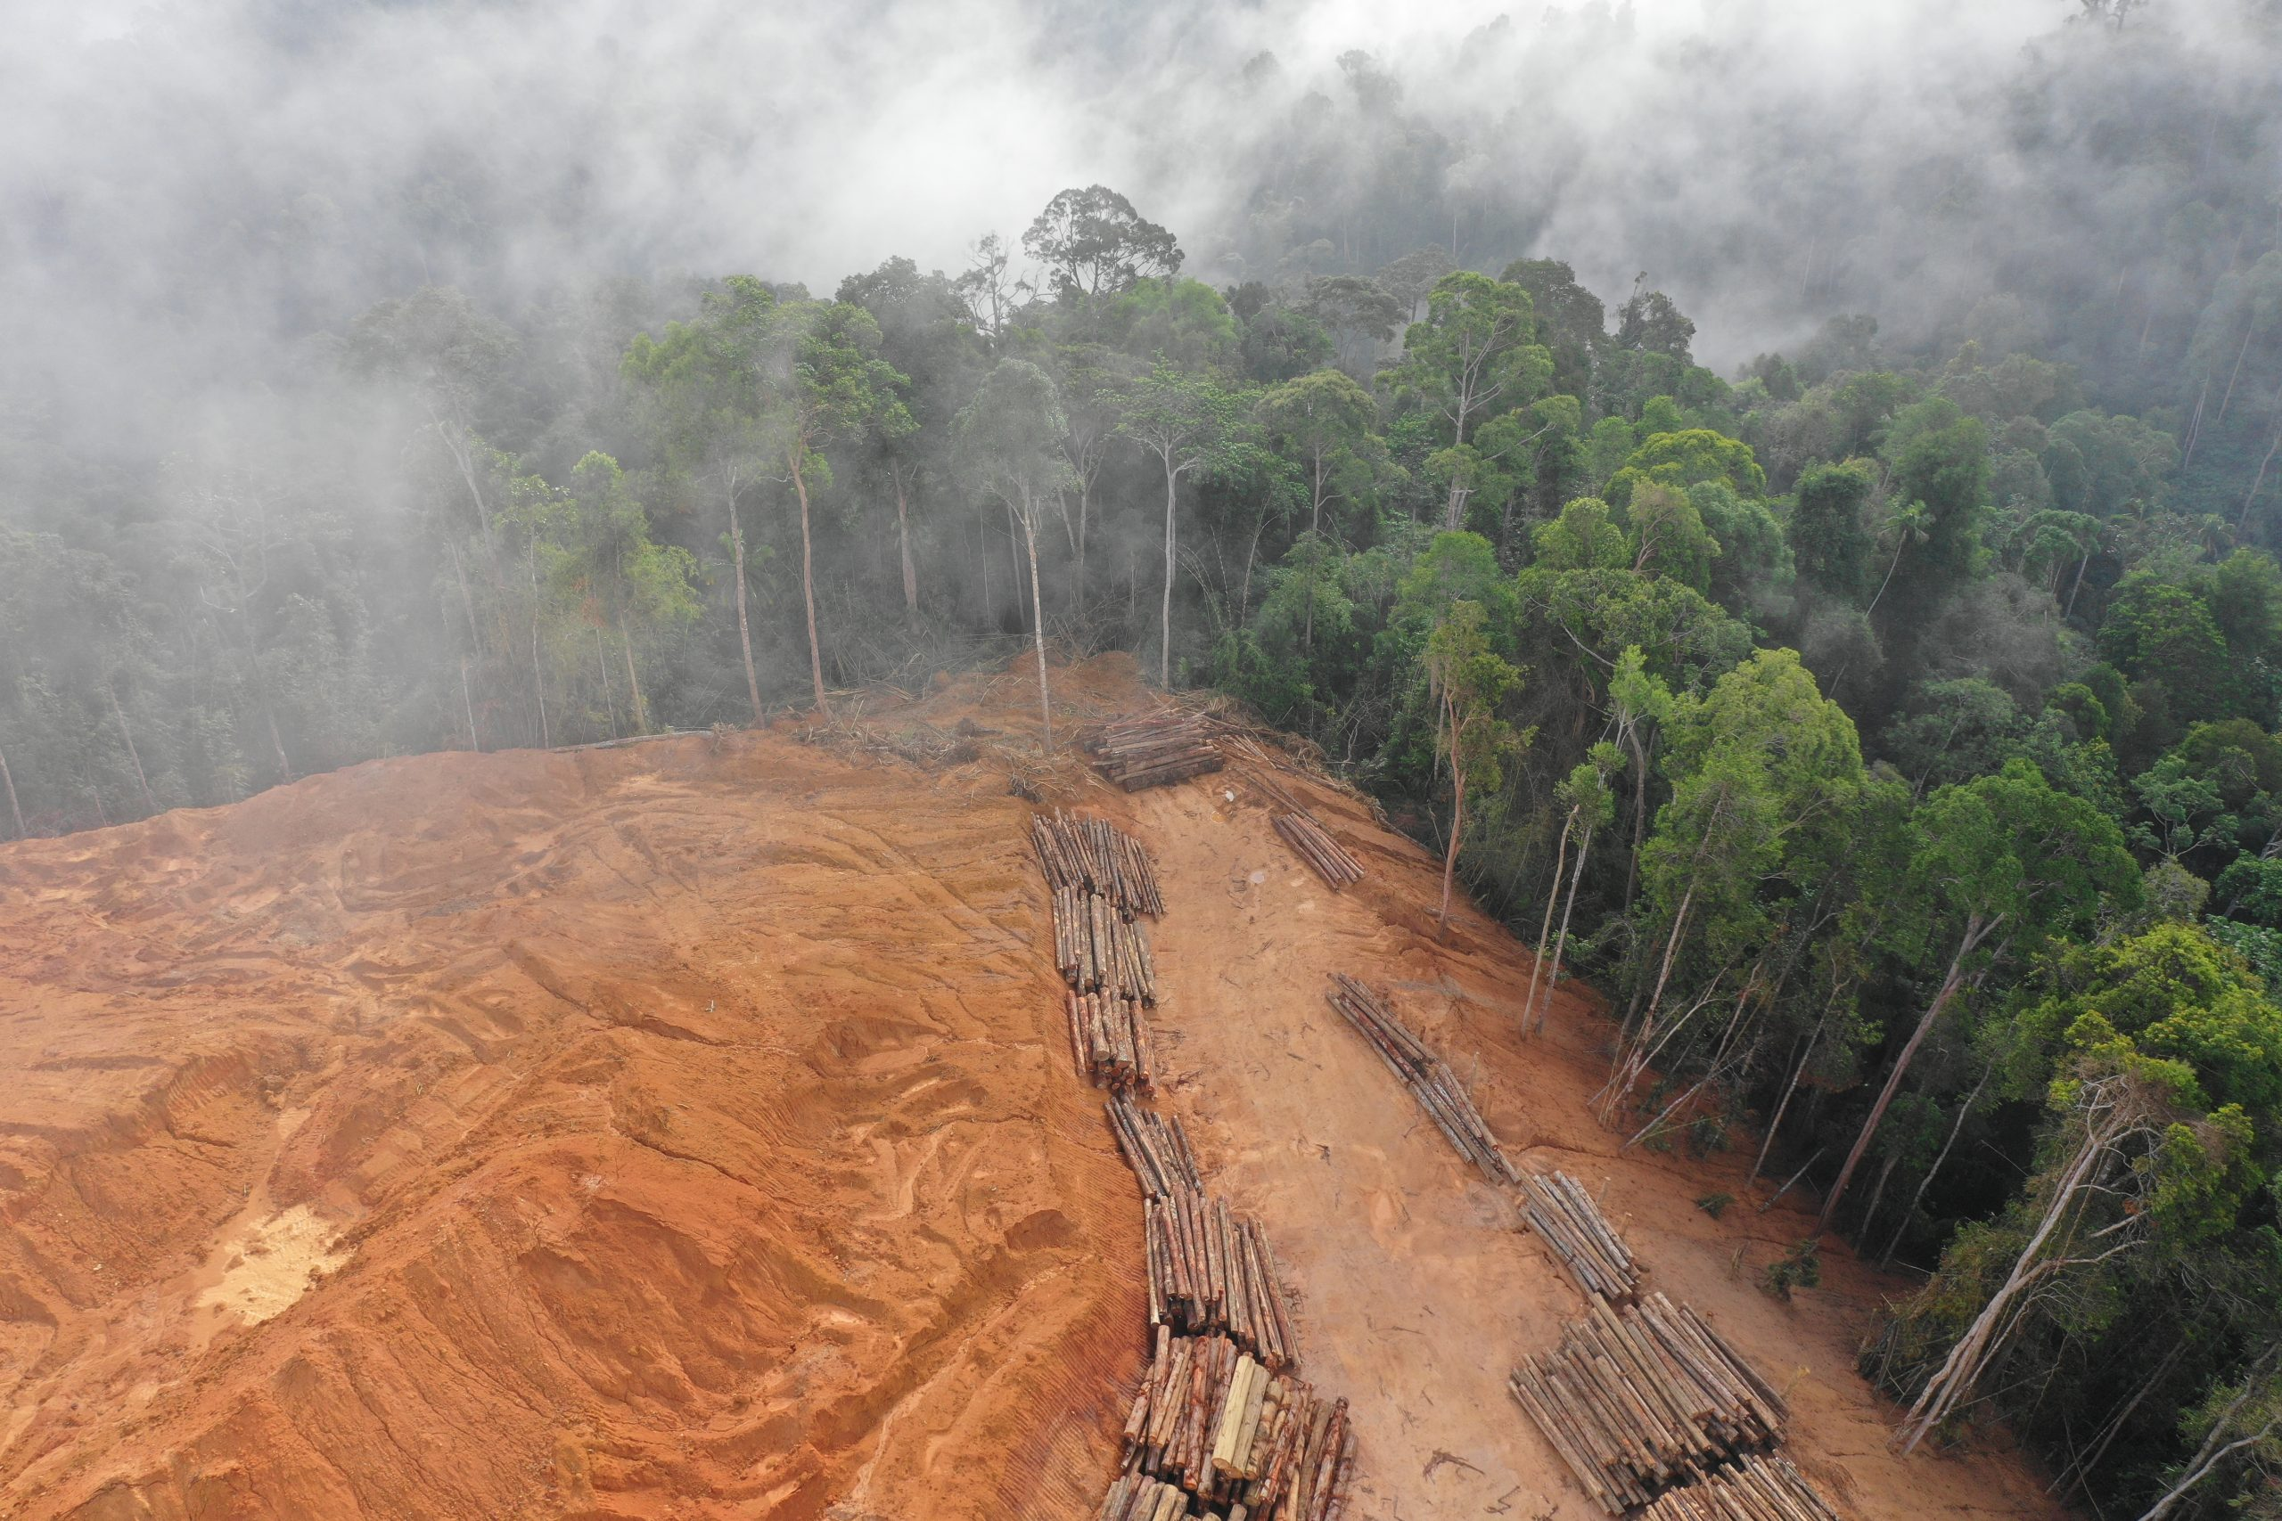
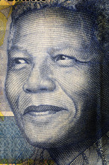
Most of this is not new, although language and processes have evolved...
UK’s first ‘ethical’ fund est 1984 - Friends Provident Stewardship
Armaments industry
Tobacco (health)
Deforestation (biodiversity)
Anti-Apartheid (Inequality)

Slide 6

What has changed?
Some issues are now too big to ignore

Slide 7
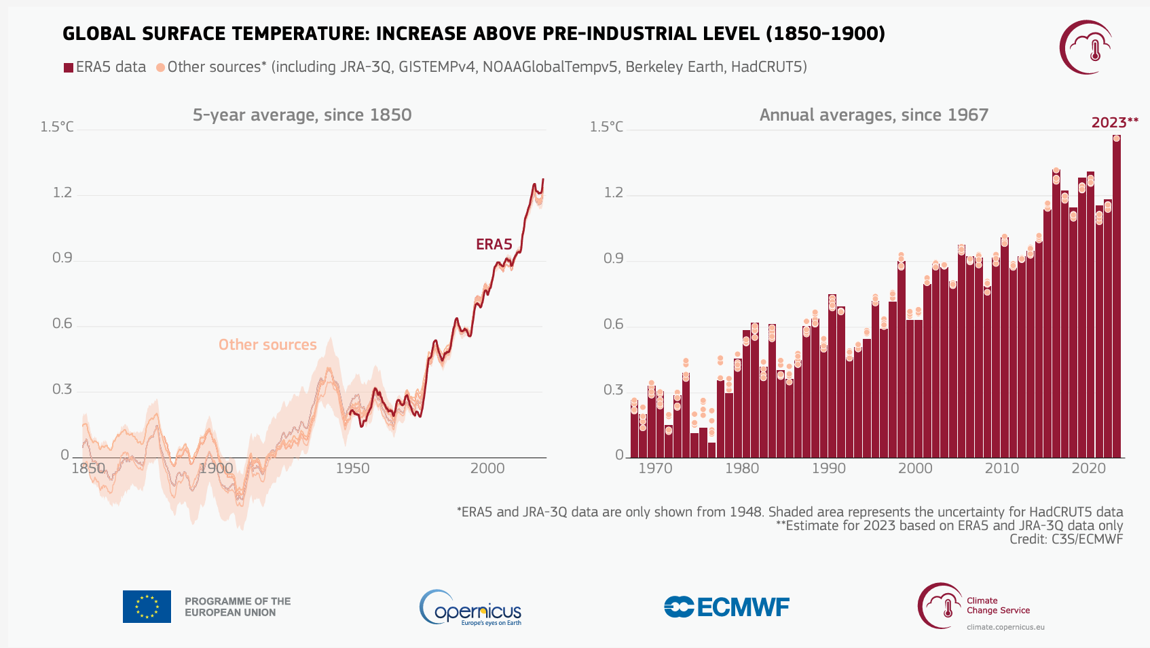
‘2023 has replaced 2016 as the warmest calendar year on record. According to the ERA5 dataset, the global-average temperature for 2023 was 14.98°C, 0.17°C higher than recorded for 2016’.’ (Copernicus)

Slide 8
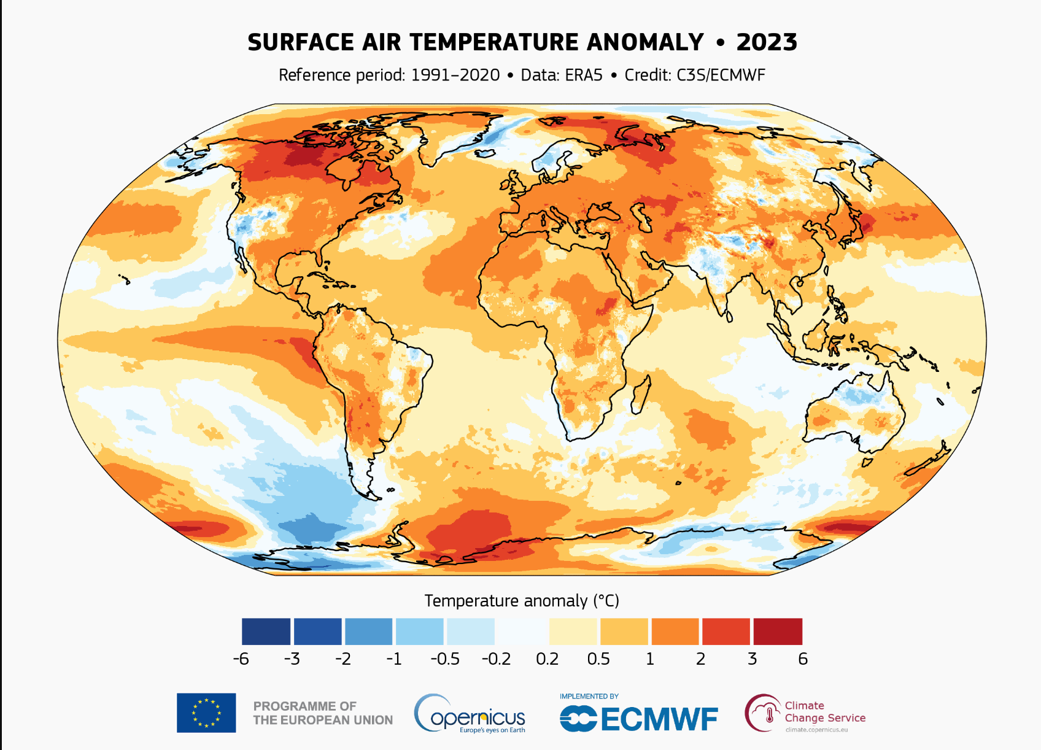
A health – and wealth – warning:

Slide 9

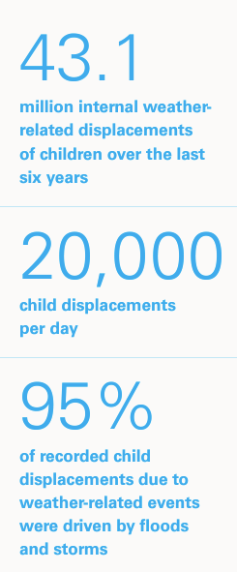
No amount of anti-woke rhetoric will help
“Globally, fossil fuel subsidies were $7 trillion or 7.1 percent of GDP in 2022, reflecting a $2 trillion increase since 2020 due to government support from surging energy prices” (£13m / minute) www.imf.org
Florida adopts anti-ESG rule for state's $186B pension plan 24 Aug, 2022 S&P Global
Guess Who Loses After Florida and Texas Bar ESG Banks? ‘Banning Wall Street’s biggest municipal bond underwriters has foisted a hidden tax on their residents totalling hundreds of millions of dollars’. Bloomberg 13 Feb 2023
Soaring insurance costs threaten hurricane prone US states…
‘Companies are fleeing Florida as covering property becomes more expensive’ FT Moral Money 10 October 2023
Unicef report 2023 ‘Children displaced in a changing climate’
www.unicef.org
‘Florida’s last resort property insurer is now state’s biggest’ Bloomberg Law Aug 23

Slide 10
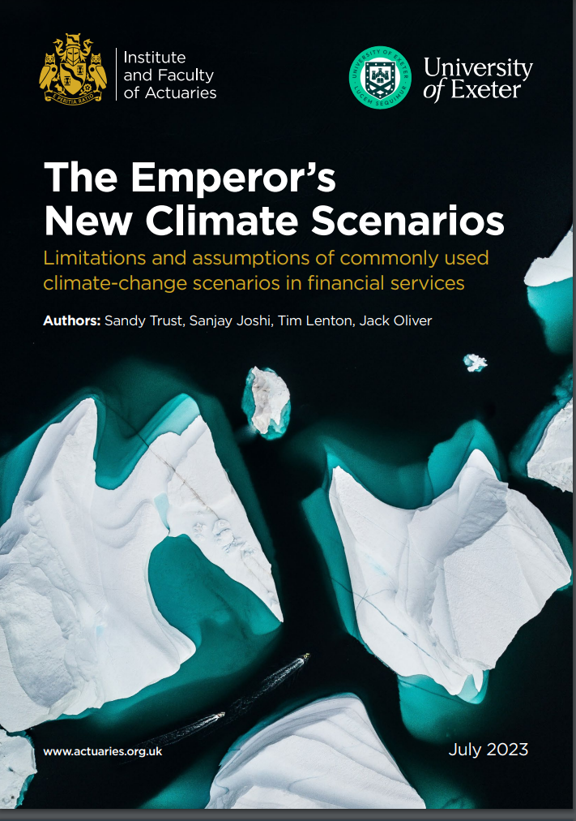
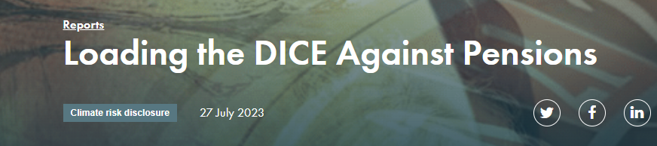


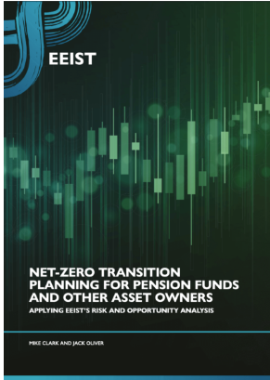

Poor climate risk modelling is worrying actuaries & scientists as is ‘lack of investor urgency’ (Q3 2023)
Economic analysis that informs investment consultant models are at odds with scientific literature (Carbon Tracker), … massively underestimate risk to portfolios & miss tipping points (all)
Current Net Zero strategies are too influenced by ‘modern portfolio theory’ and not ‘decision useful’ (EEIST)
Investors putting too much faith in models – & time is too short to wait for perfect models (IFoA)
Pensions (etc) have a role to play in addressing Net Zero and investing for a world that beneficiaries would want to live in. (EEIST)
FS community encouraged to contemplate “a ruin scenario of 100% GDP loss” (IFoA)
Notes:
University of Exeter et al
We have left it too late to tackle climate change incrementally. We now require a dramatic acceleration of progress through transformational change across society and the global economy. The pensions industry has an undeniably important role to play in supporting the journey to net zero, not least through investing for a world that its beneficiaries would want to live in.
‘…net-zero strategies guiding pension funds and other asset owners … are too strongly influenced by modern portfolio theory…official climate scenarios are increasingly regarded as not being ‘decision-useful’.
Carbon tracker - KEY FINDINGS
Investment consultants to pension funds have relied upon peer-reviewed economic research to provide advice to pension funds
Following the advice of investment consultants, pension funds have informed their members that global warming of 2-4.3°C will have only a minimal impact upon their portfolios.
The economics papers informing the models used by investment consultants are at odds with the scientific literature on the impact of these levels of warming.
Minsky moment…
Institute & Faculty of Actuaries
Tipping points missed (eg loss of Amazon & West Antarctic ice sheets)
“remaining carbon budget for limiting warming to +1.5C [may be] already zero”
“history is replete with incidents [when] we have placed too much faith in models”.
“Time is too short to wait for models that are perfect”
FS community encouraged to contemplate “a ruin scenario of 100% GDP loss”
Need to avoid … ‘herd mentality’.
Like…modelling the scenario of the Titanic hitting an iceberg but excluding … the possibility that the ship could sink

Slide 11
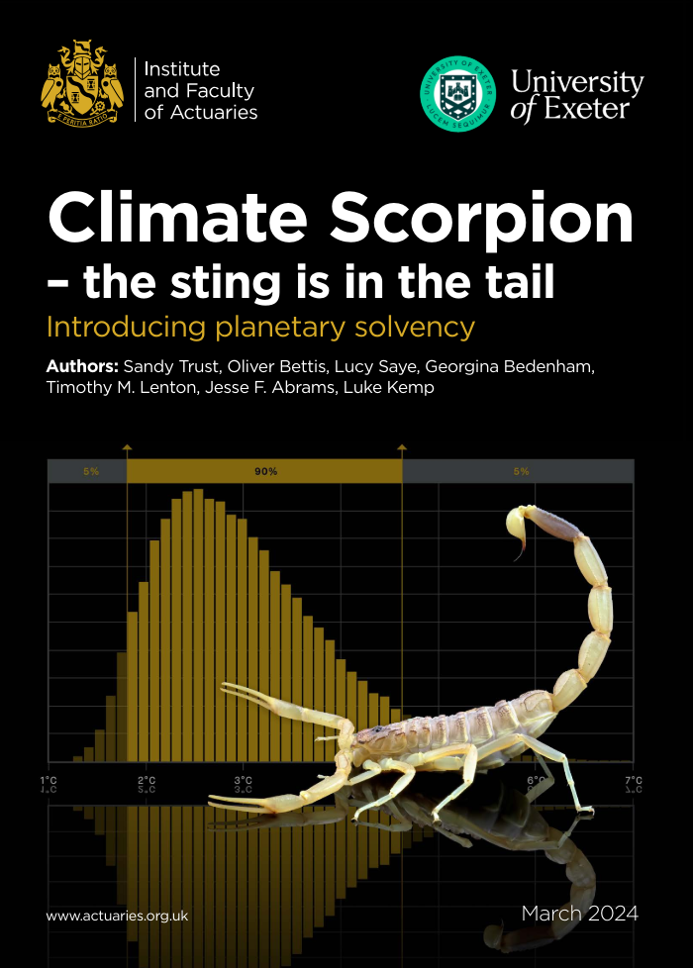
Institute of Actuaries
March 2024
Climate Scorpion – focus on tail risk (‘unlikely but significant’)
Need to apply an ‘actuarial approach’ ie consider range of scenarios - including ruin
‘Planetary Solvency’ – focus on nature and climate together

Slide 12
2
Clients’ views matter
(spot the gap)

Slide 13
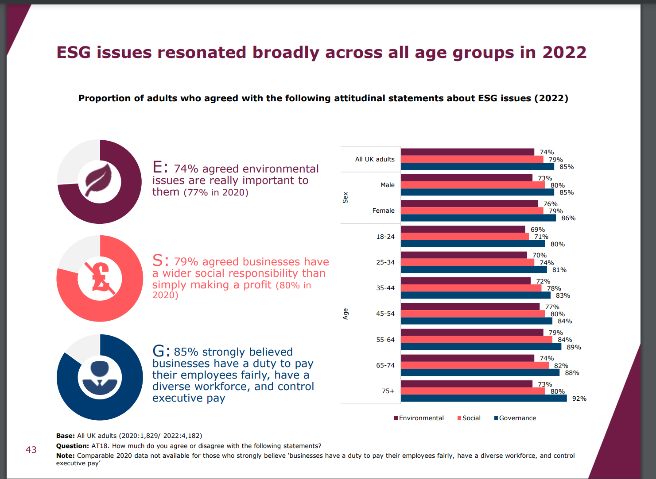
FCA recognises mismatch
FCA Financial Lives Survey 2022
‘…at May 2022 79% of consumers think businesses have a wider social responsibility than simply to make a profit.’
https://www.fca.org.uk/publication/financial-lives/fls-2022-consumer-investments-financial-advice.pdf

Slide 14
Office of National Statistics (ONS), Q4 2022
When asked about a range of issues, climate change was the second biggest concern facing adults in Great Britain (74%), with the rising cost of living being the main concern (79%).
Around three in four adults (74%) reported feeling (very or somewhat) worried about climate change; the latest estimate is similar compared with the percentage who said they felt worried (75%) around a year ago.
Around 1 in 10 people (9%) felt unworried (somewhat unworried or not at all worried) about climate change, higher than a year ago when it was 6%, and around one in five (17%) said they were neither worried nor unworried.
https://www.ons.gov.uk/peoplepopulationandcommunity/wellbeing/articles/worriesaboutclimatechangegreatbritain/septembertooctober2022
Requires shift in narrative

Slide 15
3
Market ….Fund strategies vary – and that’s ok!
(Advisers Sustainability Group set up to help deal with this)

Slide 16
The ‘market mosaic’ has evolved and diversified over time…
Environmental
Clean Tech
ESG Integration
Climate Risk
Sustainable Finance
Climate Risk
Ethical Screening
Sustainability
Engagement / Stewardship
Responsible Ownership
(Social) Impact
‘Complementing not competing’

Slide 17
Fund strategy ‘mix & match’
  4. Issues
  Environmental
  Social
  Governance
  Ethical
  3. Approaches
  Avoid
  Support
  Engage (stewardship)
2. Real world ‘intended outcomes’
  Invest to grow ‘solutions’
  Encourage existing companies to transition
1. Performance
  These are investments…
4 3 2 1

Slide 18
4
Key concepts – to help you decode fund/portfolio information

Slide 19
a) Issues overlap (interconnected)
Classify the following common fund policies -
‘environmental’, ‘social’, ‘governance’ or ‘ethical’:
‘Excludes coal, oil and gas majors’
‘Excludes tobacco companies’
‘Cyber / digital security policy’
‘Fast fashion exclusion’
‘Responsible palm oil policy’
‘Invests in gilts/sovereigns’ (or similar)

Slide 20
Describing issues as E/S or G is ‘Art and Science’
(pretending otherwise can indicate low understanding)
‘Excludes coal, oil and gas majors’ (environmental – but also Social and Gov etc?)
‘Excludes tobacco companies’ (ethical – and social)
‘Cyber / digital security policy’ (governance & social)
‘Fast fashion exclusion’ (social and environmental)
‘Responsible palm oil policy’ (destruction of rainforest, abuse of indigenous people – but are the alternatives better or worse?)
‘Invests in gilts (or sovereigns)’ (opinions vary – which is why disclosure matters)
Narratives change over time & there are always embedded assumptions and subjectivity – hence the benefit of transparency and principles-based regulation

Slide 21
b) ‘Intentionality’
Is this strategy aligned to delivering positive change? (Yes / No)
Aims to manage (short term) risk / volatility / tracking error
Aims to help solve a sustainability challenge
Designed for ‘clients who care’ about sustainability
Recognises systemic risks / looking for new opportunities
Have stewardship strategies
Criticised in the media

Slide 22
Is the strategy aligned to delivering positive change?
No (‘ESG’ indicator) Yes - ‘sustainable fund’ / intentionality Maybe - need to dig deeper
No - Aiming to manage short term risk / volatility / tracking error (often governance focused)
Yes - Intentionality / aiming to help solve a sustainability challenge
Yes - Designed for ‘clients who care’ about sustainability
Yes - Recognises systemic risks / looking for new opportunities
Maybe - Have stewardship strategies [either]
Maybe – Criticised in the media [?!%?]

Slide 23


c) Do you agree with Elon Musk?
“ESG is the devil”
14 June 2023 (X/Twitter), in response to ‘tobacco crushing Tesla’ in [well known ESG] ratings.
Which of the following apply?
He is wrong
He has a point
Unhelpful comment as people listen to him
It matters what companies actually do / make
Having good governance matters

Slide 24
Do you agree with Elon Musk?
“ESG is the devil”
14 June 2023 (X/Twitter), in response to ‘tobacco crushing Tesla’ in [ESG] ratings.
In my opinion the following apply…
He is wrong (No)
He has a point (Yes)
Unhelpful comment as people listen to him (Yes)
It matters what companies actually do / make (Yes)
Having good governance matters (Yes)

Slide 25
Recognising ‘intentions’:
(Nothing is black/white, but companies do/make is important & will they help deliver change?)
Positive sustainability outcomes (Intentionality – SDR label friendly)
Eg
Aiming to make a difference
forward looking / explore growing opportunities / transitioning
products /services help solve sustainability challenges
for people who care about the future
ESG risk management / integration (increasingly BAU)
Eg
focus on short term financial goals and profit
backward looking (ESG) risk data & ratings
use conventional benchmarks / tracking error
little focus on what companies ‘do’ or ‘make’

Slide 26
Greenwash – overstating environmental credentials for business benefit vs
Greenhushing – keeping quiet about activity / credentials (for fear of criticism?)
Key concepts

Slide 27
5
Regulation … is changing the landscape – and will make your role more important

Slide 28
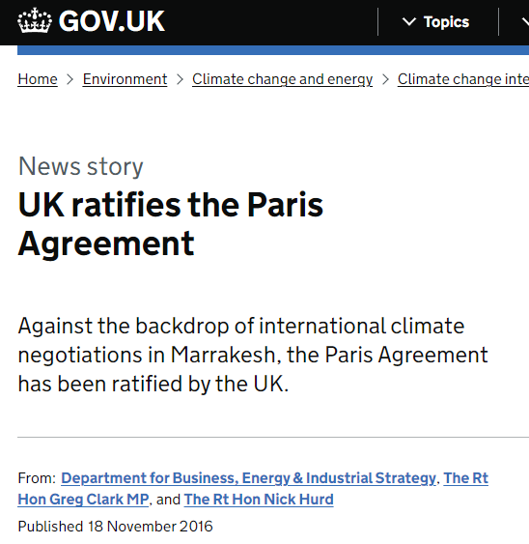
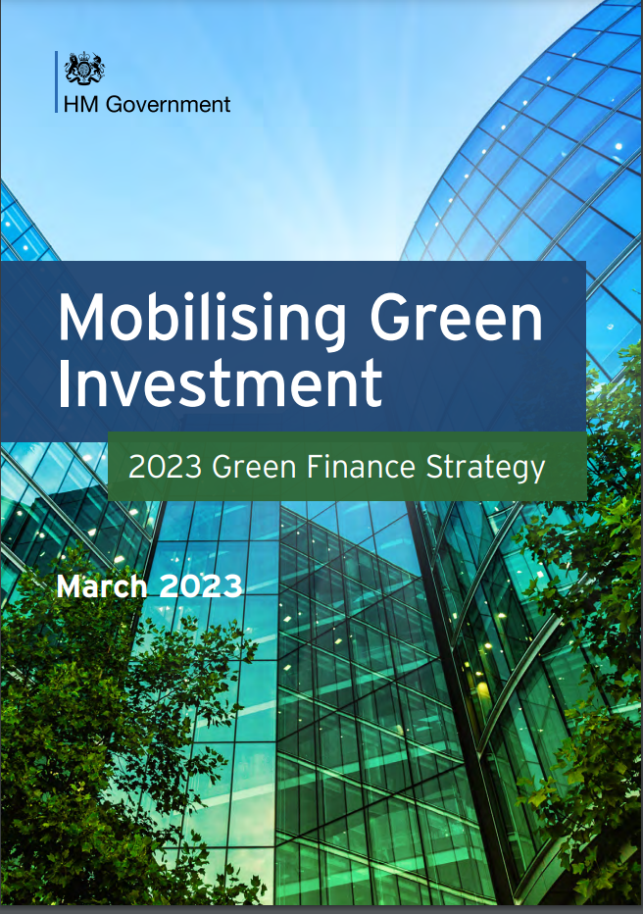
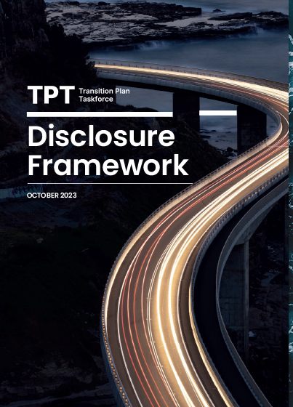
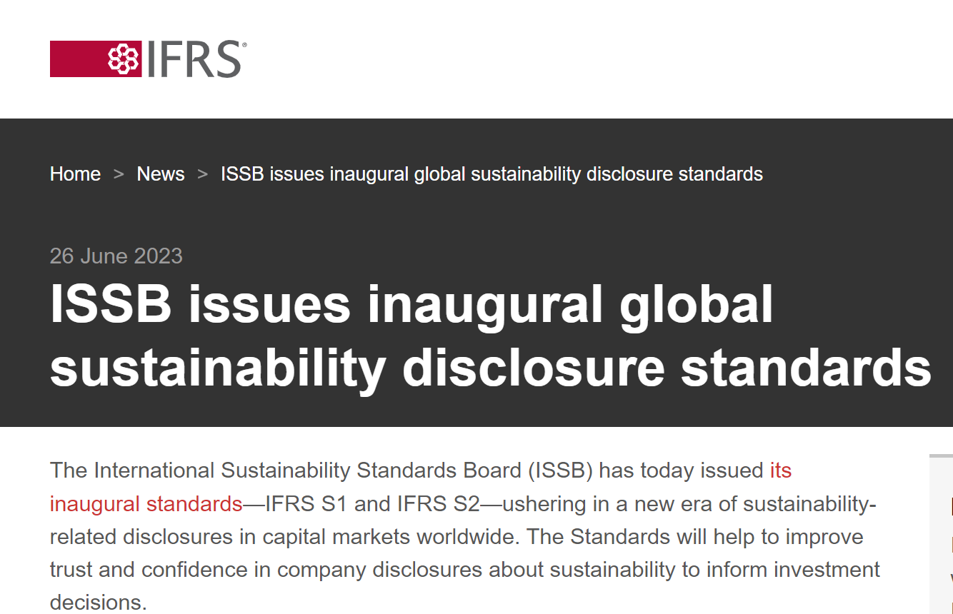
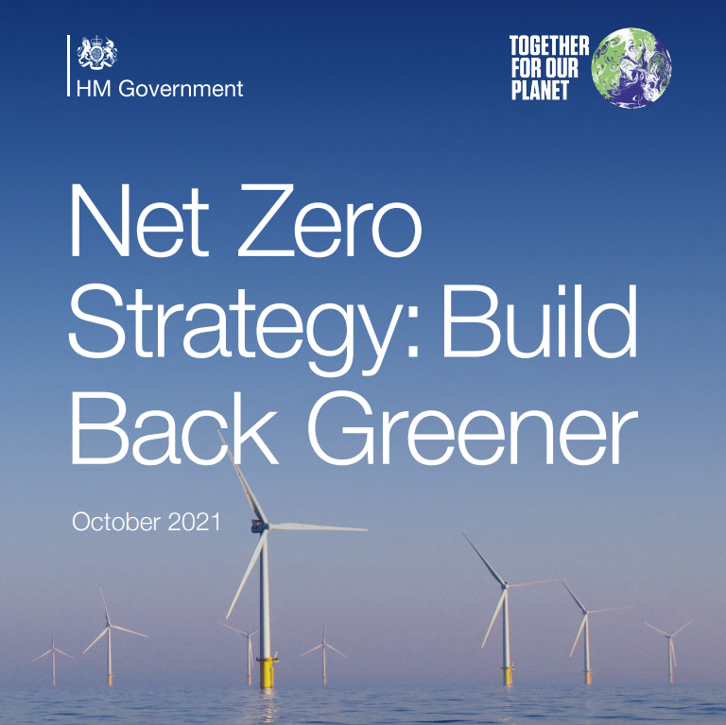
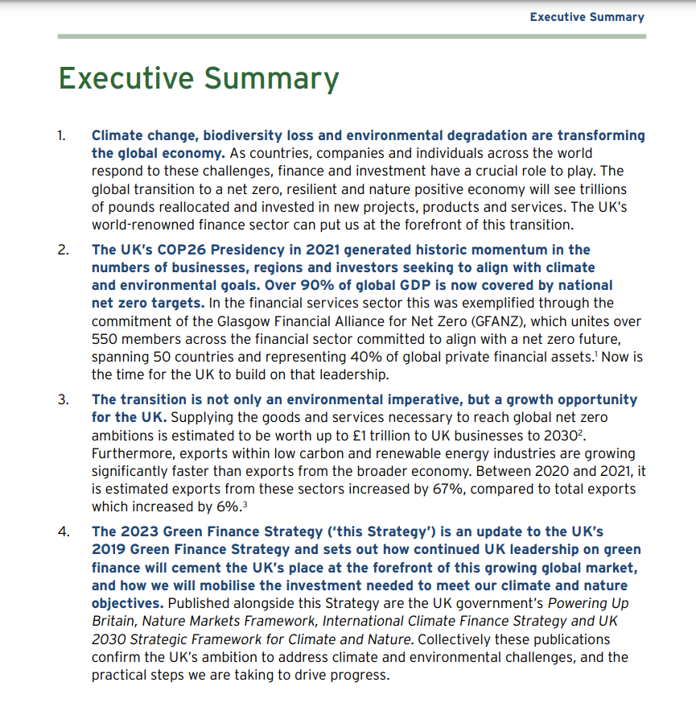
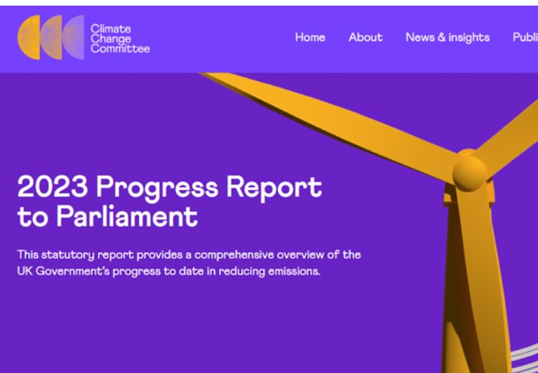
New rules emerging from ongoing (if bumpy) progress
ISSB (IFRS S1 &2) welcomed by FCA,
Supported by IOSCO

Slide 29
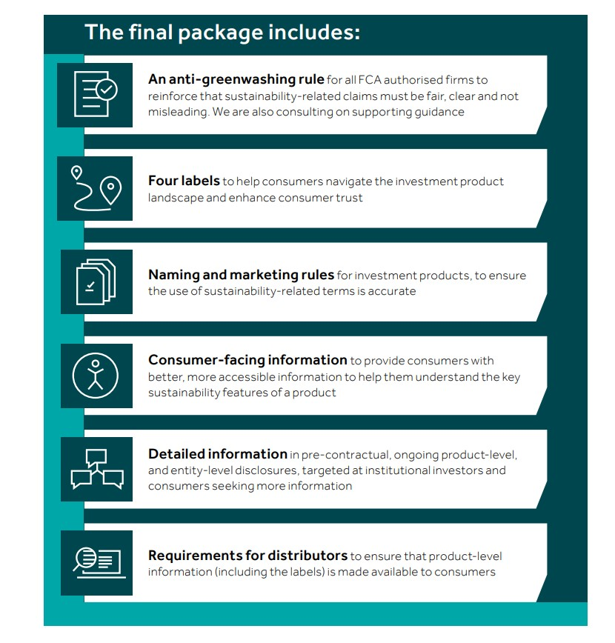
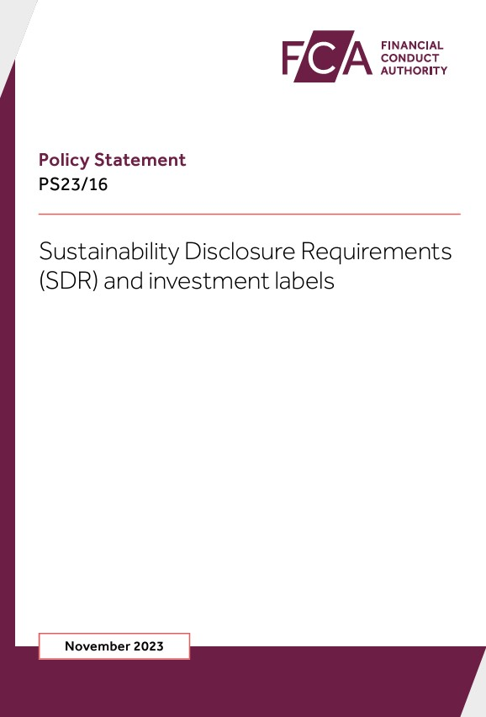
Sustainability Disclosure Requirements
New SDR rules – November 2023

Slide 30
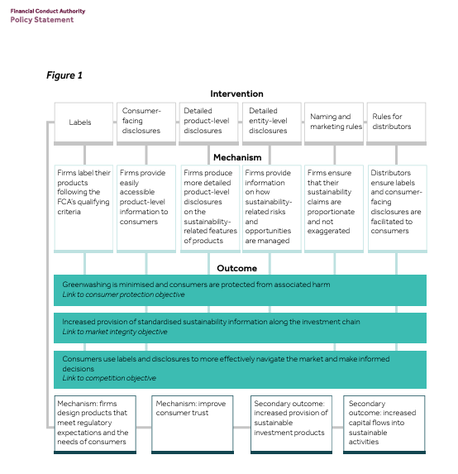
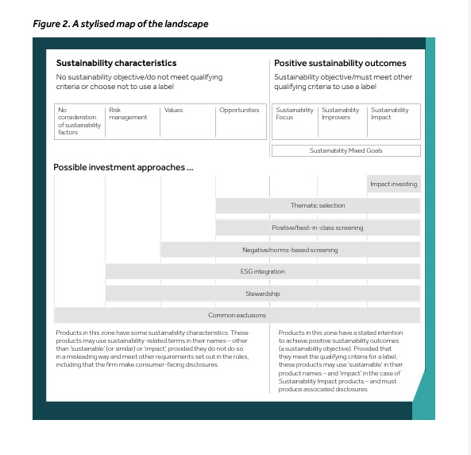
What is SDR & what does it aim to do?
Images from the SDR - FCA PS23/16
‘characteristics’ Vs ‘positive outcomes’

Slide 31
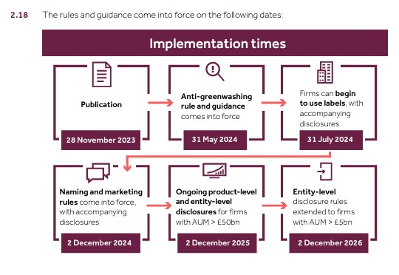
When does SDR take effect?

Slide 32
Key SDR concepts:
Principles based
Anti-Greenwash (across the board) need to be ‘clear, fair and not misleading’
Only in scope funds can chose to use labels
Labelling focuses on ‘positive’ attributes (and evidence)
                At least 70% of labelled sustainable fund assets to align to objectives – (AM to define what this means).
                No (labelled) fund assets should ‘conflict with objectives’
                Naming & marketing rules for ‘sustainable’ and ‘non-sustainable fund options’ – if mention (environmental/social) sustainability
Disclosures: consumer facing, pre-contractual, ongoing & entity level
Platforms must carry labels and consumer facing disclosures
Some areas are still ‘work in progress’ eg greenwash rules, portfolios – nb adviser group ‘industry led’
Aims to aid client decision making and deliver better outcomes, > aid pricing and help transition to higher sustainability standards

Slide 33
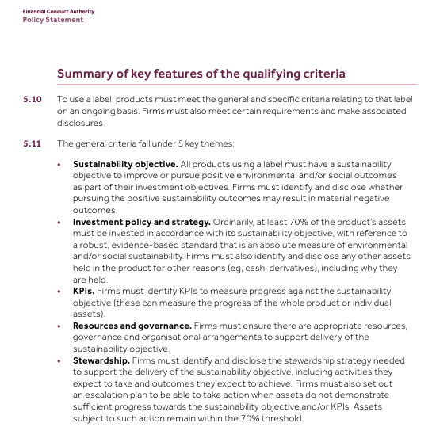
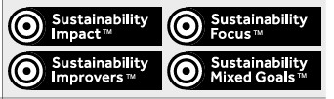
What are the new labels?
Labelled funds must aim to deliver positive sustainability outcomes
Funds can be intentionally not labelled
Clients will need help understanding labels – and beyond

Slide 34
New labels for UK regulated sustainable funds (offshore tbc)
Mentions Env / Social / Sustainability
Intentionality – Yes
(can use label)
Improver label
Focus label
Intentionality – No
(can not use label)
Consider ESG risk
Impact label
Mixed label
Unlabelled
RO / stewardship
Other eg thematic

Slide 35
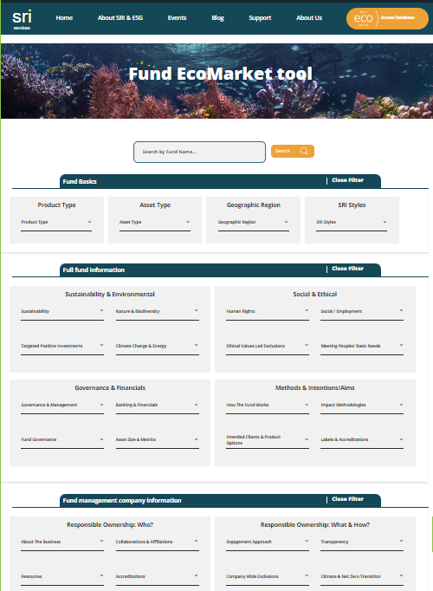
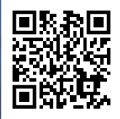
Fund EcoMarket.co.uk
Because ‘what individual funds ‘actually do’ matters to clients’:
Free to use
Designed for UK financial advisers
Aim to cover all relevant UK listed options
c250 fund filters
Individual fund ‘More Info’ fields

Slide 36
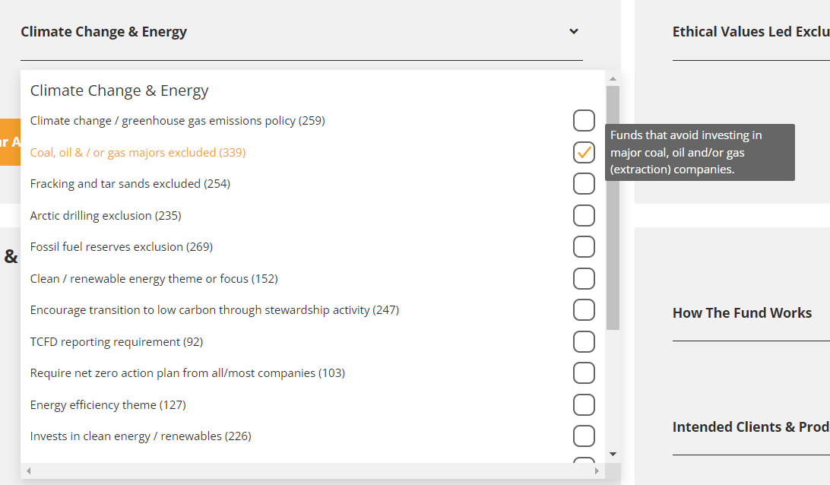
Fund EcoMarket
Find funds that match individual needs - eg:

Slide 37
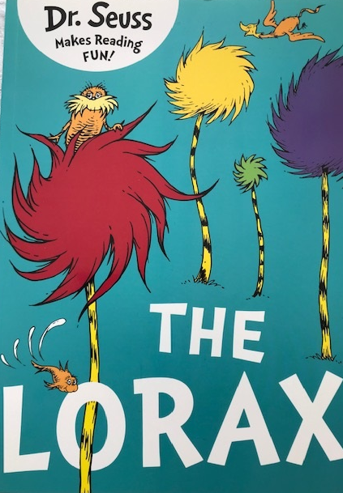
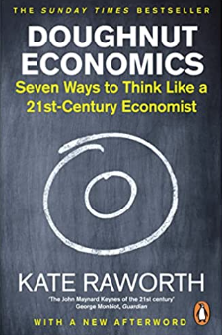
Thank you for listening
Any Questions?
Julia Dreblow
www.FundEcoMarket.co.uk
For information only. SRI Services is not authorised to offer advice.

