Slide 1
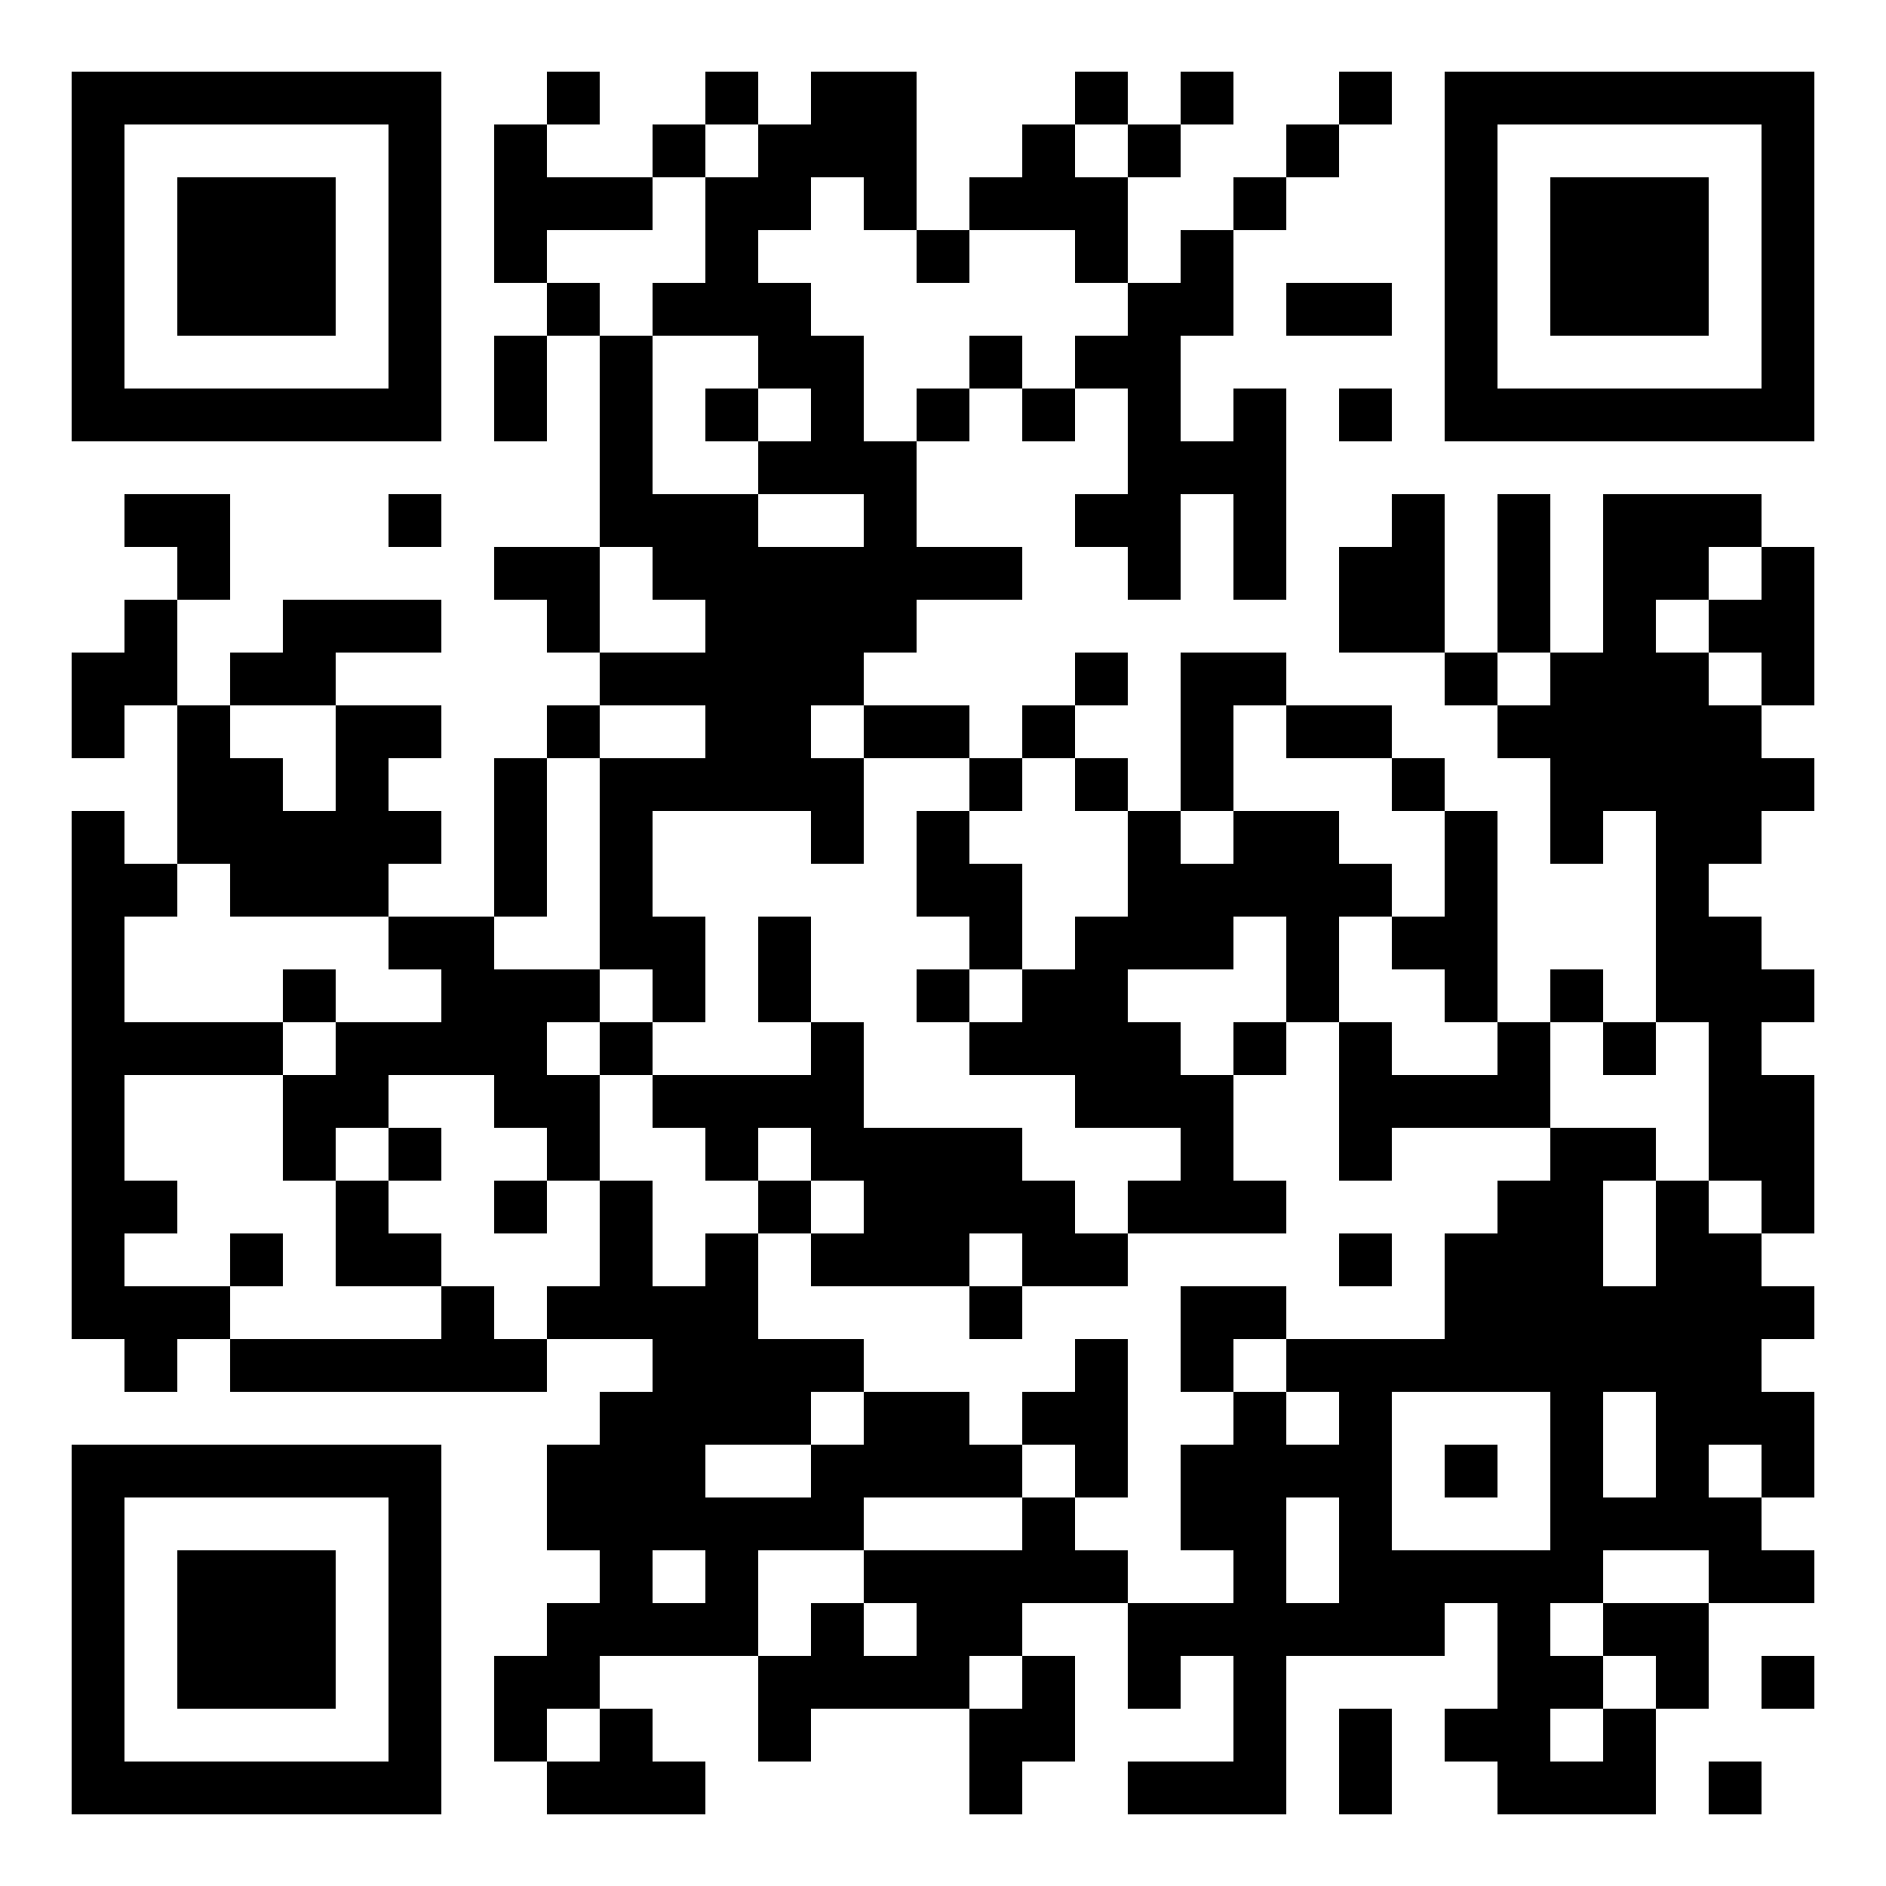

‘A guided tour of sustainable, responsible and ESG investments’
Julia Dreblow
Founder SRI Services & Fund EcoMarket
2 November 2023
Session time:
12.05 – 12.35

Slide 2
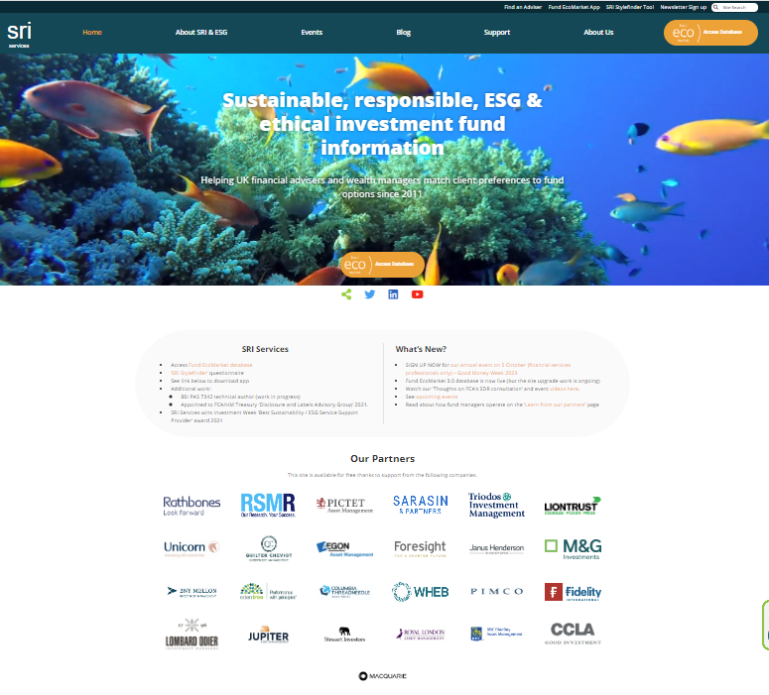
Who am I to talk…?
Specialised since 1990’s
Run independent adviser /wealth manager focused business & Fund EcoMarket database since 2010
  Share data with Fidelity & ii
  Work with eg Parmenion, PIMFA, RSMR
FCA DLAG member since 2021
Writing fund PAS 7342 for BSI
On new PFS Sustainable Financial Advice panel (2023)
  Previously on not-for-profit UKSIF board (10y total)
  … Former broker consultant, SRI Marketing Manager at Friends Provident (1996-2008)

Slide 3
Learning Objectives
To recognise the key features of the sustainable investment & ESG landscape and their relevance to financial services
To gain an understanding of key drivers of change - and that change will remain a constant feature of the investment landscape
To equip advisers to have better conversations about sustainable investments with clients

Slide 4
First ethical fund launched in 1984
Opinions & methods may vary – but was this ever really ‘niche’?
Deforestation (biodiversity)
Tobacco (health)
Anti-Apartheid (Inequality)
Armaments industry

Slide 5
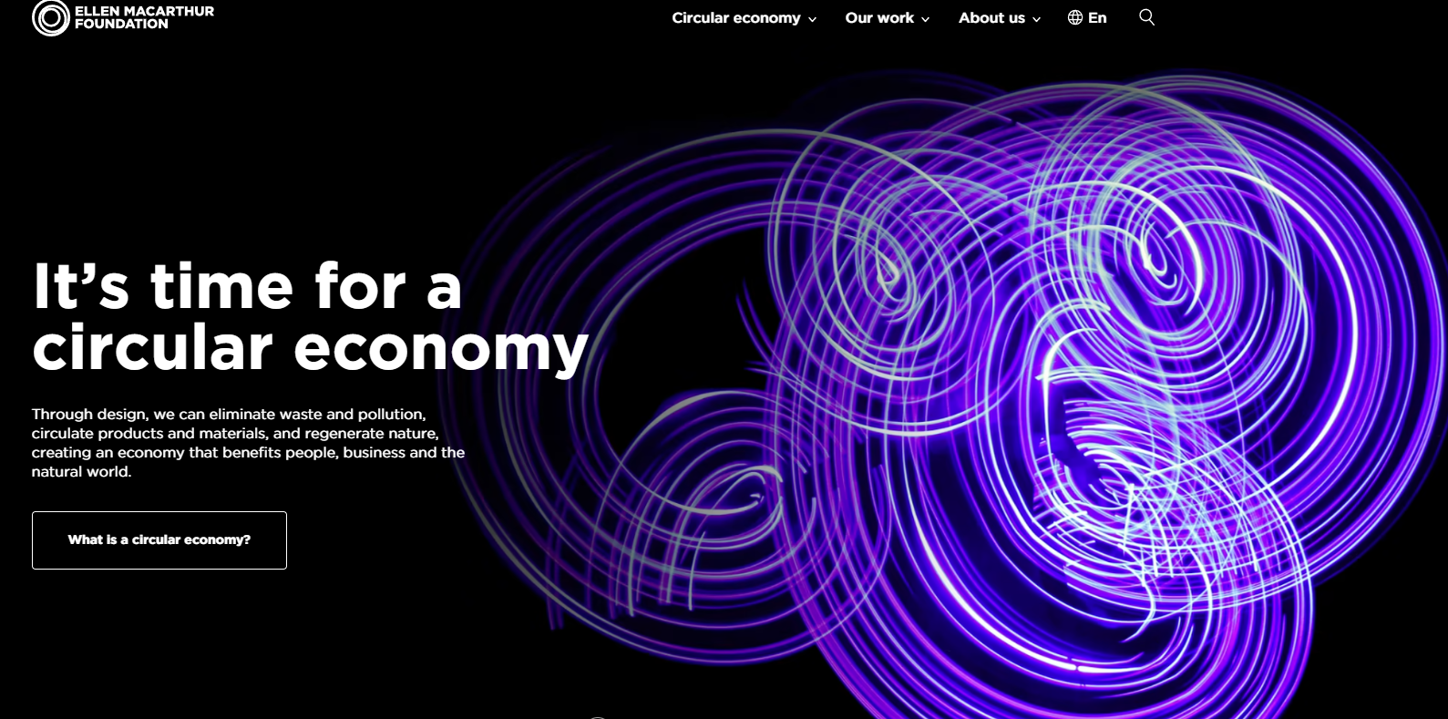
What has changed?
Bigger risks & opportunities – increased urgency

Slide 6
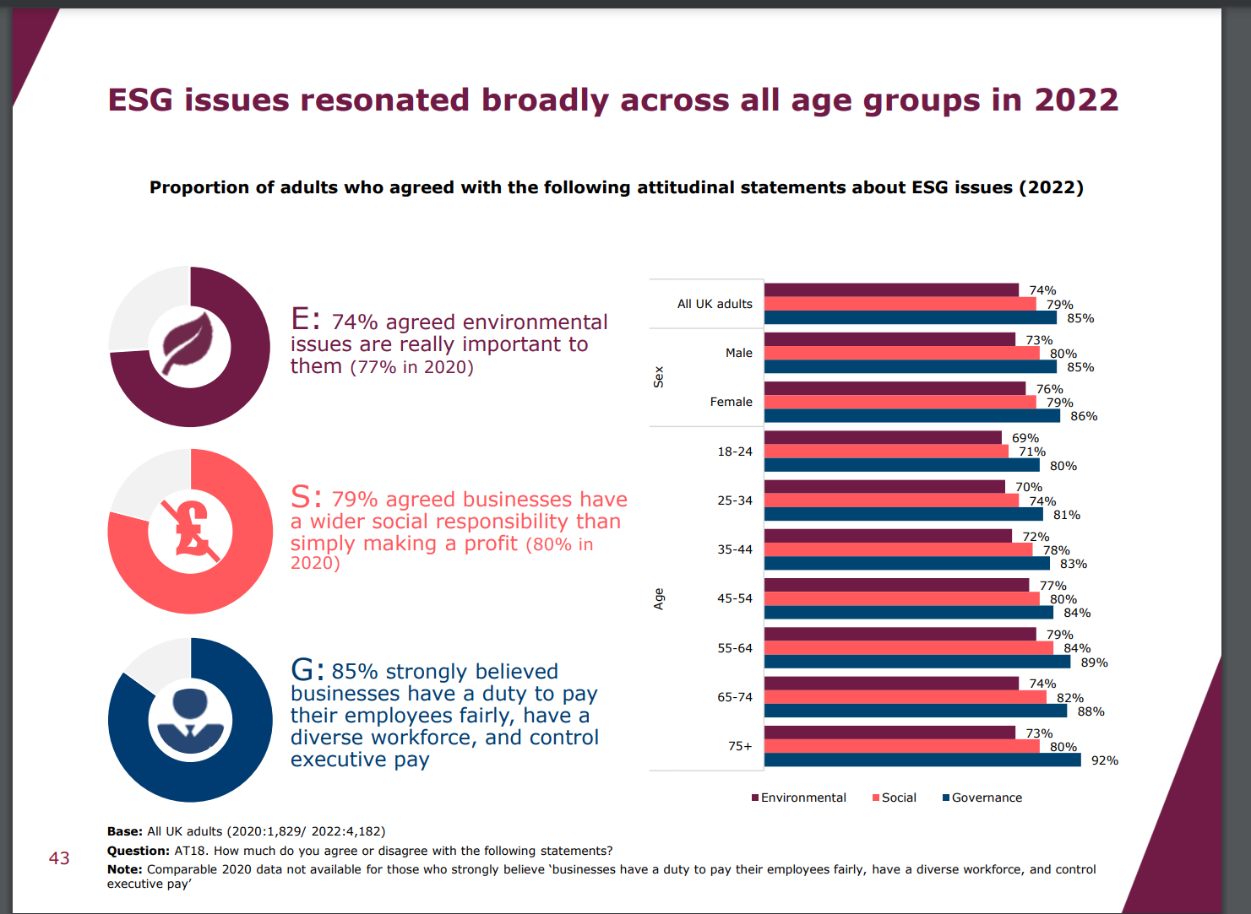
Firmly mainstream - clear public interest
FCA Financial Lives Survey 2022
‘…at May 2022 79% of consumers think businesses have a wider social responsibility than simply to make a profit’.
https://www.fca.org.uk/publication/financial-lives/fls-2022-consumer-investments-financial-advice.pdf

Slide 7
ONS research Q4 2022
When asked about a range of issues, climate change was the second biggest concern facing adults in Great Britain (74%), with the rising cost of living being the main concern (79%).
Around three in four adults (74%) reported feeling (very or somewhat) worried about climate change; the latest estimate is similar compared with the percentage who said they felt worried (75%) around a year ago.
Around 1 in 10 people (9%) felt unworried (somewhat unworried or not at all worried) about climate change, higher than a year ago when it was 6%, and around one in five (17%) said they were neither worried nor unworried.
https://www.ons.gov.uk/peoplepopulationandcommunity/wellbeing/articles/worriesaboutclimatechangegreatbritain/septembertooctober2022
Requires shift in narrative for advice profession

Slide 8

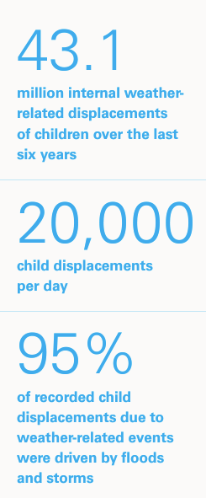
What about ‘Anti ESG’ & ‘Woke Capitalism’…?
& ‘inactivists’
“Globally, fossil fuel subsidies were $7 trillion or 7.1 percent of GDP in 2022, reflecting a $2 trillion increase since 2020 due to government support from surging energy prices” (£13m / minute) www.imf.org
Florida adopts anti-ESG rule for state's $186B pension plan 24 Aug, 2022 S&P Global
Guess Who Loses After Florida and Texas Bar ESG Banks? ‘Banning Wall Street’s biggest municipal bond underwriters has foisted a hidden tax on their residents totalling hundreds of millions of dollars’. Bloomberg 13 Feb 2023
Soaring insurance costs threaten hurricane prone US states…
‘Companies are fleeing Florida as covering property becomes more expensive’ FT Moral Money 10 October 2023
Unicef report 2023 ‘Children displaced in a changing climate’
www.unicef.org
‘Florida’s last resort property insurer is now state’s biggest’ Bloomberg Law Aug 23

Slide 9

Too big to ignore
Analysing ‘ESG risk’ is increasingly BAU … but different from ‘focusing on sustainability issues and outcomes’
FCA’s SDR seeks to differentiate between funds that assess ESG risk and those with sustainability objectives - improve client understanding/outcomes.

Slide 10
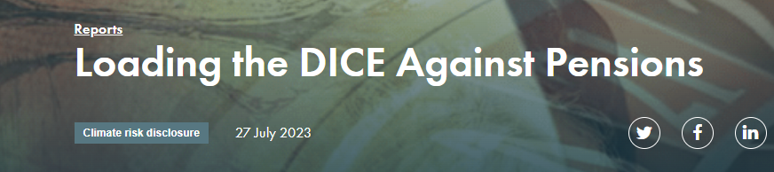
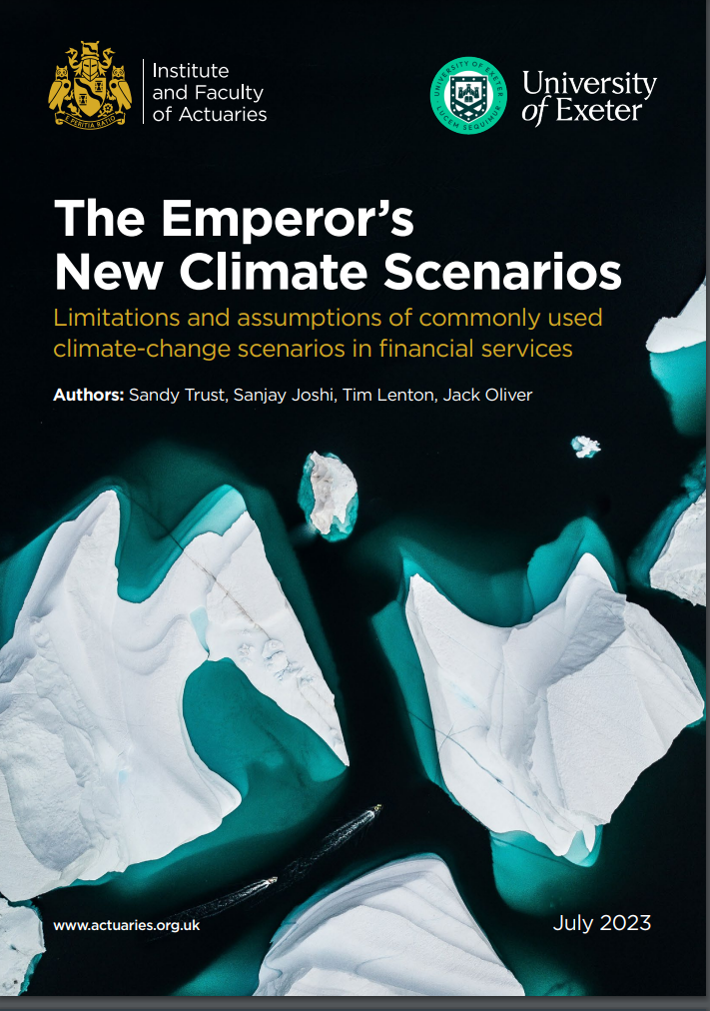


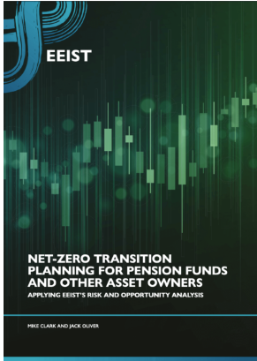

Leading voices are sounding the alarm on climate risk modelling
& ‘lack of investor urgency’ (Q3 2023)
Economic papers that inform investment consultant models are at odds with scientific literature (Carbon Tracker), they massively underestimate risk to portfolios & miss tipping points (all)
Current Net Zero strategies are too influenced by modern portfolio theory and not ‘decision useful’ (EEIST)
Investors putting too much faith in models – & time is too short to wait for perfect models (IFoA)
FS community encouraged to contemplate “a ruin scenario of 100% GDP loss” (IFoA)
Heading for a Minsky Moment
Pensions (etc) have a role to play in addressing Net Zero and investing for a world that beneficiaries would want to live in. (EEIST)
Notes:
University of Exeter et al
We have left it too late to tackle climate change incrementally. We now require a dramatic acceleration of progress through transformational change across society and the global economy. The pensions industry has an undeniably important role to play in supporting the journey to net zero, not least through investing for a world that its beneficiaries would want to live in.
‘…net-zero strategies guiding pension funds and other asset owners … are too strongly influenced by modern portfolio theory…official climate scenarios are increasingly regarded as not being ‘decision-useful’.
Carbon tracker - KEY FINDINGS
Investment consultants to pension funds have relied upon peer-reviewed economic research to provide advice to pension funds
Following the advice of investment consultants, pension funds have informed their members that global warming of 2-4.3°C will have only a minimal impact upon their portfolios.
The economics papers informing the models used by investment consultants are at odds with the scientific literature on the impact of these levels of warming.
Minsky moment…
Institute & Faculty of Actuaries
Tipping points missed (eg loss of Amazon & West Antarctic ice sheets)
“remaining carbon budget for limiting warming to +1.5C [may be] already zero”
“history is replete with incidents [when] we have placed too much faith in models”.
“Time is too short to wait for models that are perfect”
FS community encouraged to contemplate “a ruin scenario of 100% GDP loss”
Need to avoid … ‘herd mentality’.
Like…modelling the scenario of the Titanic hitting an iceberg but excluding … the possibility that the ship could sink

Slide 11

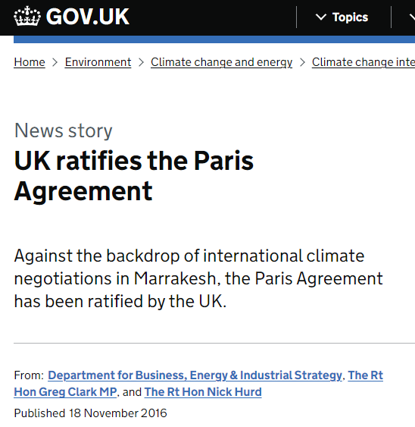
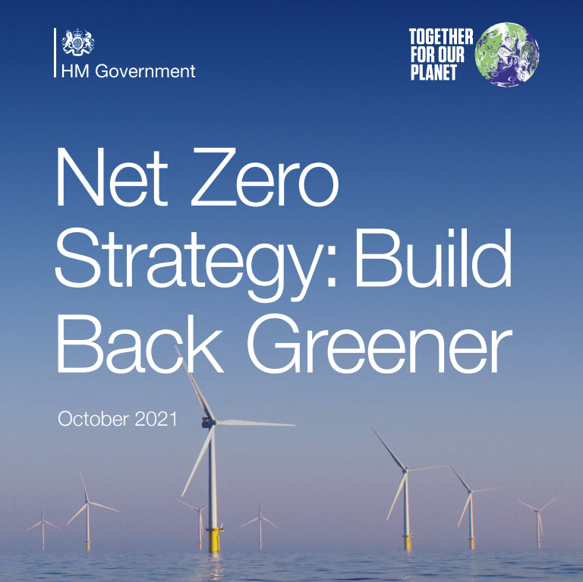
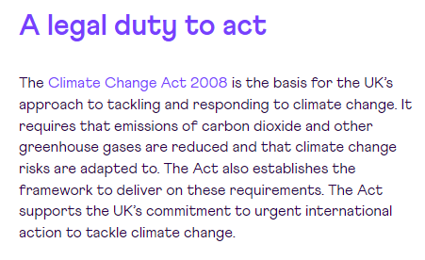

Not optional
The UK has a legal duty to act on climate …
www.theccc.org.uk

Slide 12
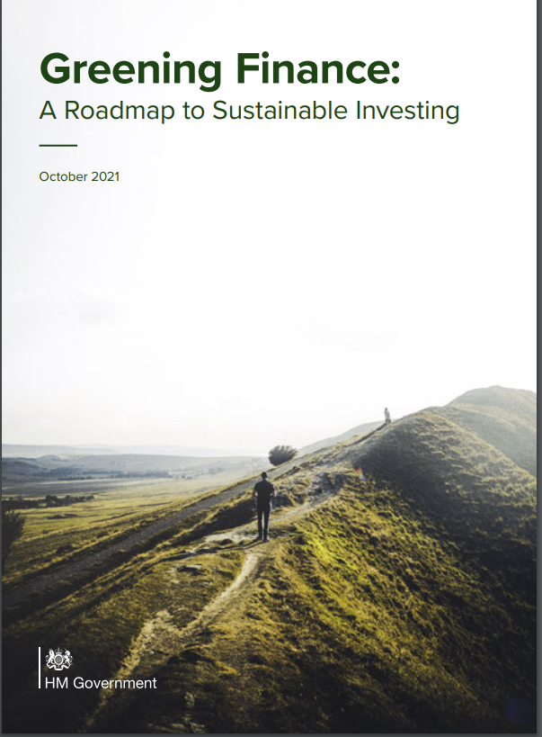
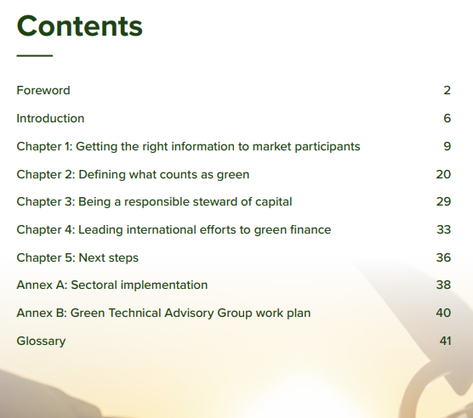
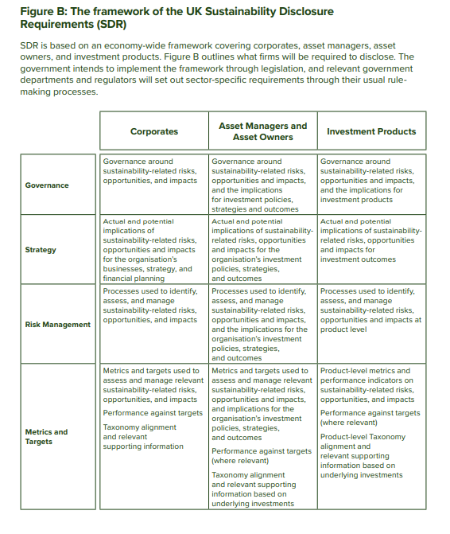
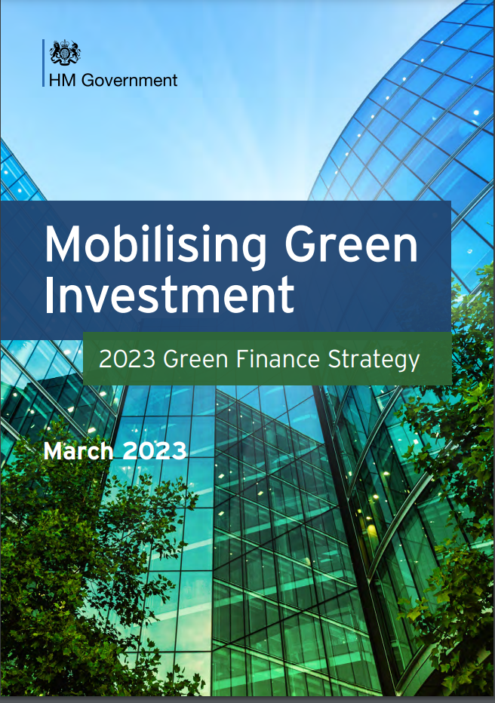
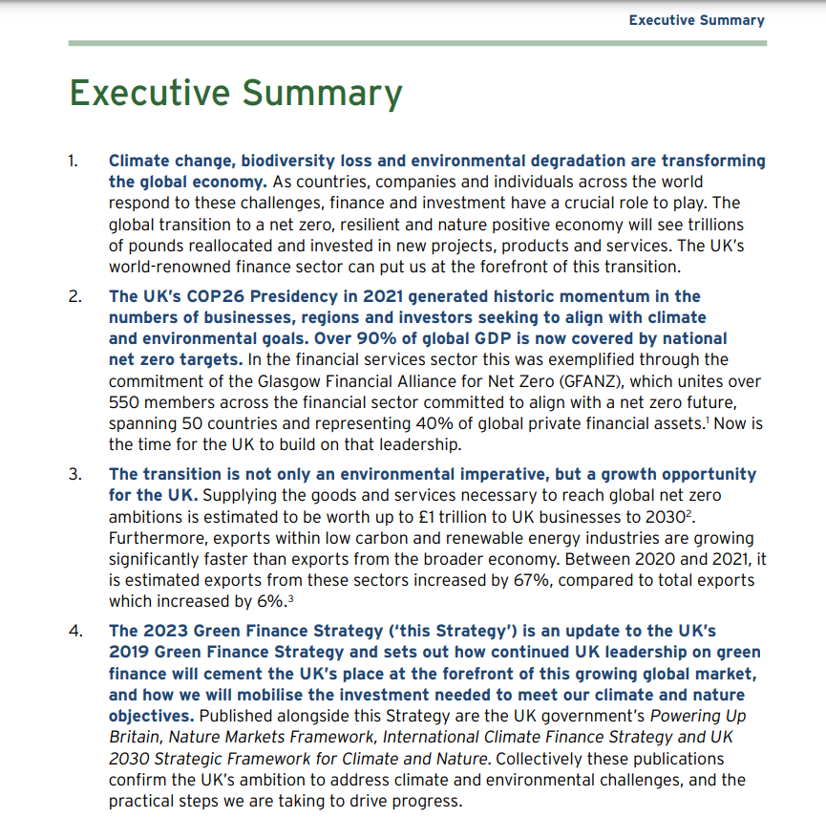
Government policy (Oct 21) > upcoming regulation

Slide 13
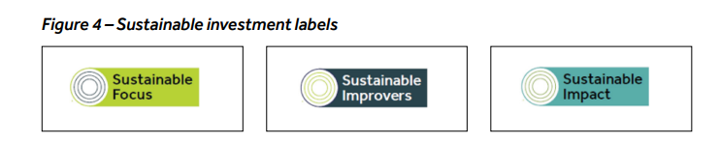
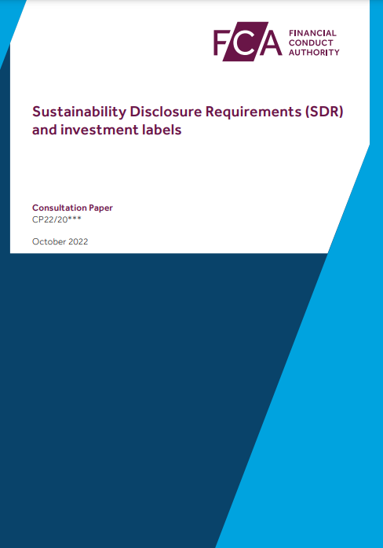
‘Sustainability Disclosure Requirements & investment labels’ consultation
(FCA’s DP22/20 Oct 2022)
What the FCA ‘wants’ to change: (p5)
Sustainable investment labels (for consumers)
Consumer facing disclosures
Detailed disclosures
  (pre-contractual, ongoing fund sustainability perf info, sustainability ‘entity’ report)
Naming and marketing rules
Requirements for distributors
General ‘anti-greenwash’ rule
Reporting Q4 2023

Slide 14
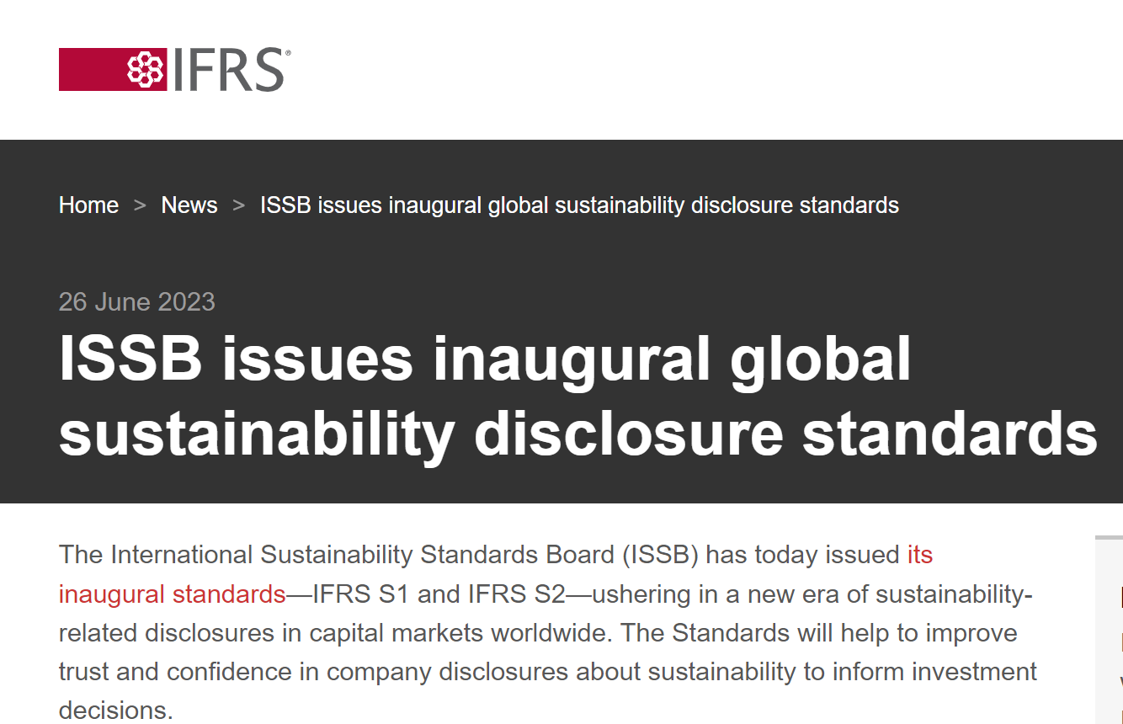
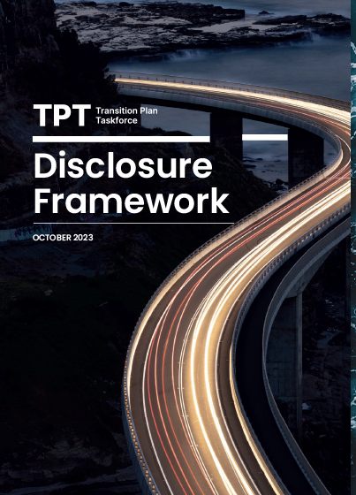
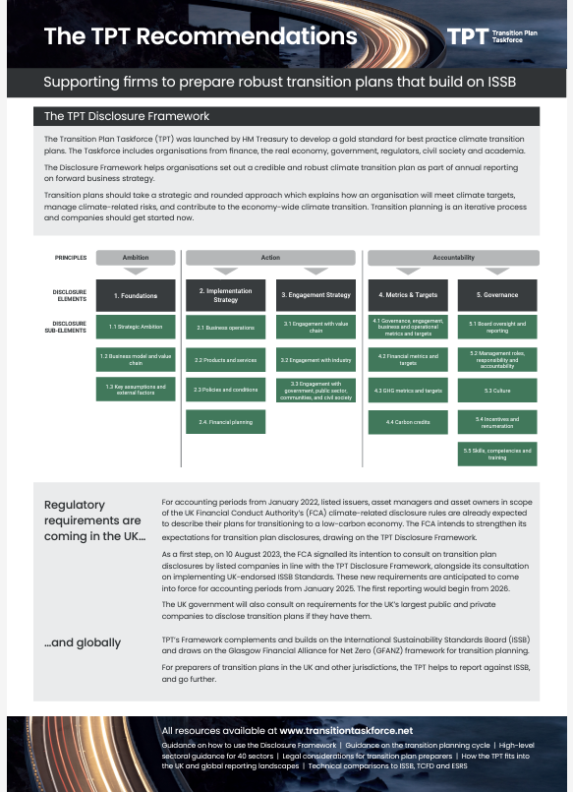
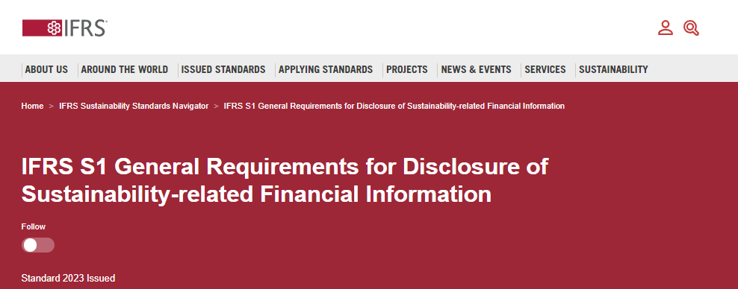
Recent improvements …
International sustainability reporting standards > better data
(UK) Transition framework > Ambition, Action, Accountability > faster shift

Slide 15
Words & concepts matters:
Sustainability / sustainable (can go on & on)
ESG / ESG focus (risk focus)
Impact (real world outcomes)
Stewardship (engagement & responsible ownership)
Ethical (personal values)
Screen (favour or avoid named areas)
Tilt (overweight / underweight)
Integrated (also consider…)
Double materiality – considering the impact of real-world issues on investments - and investment on the real world
Greenwash – overstating environmental credentials for business benefit
Intentionality – funds specifically aiming to improve things
Transitioning / Transition plan – moving (planning shift) towards a sustainable business model

Slide 16
Key concept to discuss with clients -‘fight or flight’
‘Divest or Engage’
(some decisions are easier than others)
  Fund basics:
  Issues
  Environmental
  Social
  (Governance)
  (Ethical)
  Approaches
  Avoid
  Support
  Engage

Slide 17

Helping you meet clients’ personal preferences www.sriServices.co.uk website and
Fund EcoMarket database

Slide 18
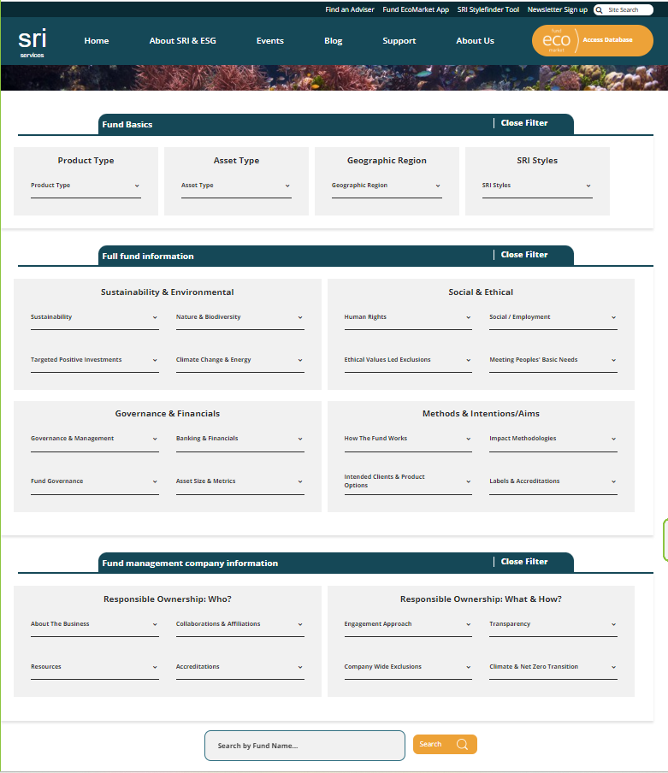
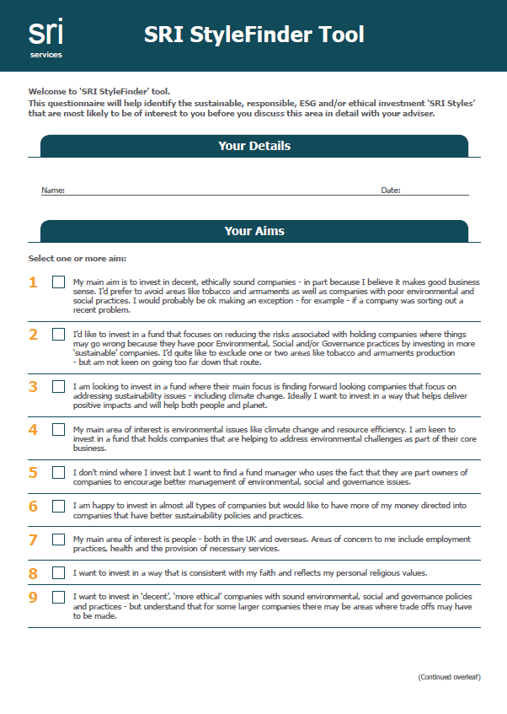
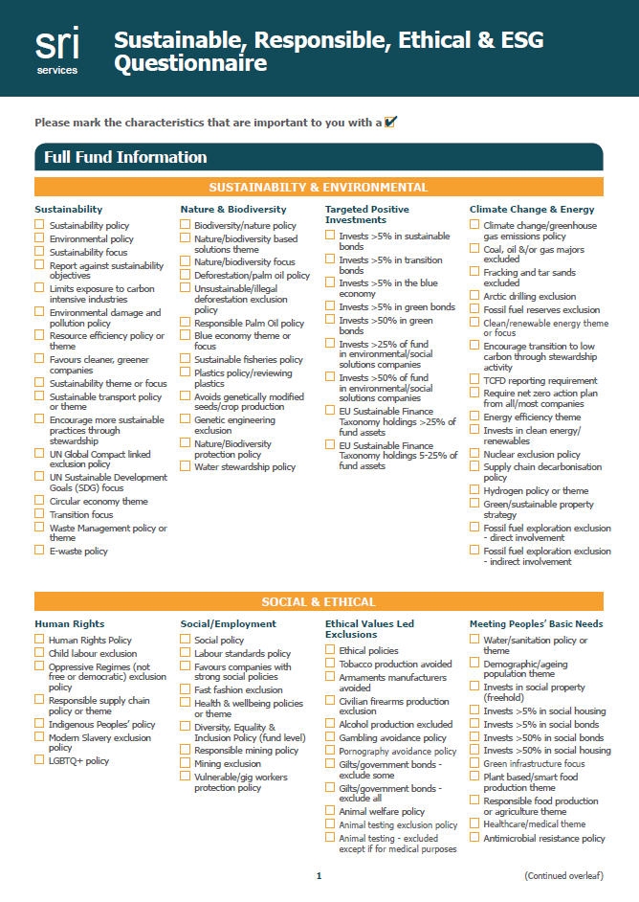

Filters for
specific client requirements:
Fund EcoMarket tool:
Getting started with ‘SRI StyleFinder’:

Slide 19
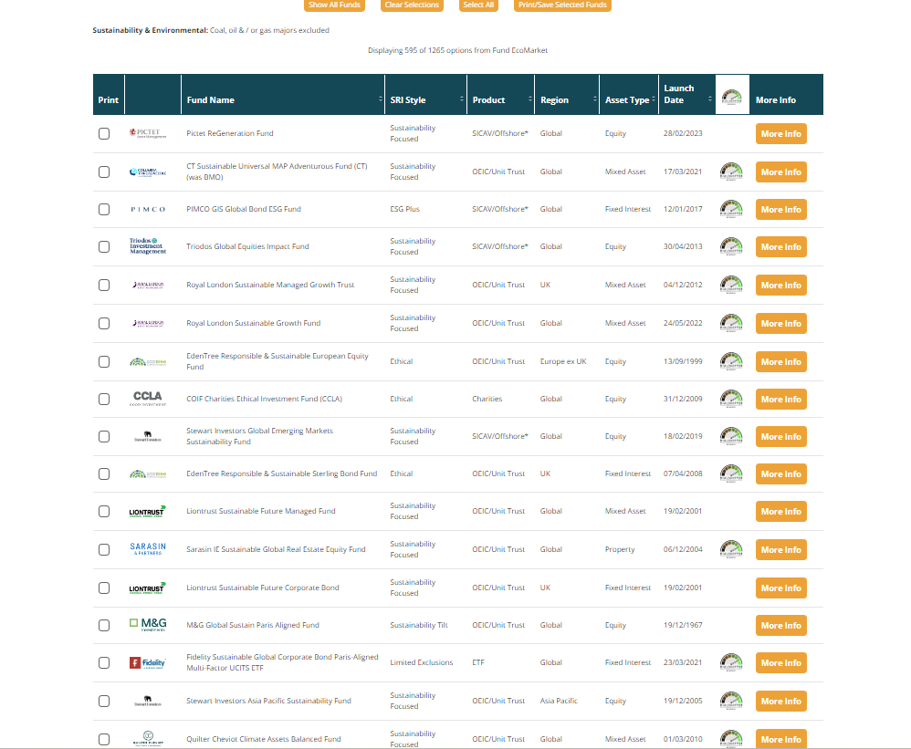
Filters & fund / fund manager disclosures – direct from fund managers
Est 2010
V3.0 2023

Slide 20
Moving forward
Things are changing fast now - creating risks & opportunities
This is complex & dynamic – don’t over promise - disclosures and labels will help, interested clients will know this is complex
Focus on the science … then regs – the planet does not care about benchmarks, marketing – or short-term performance
Consumer Duty and SDR will align
Investors hold the key to the future clients want
This afternoon’s session will explore bringing this into your business
                14:10 – 14:40 ‘Expert perspectives (panel) on sustainable and ESG
                investments’
New PFS / CII activity:
10 member ‘PFS Sustainable Financial Advice Panel’, Chaired by CEO Don MacIntyre
Aiming to enhance advice standards & client outcomes through leadership, education, guidance and setting new standards
Launched Oct 2023 - e-learning course & member survey

Slide 21

This is important
You are a VITAL link in the chain advise for ‘the future clients want to live in’

Slide 22
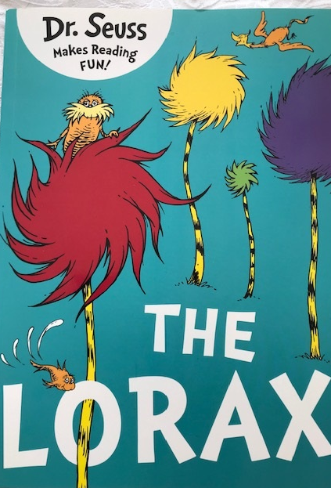

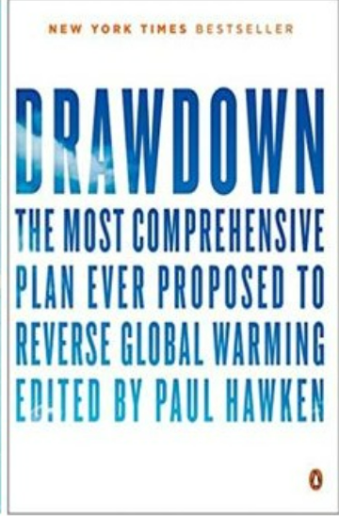

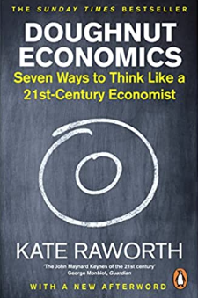
Thank you for listening!
Julia Dreblow
www.sriServices.co.uk
www.sriServices.co.uk/about-sri/learn-from-our-partners/
For information only. We are not regulated or authorised to offer advice.

